Slide 1
A Day in The Life
Rikki Winchester

Slide 2
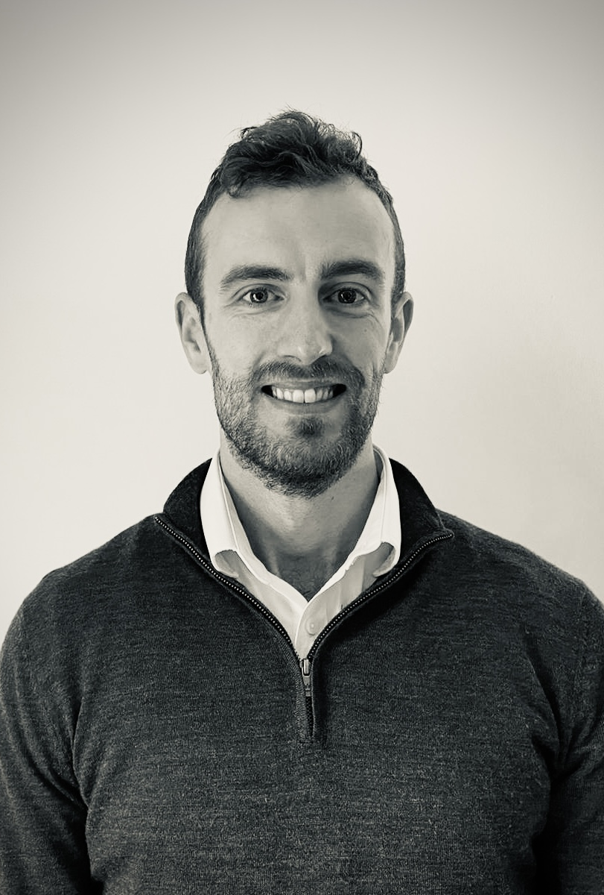
Introduction
FY1
Respiratory
General surgery
Orthogeriatrics
FY2
Urology
Psychiatry
Gastro

Slide 3
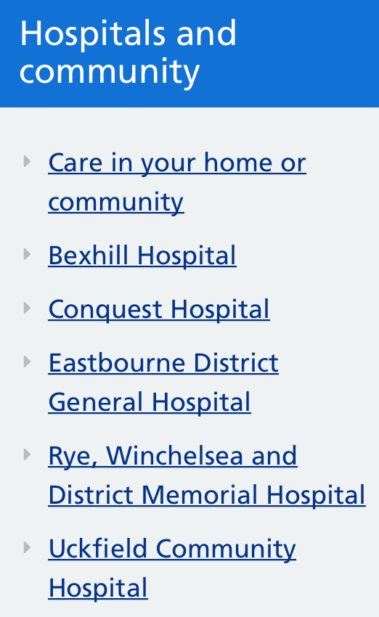
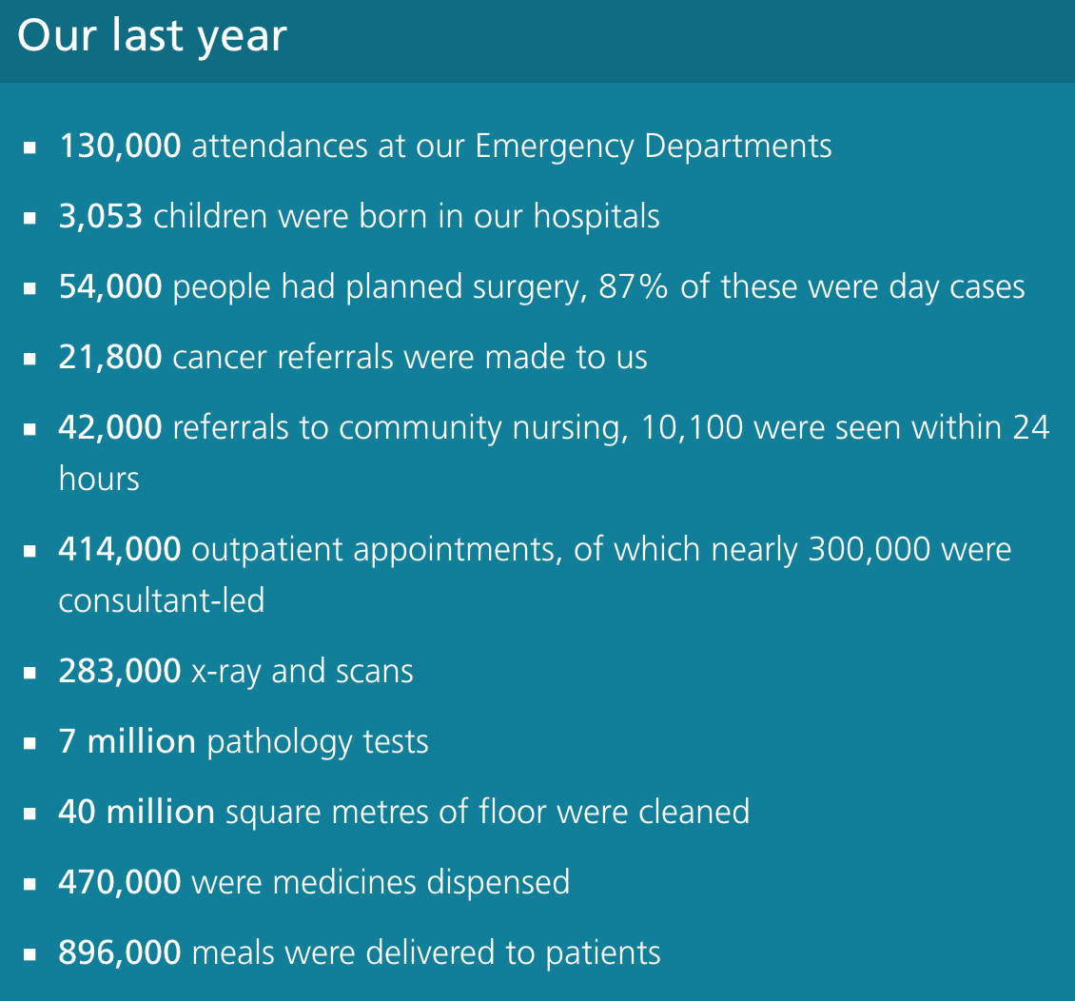
ESHT

Slide 4
Foundation Doctor

Slide 5
Ward Rounds
Prepping notes
Discuss with nursing staff if any concerns
Presenting patients
Highlighting issues
Accurate documentation
Job lists

Slide 6
Advice on Jobs
Create list as you go
Divide patients up
Midday huddle
End of day huddle

Slide 7
Jobs Priority
Ordering investigations
Sending referrals
Discharge letters
Updating relatives
Unwell Patients

Slide 8
Asking for Senior Advice - 1
Review notes
History
Examination
Review bloods
Review any imaging, fluid output etc
NEWS trend

Slide 9
Asking for Senior Advice - 2
Your impression
Your management plan
Order investigations
Then ask for advice

Slide 10
Academic Expectations

Slide 12
Notes:
Mandatory
Have until end of April, ARCP in May

Slide 13
Key Advice
Make it a habit
Document what you’re already doing

Slide 15
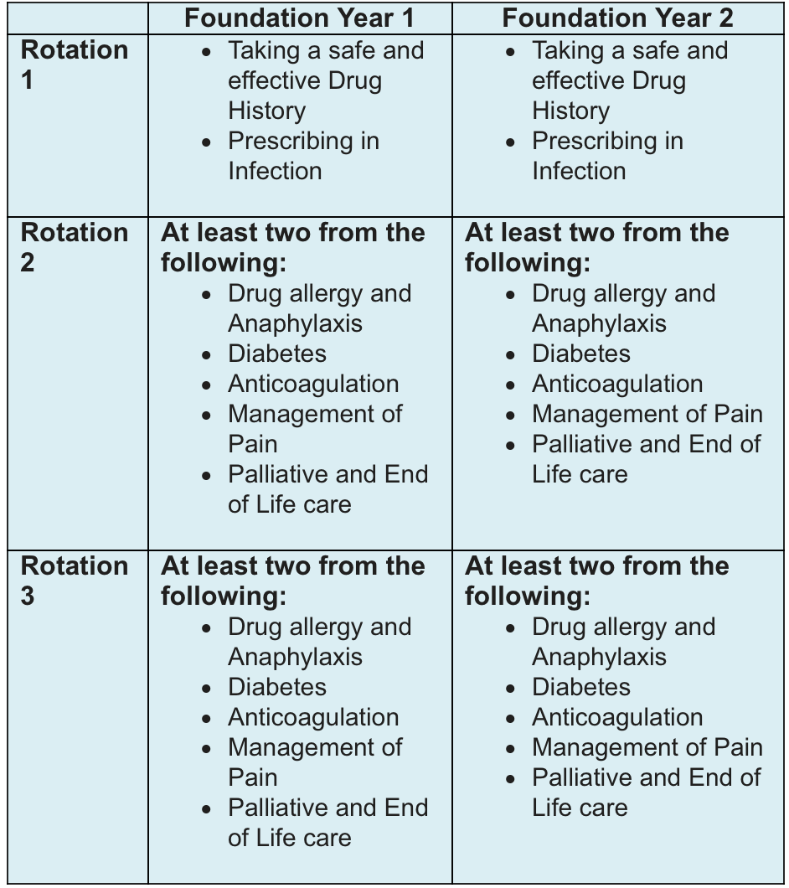

Slide 16
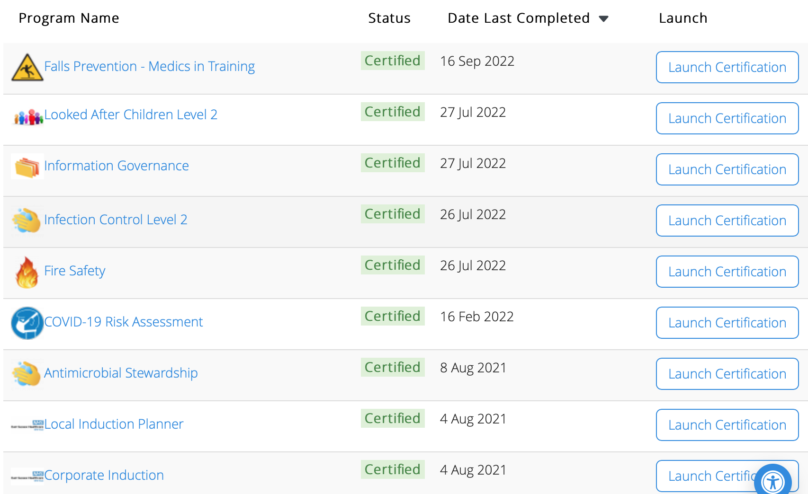

Slide 18
Simulation

Slide 19
Doctors Mess

Slide 20
Pastoral Support

Slide 21
Local Area
Notes:
Outside of work

Slide 22
Closing Thoughts
Remember the basics
You know more than you think!
Be proactive
Stay on top of your portfolio
Socialise
Enjoy!

