Slide 1
Induction 24/4/23
Welcome to East Sussex Healthcare Trust

Slide 2
Induction Sara Hampson Room Monday 24/04/2022
08.30 | Registration and Welcome by Kings Sub Dean Dr John Somarib and consultants (refreshments provided)
09.15 | Admin Induction: Forms & Student ID lanyards.
09.30 | Library Induction Welcome by Paul Gosling, Pastoral fellow
09.45 | Welcome by Education Fellows
10.00 | Welcome by Foundation Year One Doctors
10.15 | Depart to wards

Slide 3
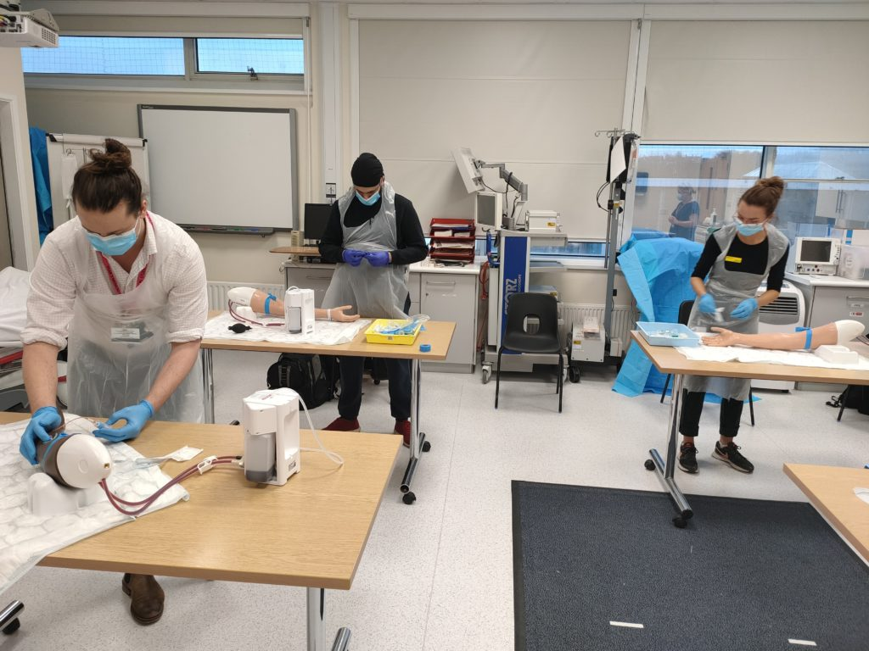
Medical Students’ Induction
Welcome
Dr John Somarib (KCL Sub Dean)
Dr Kamil M Quraish KCL Acute Care Block Lead)
Dr Rannie Nahas(KCL – Acting LTC Block Lead)
Undergraduate Administrator – Angela Geoghegan
Education Fellows
Pastoral Fellow - Paul Gosling
Pastoral Support – Rev Graham Atfield :
“What do Chaplains Do?”
Mandatory training – PPE, fire training, infection control
Tour of the hospital

Slide 4
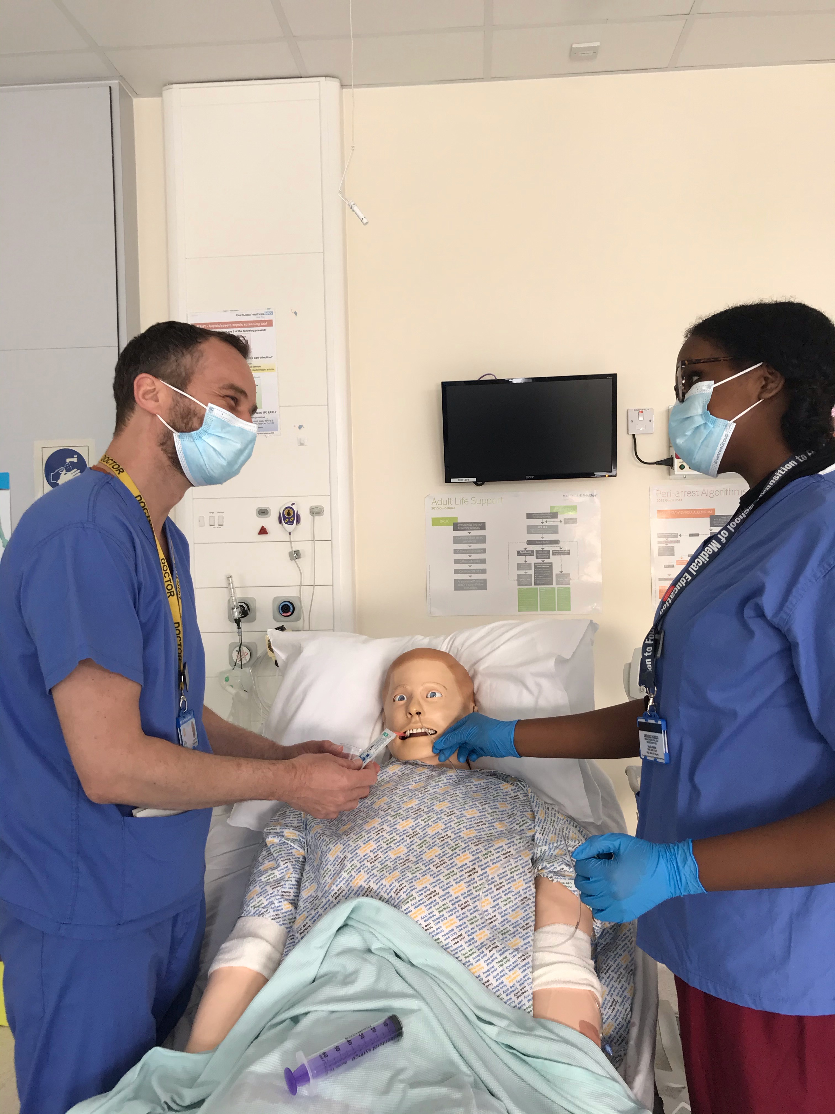
We aim to make your stay enjoyable, educational and productive whilst at East Sussex Healthcare NHS Trust.

Slide 5
Medical Student Leads
Role | Eastbourne | Conquest Hospital
KCL Sub Dean | Dr John Somarib johnsomarib@nhs.net | Dr Chris Scanlon
KCL Acute Care Block Lead: | Dr Mamil Mohammed QURAISHI, <mohammedkamil.quraishi@nhs.net | Dr S Berliti stefano.berliti@nhs.net Mr Y El-Dhuawaib yesar.el-dhuwaib@nhs.net
KCL LTC Block Lead: | Dr R Nahas rannienahas@nhs.net | Dr T Christopherson thereza.christopherson1@nhs.net

Slide 6
Educational and Pastoral Fellows
Name |  | Department | Site
Vacant |  | Rheumatology/SIM | EDGH
Dr Lucy Whittaker |  | Emergency Medicine | EDGH
Dr Pyi Tint (Danny) |  | Emergency Medicine | EDGH
Vacant |  | Emergency Medicine | EDGH
Vacant |  | Emergency Medicine | EDGH
Paul Gosling paul.gosling@nhs.net | Nurse Fellow | EDGH
Jolie Wilkinson Jolie.wilkinson@nhs.net | Pastoral Fellow | EDGH/ CQ

Slide 7
Structured Teaching/Learning opportunity
Ward rounds and bedside teaching – Fy1
Grand rounds/ Schwartz rounds
Structured teaching/lectures
Clinics and on-Calls
Allocation to Fy1
Simulation/ skills lab
Resus and acute care teaching
voicing your educational needs
logbooks
24/7 Library
Foundation doctor-led teaching
(Tues & Thurs)

Slide 8
TTF1s 24 April to 16 June 2023 EDGH
 | 24 April | 1 May | 8 May | 15 May | 22 May | 29 May | 5 June | 12 June
Mariam Al-Jumaily | Geriatric | Geriatric | Geriatric | Geriatric | Urology | Urology | Respiratory | AMU
Ami Davies | Geriatric | Geriatric | Geriatric | Respiratory | Respiratory | Respiratory | Respiratory | AMU
Laila Hazara | Rheumatology | Rheumatology | Rheumatology | Rheumatology | AMU | Respiratory | Urology | Urology
Rachel Jones | Endo | Endo | Endo | Endo | AMU | Geriatric | Geriatric | Geriatric
Ashwati Nair | AMU | Urology | Urology | Psychiatry | Cardiology | Endo | Endo | Endo
Priyanka Oza | Urology | Urology | Rheumatology | Rheumatology | Rheumatology | Rheumatology | AMU | Respiratory
Ella Strudley | Urology | Urology | Urology/AMU | AMU | Geriatric | Geriatric | Geriatric | Geriatric

Slide 9
FY1s:
AMU/ AAU:
Salwa Owasil
Endo:
Ricard Hughes
Urology
Alinur Kerow
GERIATRIC:
Thomas Oswald, Holly Harman. Fatama (aka Saptieu) Mahdi, Yui Sasaki, Dua Malik
Rheumatology
Ilunga Kabila
Respiratory
Florence Pickles, Catherine McIlroy
Cardiology
TBC

Slide 10
Time table
Date | Days | Hospital | Room | Time | Workshop | Facilitator
24th Apr | Monday | EDGH |  | 08;45 1-2pm | Induction Ward round | John Somarib Dr. Artesl
25th | Tuesday | Eastbourne DGH | St mary Suit | 14:00-16:0-0 | ILS | S Rochester
26 April | Wednesday | EDGH | John Cook Room | 12:30pm – 1:30pm | BMA Lunch | John Hayward (BMA)
2nd May | Tuesday | Eastbourne DGH | Outdoors/Hospital compound | 14:00-16:0-0 | Shift Working, Health and Sleep | Paul Gosling
Tues 9th May | Tuesday | EDGH | Outdoors/Hospital compound | 14:00-16:00 | Managing Stress and Self Care | Paul Gosling
TBC | ? | Easbourne DGH | A&E? | Anytime | Shadowed by a F1 | Pyi/Lucy
TBC |  | EDGH | Room 4 | 14:30 – 16:30 | Leadership | Dr J Somarib
15 March | Wednesday | Eastbourne DGH | Sara Hampson | 14:00-16:00 | HORUS e Portfolio SLE | Pyi/Lucy

Slide 11
Grand Round Grand Rounds on Mondays- 12:30pm lunch for 1pm Talk. Lecture Theatre
May 15th – Professor Patel, Cardiology
May 22ns – Library Services – Sabelo #Masasure
June 5th – Palliative Care – Dr Palliative
June 12th – Clinical Key

Slide 12
Virtual On Call and Simulation
Ed fellow to confirm dates and time
QURAISHI, Mohammed Kamil

Slide 13
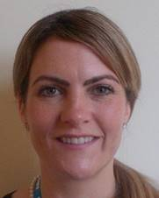
Pastoral Support
Nurse Pastoral Fellows:
Jodi Wilkinson and Paul Gosling
See student handbook for extensive list
of sources of support

Slide 14
ASK and TELL
ASK us questions
TELL us if something concerns you
Make the most of your learning experience

Slide 15
Library
The library is open Monday to Friday 8.30am to 5.00pm. Outside these hours users can access both libraries using their Trust swipe card for 24 hour access.
If you need to contact library please email them on esh-tr.libraryservices@nhs.net
PCs are accessible in the library 24/7 using your Sussex username and password.

Slide 16
Attendance
Please let the education centre know if you are going to be absent or are off sick
Please let your team know when not attending timetabled teaching
Please register with a GP – see your handbook

Slide 17
Places to visit in Eastbourne and surrounding areas
Where to go and places to visit please go to www.visiteastbourne.com

Slide 18
Q&A
Questions

Slide 19
Medical Student Leads
Dr Mark Whitehead Director of Medical Education
Dr Sam Panthakalm
Dawn Urquart - Assistant Director of Integrated Education
Dr John Somarib KCL Sub Dean Year 5
Steve Rochester Senior Resuscitation Officer
Jo Jukes – Human Factors and Simulation Manager

