Slide 1
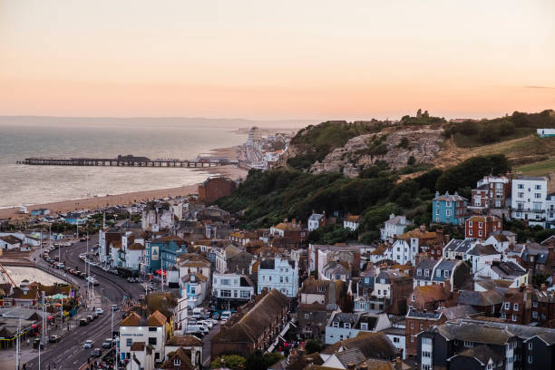
Welcome
To ESHT &
The Conquest Hospital and EDGH
BSMS year 4 Paediatrics

Slide 2
BSMS Year 5 Conquest Placement Induction
Contents:
Welcome by Undergraduate Administrator:
Welcome to ESHT & ESHT hospitals and services and welcome by UG lead
Names of UG Lead and Ed Fellows
Library Information
Accommodation/Wi Fi
Education Fellows
Support (for queries, pastoral etc)
Ask and Tell
What is Provided for You
Placement Clinic Information
Attendance – Expectations from You
Induction Packs
Hastings places to visit
Eastbourne Places to visit
Pastoral and Education Fellows
Library tour
Hospital Tours and Ward Induction

Slide 3
Welcome
Welcome to East Sussex Healthcare NHS Trust
On behalf of East Sussex Healthcare, we extend a very warm welcome to you all. We will do all we can to make your stay enjoyable, educational and productive while at East Sussex Healthcare NHS Trust.

Slide 4
ESHT Services
Conquest Hospital (which is rather unique in this area in that it has its own lagoon and mini wildlife sanctuary)
Eastbourne District General Hospital
Bexhill Hospital
Rye, Winchelsea and District Memorial Hospital
Uckfield Hospital
And we also provide a range of services at other clinics and health centres across the area.

Slide 5
BSMS Year4 UG Lead
Dr Gopal
BSMS Year 4 Lead Conquest and Eastbourne- Welcome Talk

Slide 6
Educational Fellows
Name | Department | Site | E-Mail Address
Dr Taiba Suddek | Acute Medicine | Conquest | taiba.suddek@nhs.net
Dr Bao Khuu | Acute Medicine | Conquest | bao.jkhuu@nhs.net
Dr Dina Sulit | Acute Medicine | Conquest | dina.sulit@nhs.net
Dr Letizia Vasilena | Rheumatology | EDGH | l.valisena@nhs.net
Dr Joshua King | Palliative Medicine | EDGH | joshua.king2@nhs.net
Dr Ellen Wikenfors | Emergency Medicine | EDGH | ellen.wikenfors@nhs.net
Dr Pyi Tint | Emergency Medicine | EDGH | pyi.tint@nhs.net
Dr Mustafa Al-Ghazi | Emergency Medicine | EDGH | m.al-ghazi@nhs.net
Dr Laura Conway | Simulation | X-site | laura.conway5@nhs.net
Dr Stephanie Ketley | Emergency Medicine | EDGH | stephanie.ketley1@nhs.net
Dr Amina Akhtar | General Surgery | Conquest | amina.akhtar6@nhs.net
Dr James Speed | Emergency Medicine | Conquest | james.speed2@nhs.net
Dr Chaudry | General Surgery | Conquest | muhammad.chaudhry16@nhs.net

Slide 7
Library
The library is open Monday to Friday 8.30am to 5.00pm. Outside of these hours, users can access both libraries using their Trust swipe card for 24 hour access.
If you need to contact library please email them on esh-tr.libraryservices@nhs.net
PCs are accessible 24/7 using your Sussex username and password.

Slide 8
Rotations during Placement
You will spend 3 weeks at Conquest and 2 weeks at Eastbourne Hospital (two alternating groups, one start at Conquest and the other starts at EDGH 1st two weeks, 3rd week all at Conq and then swap for last two weeks)
Conquest – Kipling Childrens Ward, Kiplings Outpatients unit, Short Stay Paediatric Assessment Unit (SSPAU), Special Care Baby Unit (SCBU), Theatre including more complex cases
Eastbourne DGH – Short Stay Paediatric Assessment Unit (SSPAU), Friston Childrens Outpatient unit and Consultant Led clinics including cystic fibrosis, allergies, diabetes, epilepsy, cardiac and community paediatric clinics and operations where the child can go home the same day, more complex cases where over night stay is necessary are carried out at Conquest or a specialist hospital
(You will receive 2-4 weekly updates of available clinics for both sites)

Slide 9
Accommodation Conq
Whilst attending the Conquest site your accommodation is provided by ROOST
Daniel Hanlon is your accommodation officer
He can be contacted by email on daniel.hanlon@theroostgroup.com
He will have contacted you separately with your instructions for attending accommodation and getting your keys.
If you have any accommodation issues, please contact Roost maintenance department (details on the information sheet in your induction pack) but also remember to inform us so that we can support you.
Upon departure please leave your key in accordance to Daniels instructions
Please also remember to return your student ID badge to the Medical Education Office in the Education Centre. If out of office hours please post in an envelope with your name and year group on it into the Education Centre letter box
For rotation 3 only –if at Conquest after swapping over please note that your last week (3rd to 6th Jan) will be onsite accommodation at Conquest – Katherine Watts will contact you separately about this

Slide 10
Accommodation EDGH
Whilst attending the EDGH site your accommodation is provided by Optivo off site accommodation, Welkin Halls of Residence, Gaudick Rd, Eastbourne. BN20 7SH. 24/7 staffed reception
https://optivostudents.co.uk/halls/Student-Halls/Welkin-Hall,-Eastbourne.aspx
They will have contacted you separately with your instructions for attending accommodation and getting your keys.
If you have any accommodation issues, please contact Optivo but also remember to inform us so that we can support you.
Upon departure please leave your key in accordance to Optivo’s instructions
Please also remember to return your student ID badge to the Post Grad Ed Office.
For rotation 3 only –if at EDGH after swapping over please note that your last week (3rd to 6th Jan) will be onsite accommodation at EDGH and you will be contacted separately about this

Slide 11
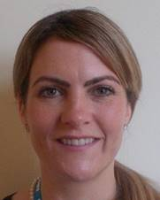
Support: Pastoral and Chaplaincy
Care First / Our Values
Pastoral Fellows:
Jolie Wilkinson (Conq)
and Paul Gosling (EDGH)
And Chaplaincy Team
See Student Handbook
for Contact Details and more information and will they introduce themselves to you in a short while this morning

Slide 12
ASK and TELL
ASK us Questions
TELL us if something concerns you
TELL us if you are not happy
Make the most of your learning experience

Slide 13
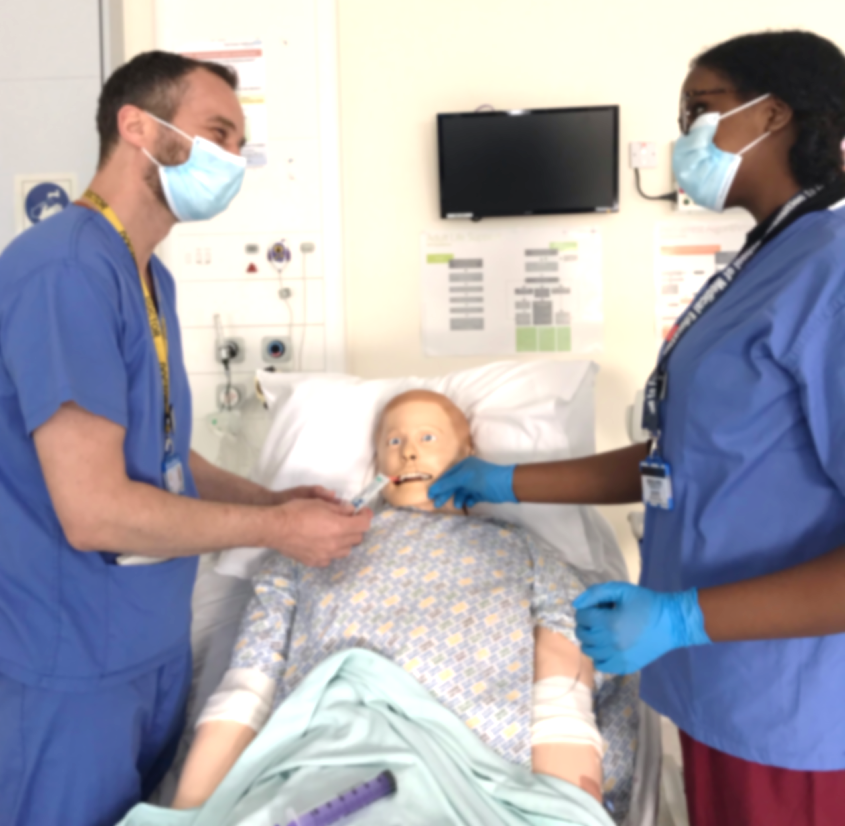
What is provided for you
Opportunities to attend a wide variety of clinics
including community based clinics on both sites and in the community
(Placement Handbook provides further details)
Opportunities to attend wards
Opportunities to attend ward rounds
and grand rounds (Tuesdays 12.45 to 2pm Conq and Weds EDGH)
WhatsApp communication
Ed Fellows led teaching: Tutorials,
Clinical Skills, Mock OSCE etc
Departmental teaching Tues pm
Sim sessions Thursday pm Kipling Ward
Tutorials on neurodevelopment
Regular catch up sessions with LEAD
Opportunity to attend special school placement for complex Neuro-disability sign off
Further instructions on how to book onto clinics are contained in your handbook
Please note that prompt attendance at clinics is required and you must book them in advance
(contact details provided in Placement Handbook)

Slide 14
Expectations from You
Please let us and the team know if you are going to be absent or are off sick, attendance links to your placement/module/course completion as explained on previous slide.
Please let your team know when attending teaching so they are aware of whereabouts.
Please book onto clinics in advance so that they know that you are coming and please attend promptly
Remember to register with a local GP

Slide 15
Induction Packs
Please take your induction pack and fill out the required paperwork:
IT log in declaration
Internet Use Policy
Student ID card application form
Occ Health Declaration form
eSearcher user responsibility
Staff Parking – student placement
And please hand the completed forms back in to me now – there are two copies
One for you to keep and one for our records
You will also find some useful information for you in your induction packs including your student handbook for this placement, map of the hospital, sharps card and blood card, wifi connection instructions etc

Slide 16
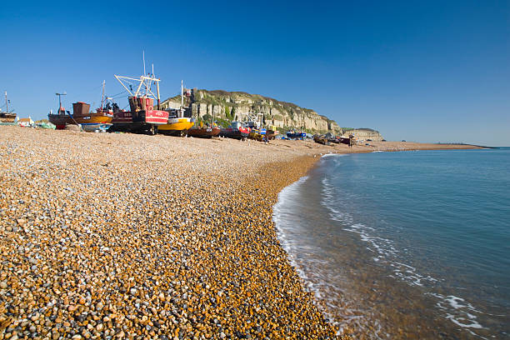
Places to Visit in Hastings and St Leonards
Very historical town – was developed in the 1800’s from being a sleepy seaside fishing village to two vibrant Towns – Hastings and St Leonards.
The first mention of the name Hastings was in the 8th Century, known as Haestingas. It started as a little Saxon village, and in 1066 was conquered by the Normans, as was most of the UK, and although known as the Battle of Hastings, the defining battle where the Normans gained power, is now thought to have been held at Battle.
Today the Towns boasts a variety of Museums and Art Galleries, and also the True Crime Museum, and High Tea at the Tea Museum
Hastings Castle, East Hill Railway and the Old Town, and St George’s street and All Saints Street with Medieval buildings and its range of shops, pups and restaurants
It is also famous for its crazy golf and holds regular competitions
Hastings is well known for its live music, held at a range of venues including ‘The Oval’, the Pier, various pubs and clubs, and there are a range of restaurants to suit a range of different tastes and pockets.
It also has the UK’s largest beach launched fishing fleet
https://www.hastings.gov.uk/visiting
www.skiddle.com/whats-on/Hastings/Hastings-Pier/
https://hastingsflyer.com

Slide 17
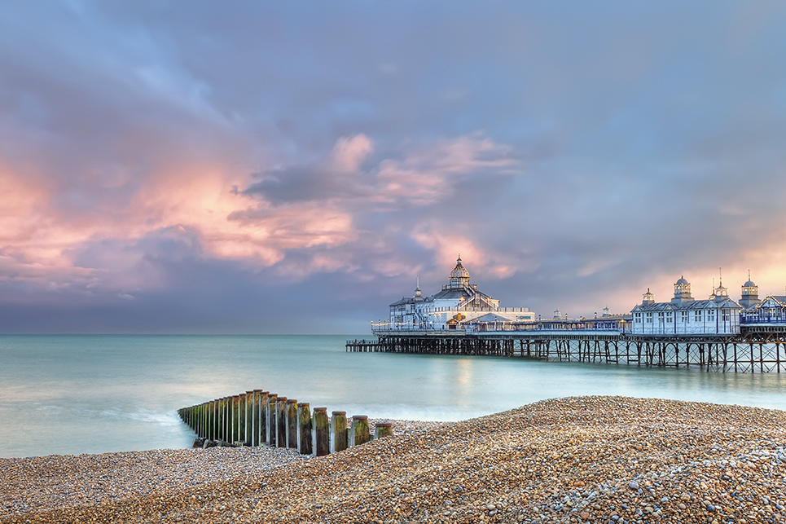
Places to visit in Eastbourne and surrounding areas
Where to go and places to visit please go to www.visiteastbourne.com

Slide 18
Introduction to the Team
My role is to support you with any queries regarding administration, accommodation, rotations, wifi etc. I am based in the Medical Education office and any of the team in the office can help you with any queries or issues during your time with us
The Pastoral Fellows and the Education Fellows will introduce themselves and explain their roles and responsibilities
We will follow that with library tour and hospital tours and then you will be taken to your ward induction by the Education Fellows
We hope you enjoy your placement with us
Please do not hesitate to contact us if you are having any difficulties or have any questions

