Slide 1
ENT EMERGENCIES
M AL-HASHIM

Slide 2
Common ENT emergencies
Basic management
How to refer
Cases you should not miss

Slide 3
On call team
0875, 0709
For patients who need to be reviewed in ENT OPD within next few days; refer to RAC clinic
RAC clinic Otitis externa, Bells palsy, FBs , Nose bleed
, sudden hearing loss

Slide 4
Rhinology (Nose)
Epistaxis
Fractured nose
Foreign body in Nose
Acute sinusitis
Orbital cellulities

Slide 5
Epistaxis
Commonest emergency
Primary
Secondary
  Warfarin
  Aspirin
  Trauma
  Medical/Haematological
Anterior or Posterior Bleed

Slide 6
Epistaxis

Slide 8
Management
Depends on presentation
ABC
Clear the airway, Stop the bleeding, Maintain circulation
Clear the airway
  Good position with adequate light
  Protect yourself
  Remove clots with suction
  Apply co-phenylcaine

Slide 9
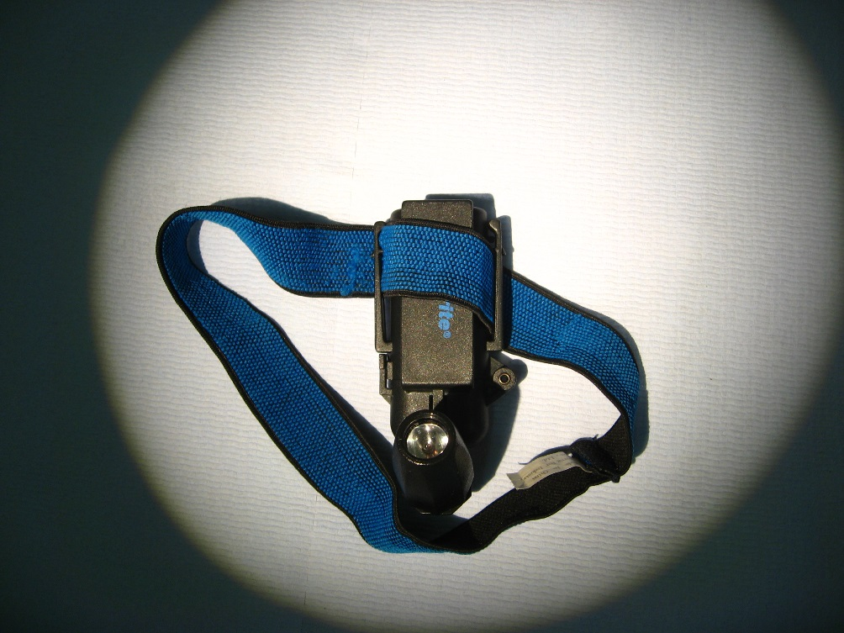
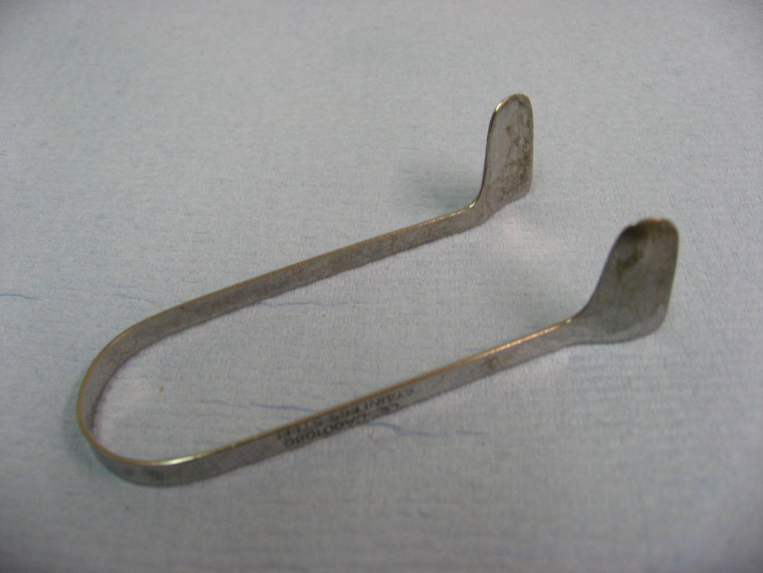
Epistaxis

Slide 10
Stop the Bleeding
Application of external pressure/application of ice pack
Cautery for Anterior bleeding (Avoid in HHT)
Nasal packing for posterior bleeding or a failed cautery

Slide 11
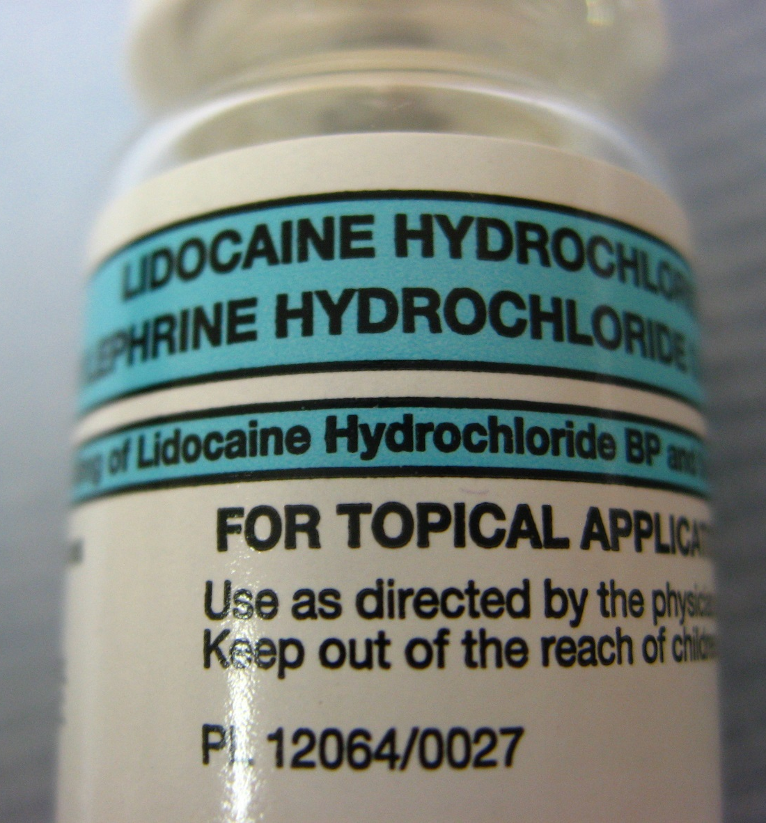
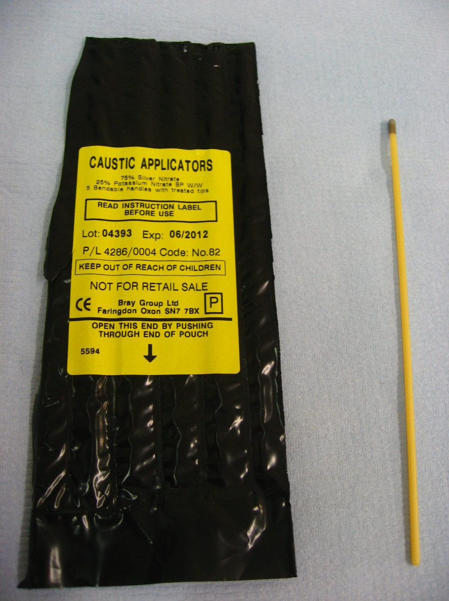
Epistaxis

Slide 12
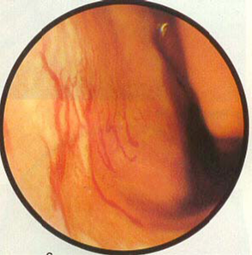
Cautery
Prominent vessels on anterior septum
Apply co-phenlycaine
Cauterise with silver nitrate stick
Apply naseptin cream to area (14 days)

Slide 13
Packing
Profuse bleeding preventing cauterization
Failed cauterization
Posterior bleeding

Slide 14
Insertion of Rapid Rhino

Slide 17
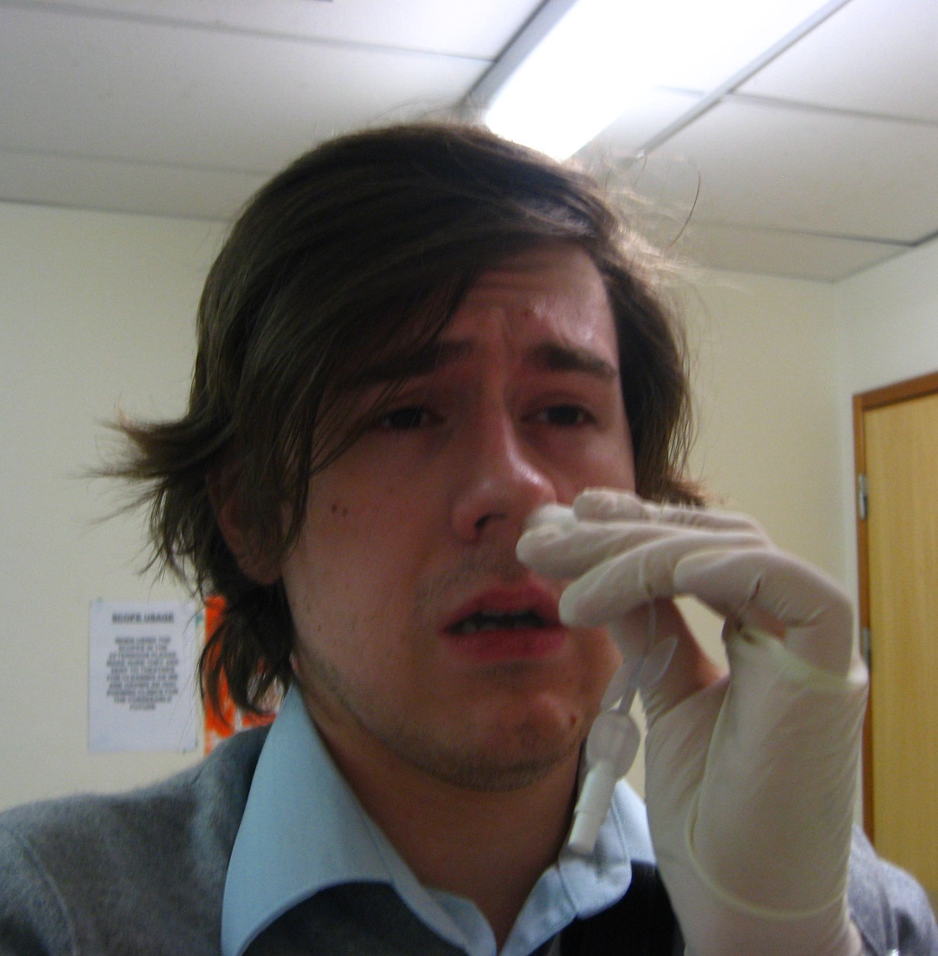
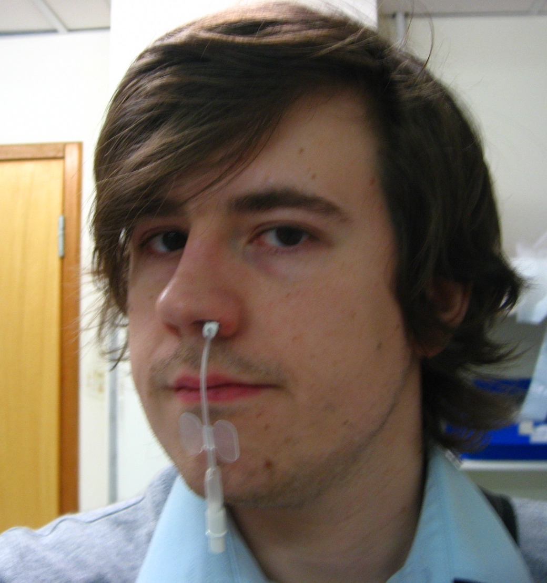
It Hurts!

Slide 18
Criteria for admission
Patients requiring a nasal pack with the following
  Uncontrolled bleeding/posterior bleed
  Recent nasal surgery
  Significant blood loss/shock
  Major cardiac/respiratory disease
  Elderly/infirm/poor social circumstances
  Patients on warfarin
  Bilateral nasal pack
Unilateral nasal pack in a fit patient: Discharge review after 24 hours to remove the pack

Slide 19
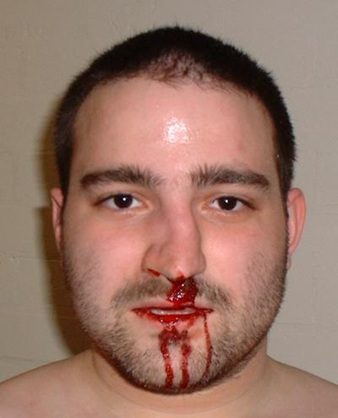
Fractured Nose

Slide 20
Fractured Nose
Clinical diagnosis
X-ray not necessary
If nose is bleeding external pressure will suffice in most cases
Exclude septal haematoma
Assess for clinical deformity
  If obvious arrange ENT follow up within 5-7days

Slide 21
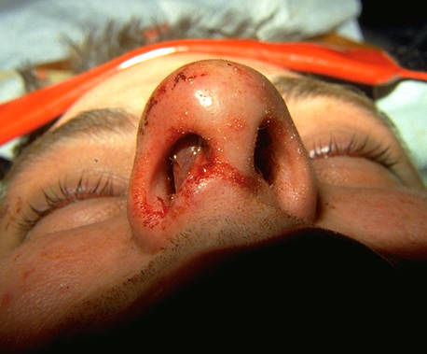
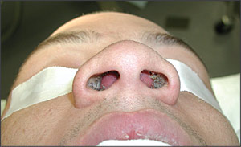
Septal Haematoma

Slide 22
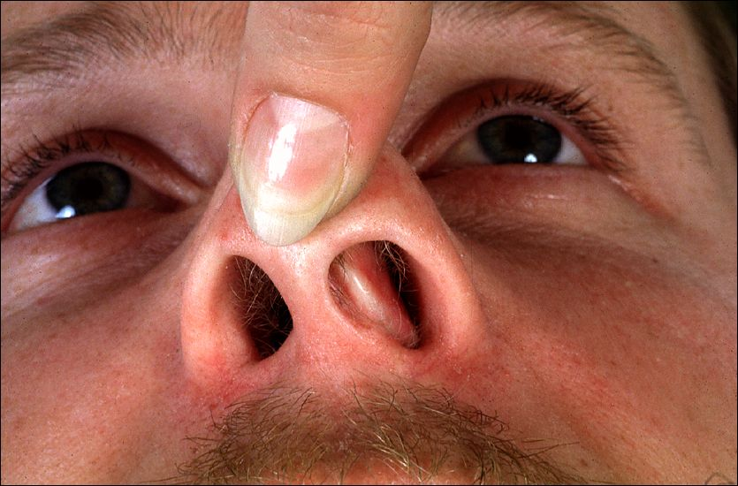
Deviated Septum

Slide 23
Foreign Body in Nose
Children, Refer to ENT
Co-operative patient remove with wax hook. Only one attempt allowed in A/E
Non co-operative frightened patient refer to ENT On Call, same day

Slide 24
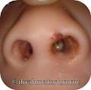
Foreign bodies
Nasal FB

Slide 25


Slide 26
Periorbital Cellulitis= Pre-septal
Orbital cellulitis= septal
Previous history of sinusitis
Recent URTI , nasal discharge
Limited eye movement, Painful eye movement, visual defect
S Pneumonia, H influenzae, Staph aureus,Anaerobes.
Analgesia, IV Abs, CT, Ophthalmology
Surgical drainage for abscess

Slide 27
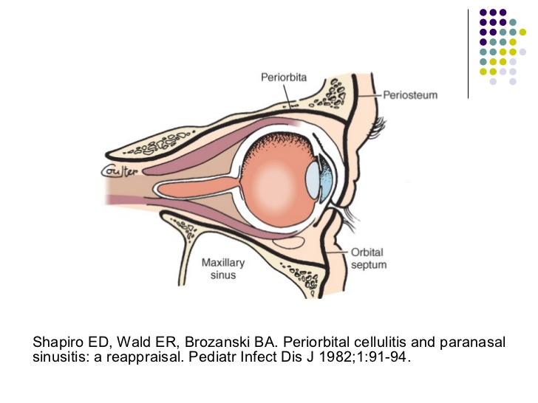
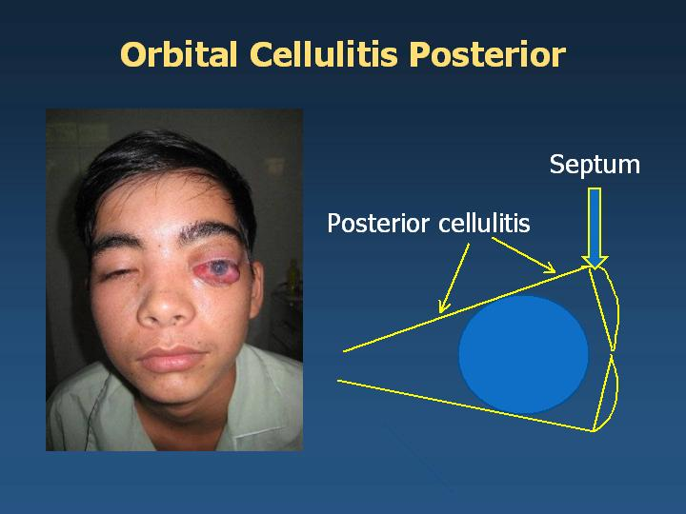
Pre septal & Post septal
Post septal infection
Proptosis & Chemosis

Slide 28
Otology
Acute Infections otitis externa & media
Trauma
  Laceration not involving cartilage
  Laceration involving cartilage
  Haematoma of pinna
  Perforation of tympanic membrane
Foreign body
Facial nerve palsy
Acute dizziness (vomiting, absence of neurological signs)
Sudden hearing loss

Slide 29
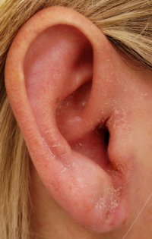
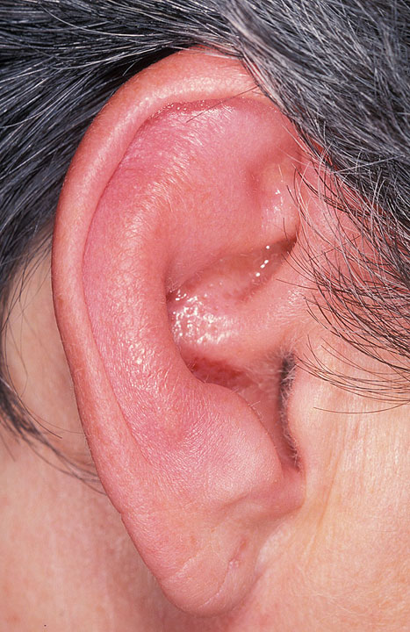
Otitis Externa

Slide 31
Management
Otitis externa/media
Analgesia
Externa
  Topical preparation (Gentisone HC, Sofradex)
  Insertion of Pope wick for closed canal
  If canal is filled with debris arrange for ENT follow-up for aural toilet
  Severe case refer to ENT On Call ( A&E Doctors)
Media
  Oral antibiotics
  Arrange ENT Review

Slide 32
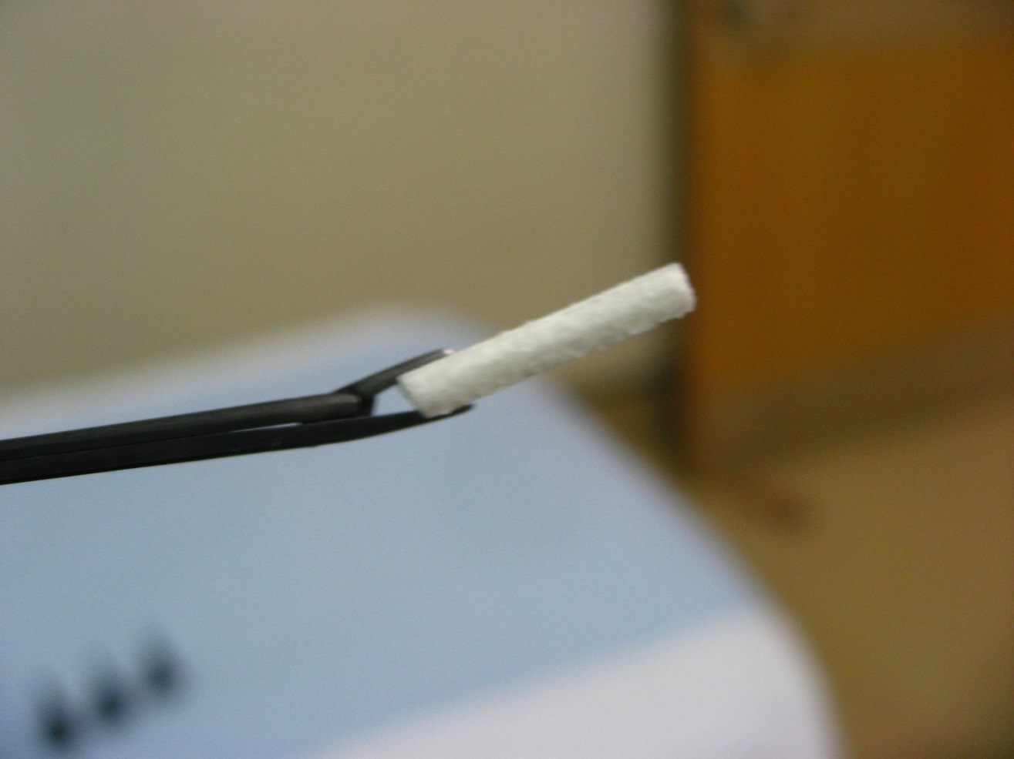
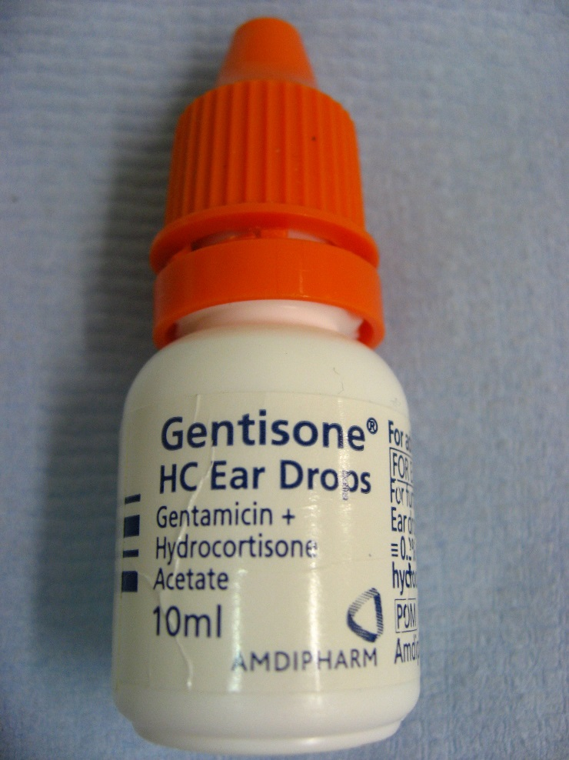
Otitis Externa

Slide 33
Facial nerve Palsy
Lower Motor neuron facial palsy
If spares the forehead, refer to the physician
Bells palsy
Ramsay Hunt Syndrome
Acute otitis media
trauma

Slide 34
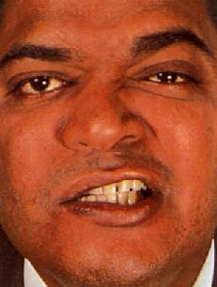
Bell’s palsy
Sudden
With/without otalgia
55% of facial palsy
Treatment:
Eye care
Steroid
? Anti virus

Slide 35
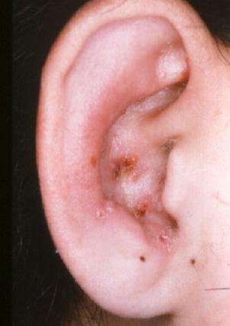
Ramsay Hunt Syndrome
Blisters/Painful rash +facial weakess
Tinnitus, dizziness, Sensory neural hearing loss, loss of taste
Analgesia, Steroid, Antiviral

Slide 36
Facial palsy from ear infections
Acute otitis media with or without ear discharge
Urgent ENT referral
IV Abs May require immediate surgical intervention
Chronic otitis media
Surgical treatment
Otitis Externa Malignant
Diabetes, pseudomonas outer ear infection, temporal bone necrosis + cranial nerve palsies
Surgical debridement, Abs for 6 months

Slide 37
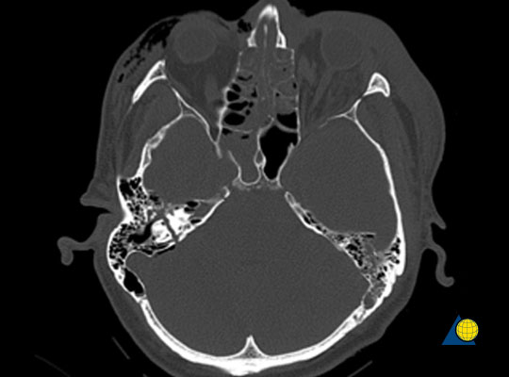
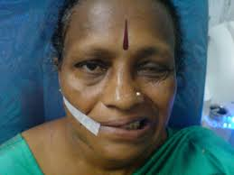
Traumatic
Temporal bone fracture ( Ear CSF, blood):
Neurosurgery
Facial injury: Maxillofacial or plastic

Slide 38
Acute Dizziness
DD Acute stroke
Dizziness is a symptom of stroke in 50% of stroke presentations.
A small stroke of the cerebellum or brain stem can present with isolated dizziness.
CT is not sensitive, MRI is not practical at A&E setting

Slide 39
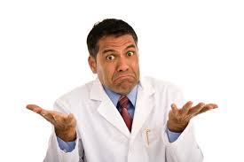
Dizziness in A&E
ENT
?physician

Slide 40
Acute Dizziness
1.Vestibular neuritis
Bad symptoms for ~2 days
2.BPPV
Last less than 1 minute
Feel normal in between or slightly dizzy
3.Meniere’s disease
Sever dizziness for 20miutes or more
Nausea / vomiting
Tinnitus
Pressure in the ear
Recurrent

Slide 41
Peripheral signs
  Horizontal unidirectional nystagmus
  Positive Head Thrust Test
  When the head is moved quickly in one direction, the reflex (i.e., the VOR) that moves the eyes toward the opposite direction is generated by the side the head moved toward. Thus a patient with vestibular neuritis of the left side will present with right-beating unidirectional nystagmus and have a positive head thrust test with movements toward the left side
Central signs
  Tortional, Bidirectional, downbeating Nystagmus

Slide 42
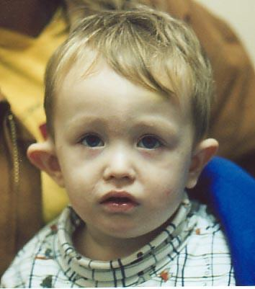
Mastoiditis

Slide 43
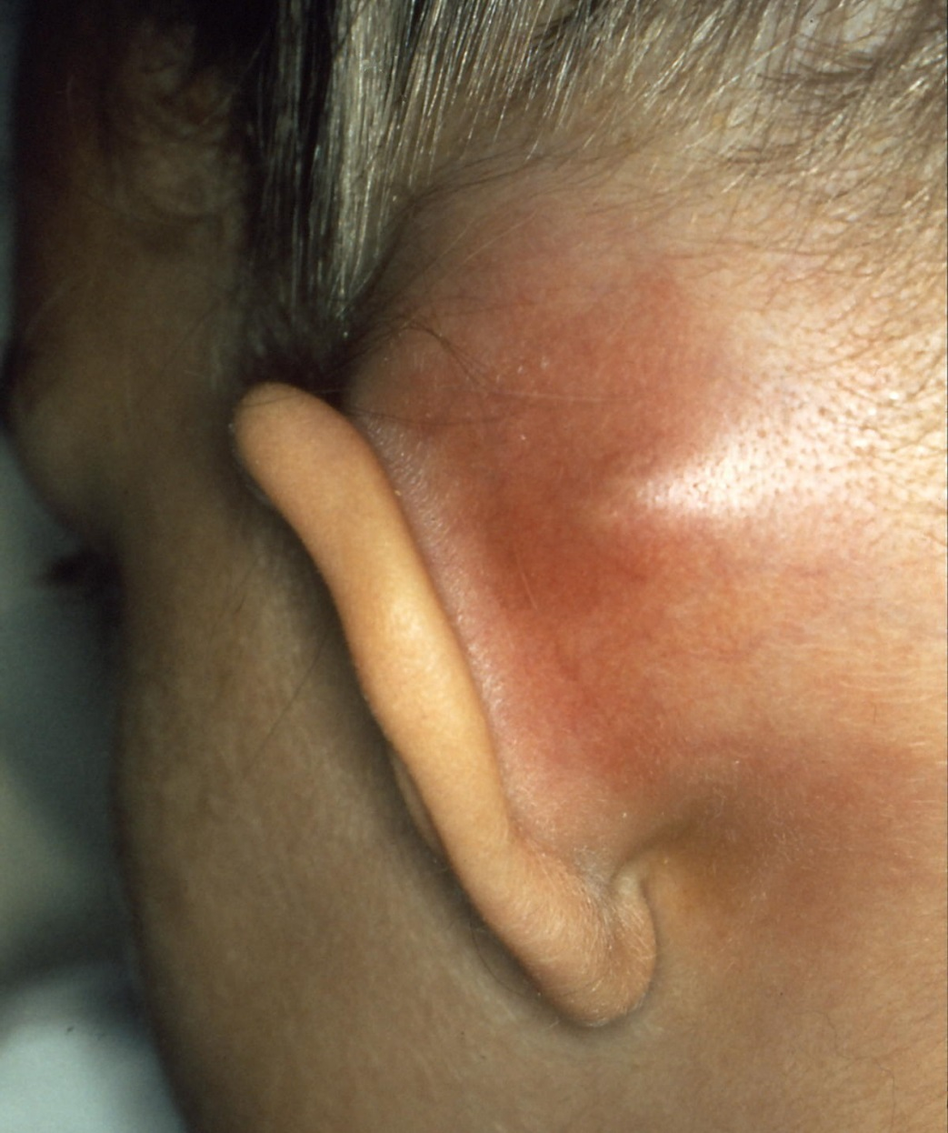
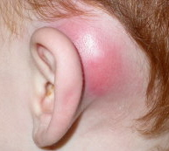
Mastoiditis

Slide 44
Perichondrial Haematoma
Follows blunt injury to the ear
Collection of blood between auricular cartilage and perichondrium of pinna
Required drainage and compression
If left untreated – cauliflower ear

Slide 45
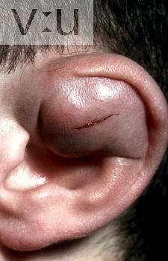
Haematoma
Aspiration + pressure bandage
Incision and drainage

Slide 46

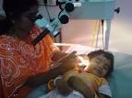
F.B Ear
Not urgent
Adults: Microscope
Arrange a RAC clinic
Small children often require GA

Slide 47
The Larynx/Pharynx
Sore throat/Tonsillitis/Glandular fever
Epiglotittis
Ingested foreign body
Neck trauma

Slide 48
Sore Throat
Acute tonsillitis
Glandular Fever
Peritonsillitis
Quinsy
Epiglottitis (Dysphgia, Drooling, No signs)

Slide 49
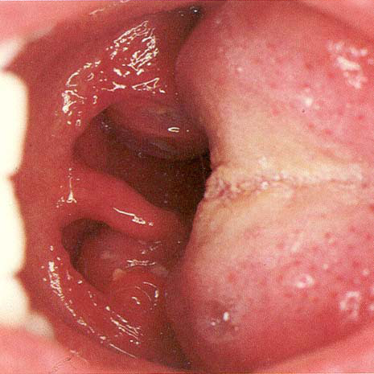
Acute Tonsillitis

Slide 50
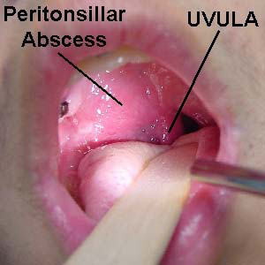

Slide 51
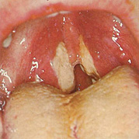

Slide 52
Management
Sore Throat/Tonsillitis
Analgesia/?Antibiotics
Refer to On Call ENT if:
  Peritonsillar abscess
  Inability to swallow due to pain

Slide 53
Epiglottis
  Normally fit patient
  Sudden onset of difficulty swallowing
  May be drooling
  Oropharynx looks unremarkable
  Urgent ENT referral
  Ceftriaxone

Slide 54

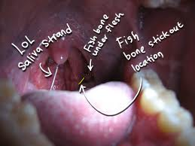
Head light
Local Anaesthetics
Tongue depressor, ? Scope ? mirror

Slide 55
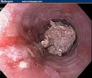
Food bolus
ABC
Dysphagia, gagging
Admission, IV fluid, ? Bescopn
Referral for OGD
FB Oesophagus :
Sharpe object( bone), Kids (coin), sever discomfort Direct oesophagoscopy under GA

Slide 56
Post tonsillectomy pain
Uncontrolled with usual medication
Cannot swallow
Admit, Iv fluid, Analgesia including Oromorph solution

Slide 57

Post tonsillectomy bleeding
-Iv Canula,
-Fluid,
Nil by mouth,
Iv Abs,
Analgesia,
Blood tests including G&S.

Slide 58
Do not miss
Sever sore throat with no physical signs
Nose bleed in young patients, far east
Unilateral middle ear infections in adults
Nose bleed, recent adenotonsillectomy
Not treating the eyes in Bell’s palsy
Facial weakness after mastoid or ear infections
Child with unilateral nasal discharge
Diabetic patient with recurrent otitis externa

Slide 59
Thank You

