Slide 1
Welcome to East Sussex Healthcare Trust

Slide 2
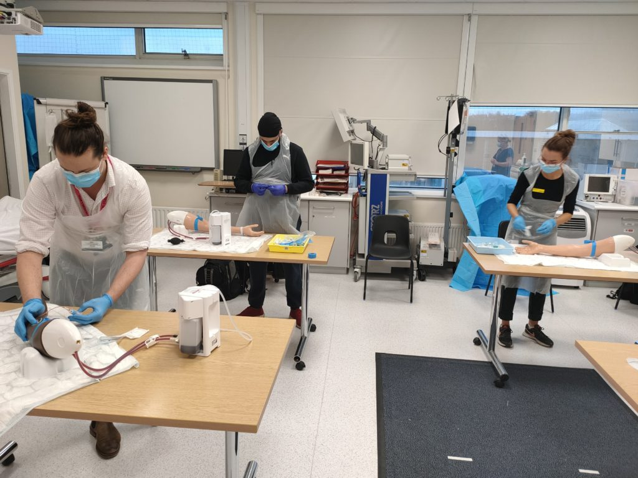
Medical Students’ Induction
Welcome
Year 3 Lead – Dr Abier Elzein (EDGH)
Undergraduate Administrator – Angela Geoghegan
Education Fellows
Pastoral Fellow - Paul Gosling
Pastoral Support – Rev Graham Atfield :
“What do Chaplains Do?”
Mandatory training – PPE, fire training, infection control
COVID testing
Tour of the hospital

Slide 3
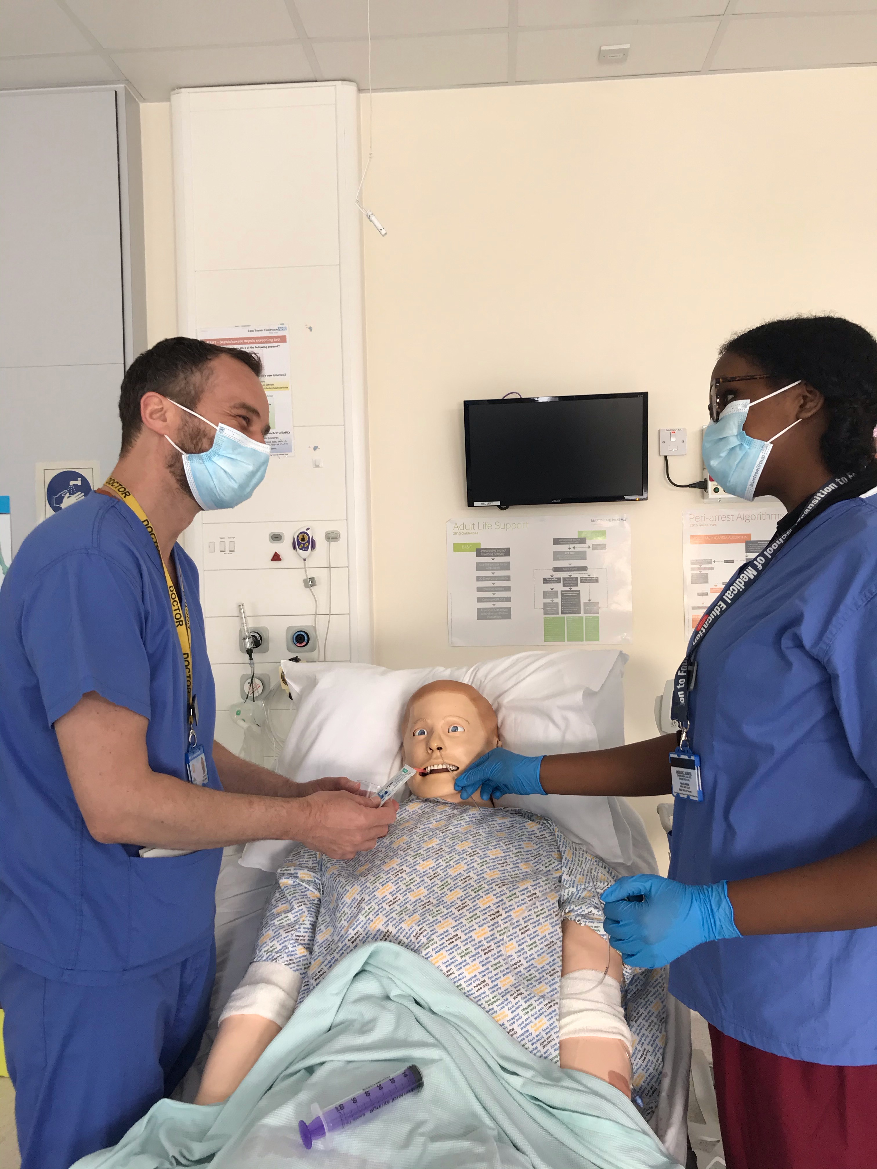
We aim to make your stay enjoyable, educational and productive whilst at East Sussex Healthcare NHS Trust.
https://www.esht.nhs.uk/medical-education/

Slide 4
BSMS Student Leads
 | EDGH | Conquest
BSMS UG Lead Cross Site | Dr Sam Panthakalam spanthakalam@nhs.net
BSMS Year 5 Lead | Dr Anna Cowley anna.cowley@nhs.net | Dr Umesh Dashora u.dashora@nhs.net
BSMS Year 3 Lead | Dr Abier Elzein abier.elzein@nhs.net | Dr Geeta Gopalakrishnan Geeta.gopal@nhs.net
Module 306 Elderly Care | Dr R Nahas | Dr H McIntyre
Module 306 Stroke | Dr C Biyanwila at EDGH For your week in the Stroke Speciality will be at Eastbourne.
BSMS Year 4 Lead | Miss Mini Nair mininair@nhs.net

Slide 5
Educational Fellows
Name | Department | Site | Email
Dr Khalid M A Ahmed | Acute Medicine/SDEC | EDGH | k.ahmed8@nhs.net
Dr Afshan Akhtar | Surgery | Conquest | afshan.akhtar@nhs.net
Dr Muhammad Chaudhry | Surgery | Conquest | muhammad.chaudhry16@nhs.net
Dr Iye Enwuchola (Anthonette) | Emergency Medicine | EDGH | a.enwuchola@nhs.net
Dr Hannah Jawwad | Emergency Medicine | EDGH | hannah.jawwad@nhs.net
Dr Harriett Johnson | Rheumatology/Simulation | EDGH | harriett.johnson1@nhs.net
Dr Rahul Karuppannan | Emergency Medicine | EDGH | r.karuppannan@nhs.net
Dr Tanzia Latifi | Emergency Medicine | Conquest | t.latifi@nhs.net
Dr Dua Malik | Acute Medicine | Conquest | duaahmed.malik@nhs.net
Dr Isabel Rimmer | Palliative Medicine | EDGH | isabel.rimmer@nhs.net
Dr Tahani Shanta | Acute Medicine | Conquest | tahani.shanta@nhs.net
Dr Rebecca E A Sinden | Palliative Medicine | Conquest | rebecca.sinden2@nhs.net
Dr Krishna Tavrawala | Emergency Medicine | Conquest | krishna.tavrawala@nhs.net
Dr Teena Thomas | Acute Medicine/SDEC | Conquest | teena.thomas14@nhs.net
Dr Stephanie Ketley | Emergency Medicine | EDGH | stephanie.ketley1@nhs.net

Slide 6
Meeting your learning requirements:
safe and supported working environment for students
consultants, trainees, nursing staff
education fellows
RESUS and SIM team (mannequins can be pre-booked for students’ own practice)
peer group study
voicing your educational needs
CBD practice week
logbooks
24/7 Library

Slide 7
Structured Teaching
Ward rounds and bedside teaching
Grand rounds/ Schwartz rounds
Departmental teaching/MDTs
Clinics
Simulation/ skills lab
Phlebotomy sessions
Resus and acute care teaching
Foundation doctor-led teaching
(Tues & Thurs)

Slide 8
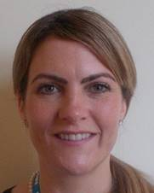
Pastoral Support
Nurse Pastoral Fellows:
Jodi Wilkinson and Paul Gosling
See student handbook for extensive list
of sources of support

Slide 9
ASK and TELL
ASK us questions
TELL us if something concerns you
(see the “My Learning Review” form)
Make the most of your learning experience

Slide 10
Attendance and Review
Please :
Let the education centre know if you are going to be absent or are off sick
Let your team know when not attending timetabled teaching
Register with a GP – see your handbook
Frequent reviews with Block Lead
Mandatory
Fortnightly or as requested
Let us know if you are unable to attend

Slide 11
Library
The library is open Monday to Friday 8.30am to 5.00pm. Outside these hours users can access both libraries using their Trust swipe card for 24 hour access.
If you need to contact library please email them on esh-tr.libraryservices@nhs.net
PCs are accessible in the library 24/7 using your Sussex username and password.

Slide 12
Places to visit in Eastbourne and surrounding areas
Where to go and places to visit please go to www.visiteastbourne.com

Slide 13
Q&A
Questions

