Slide 1
KCL 5th year LTC Programme Block 7
Dr Salwa Owasil, Education fellow, king’s ltc lead
Consultant block lead: Dr R Nahas

Slide 2
Teaching with Dr Nahas
Mandatory
Every Thursday afternoon
Date/Time | Topic/Facilitator
17th Oct 4-5pm Duncan House 1 | Frailty/Dr Nahas
24th Oct 3-4pm Duncan House 1 | Prescribing Practice/Dr Nahas
31st Oct 3-4pm JC | Rheumatoid arthritis/Dr Salwa Owasil
7th Nov 3-4pm JC | Prescribing practice/Dr Nahas
14th Nov 3-4pm Seminar Room 3 | Parkinson’s disease/Dr Nahas
21st Nov 4:30-5:30 Lecture theatre | COPD/Dr Rukudzo Msindo
28th Nov 4-5pm Duncan House 1 | Diabetes/Ed Fellow
5th Dec 3-4pm Duncan House 1 | Osteoporosis/Dr Nahas

Slide 3
Tutorials/revision sessions
Every Thursday afternoon
Guided by YOU! (Topics, MCQ revision sessions, OSCE practice)
Please have a think and let me know on the Whatsapp gc what you’d like to do each week
Date | Time/Location | Session
17th Oct | 2- 3:30pm, Clinical Education room
24th Oct | 4-5pm, Duncan House 1
31st Oct | 1:45-2:45pm DH1
7th Nov | 4-5pm, Sarah Hampson Rm
14th Nov | 4-5pm, Seminar Rm 3
21st Nov | SIMUALTION 8:30-12:30pm | SIM
28th Nov | 2-3pm, Clinical Education Rm
5th Dec | 2- 3 pm, Clinical Education Rm

Slide 4
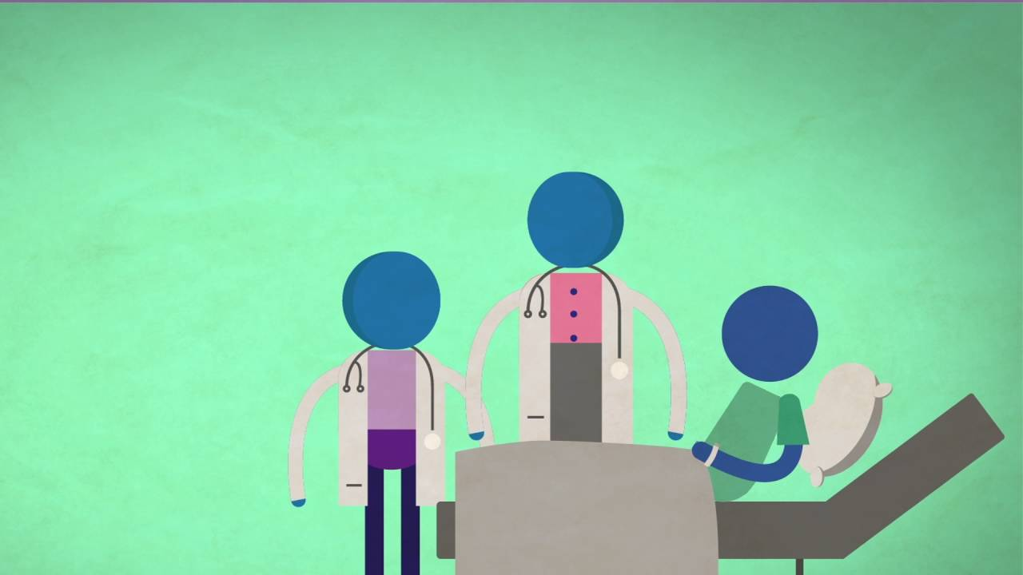
Bedside teaching TBC…
To be confirmed
If hopefully goes ahead, will be Tuesday afternoons from 2pm
Look out for messages on the Whatsapp group chat!
Date | Facilitator | Ward
15/10/24 | Aparna/Louisa | Jevington (Rheum)
22/10/24 | TBC | TBC
29/10/24 | TBC | TBC
5/11/24 | TBC | TBC
12/11/24 | TBC | TBC
19/11/24 | TBC | TBC
26/11/24 | TBC | TBC

Slide 5
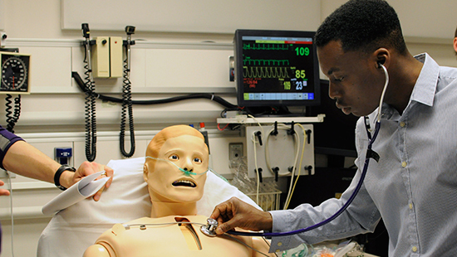
Simulation!
Thursday 21st November 8:30-12:30pm
Simulation suite in Education Centre
Not an assessment, purely for learning!

