Slide 1
Welcome to Eastbourne District General Hospital
KCL Year 5 Medical Students
14th October 2024

Slide 2
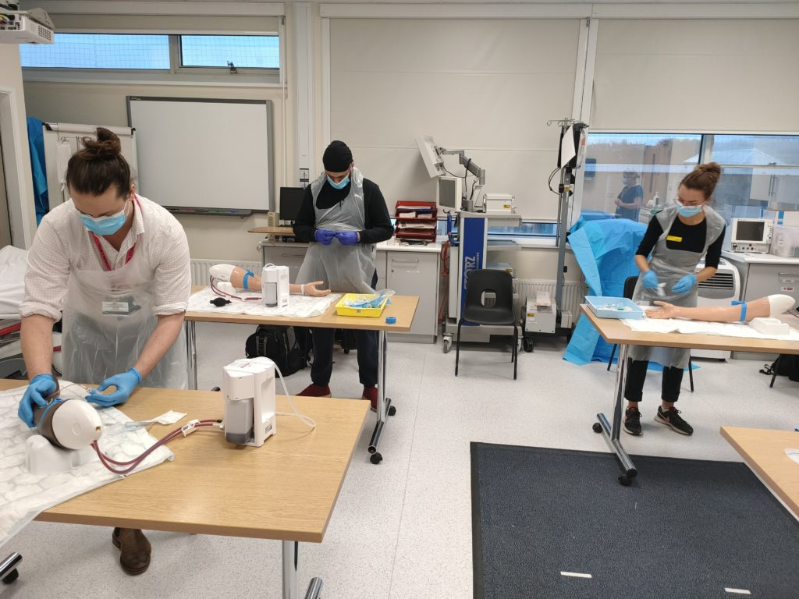
Medical Students’ Induction
Welcome
Dr John Somarib (KCL Sub Dean)
Dr Kam Quraishi (KCL Acute Care Block Lead)
Dr Rannie Nahas(KCL LTC Block Lead)
Undergraduate Administrator – Angela Geoghegan
Education Fellows
Pastoral Fellow - Paul Gosling Tour of the hospital

Slide 3
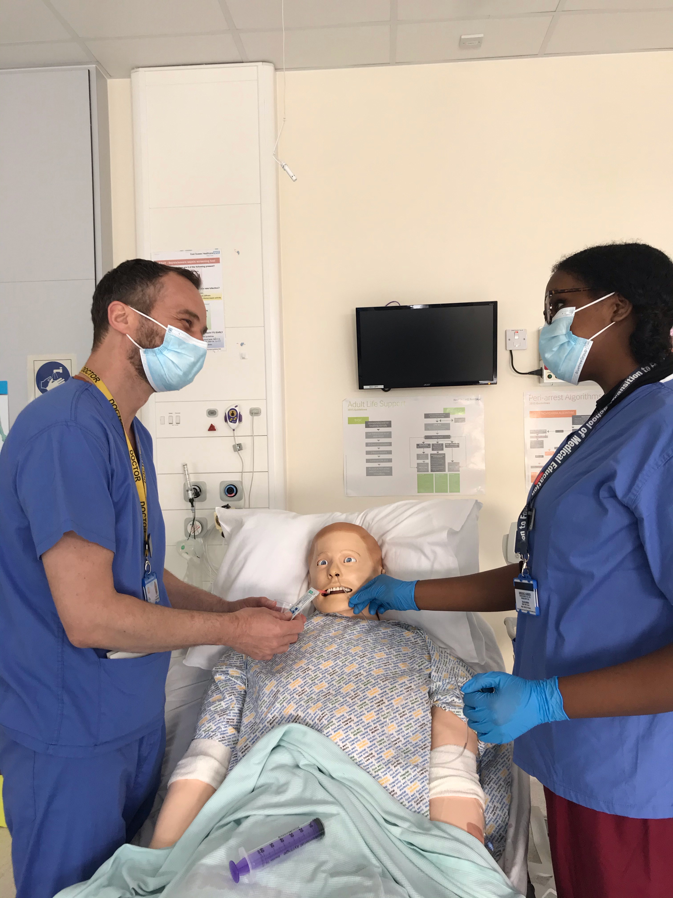
We aim to give you a fantastic learning experience at ESHT
which will be enjoyable and help boost your confidence in a medical profession

Slide 4
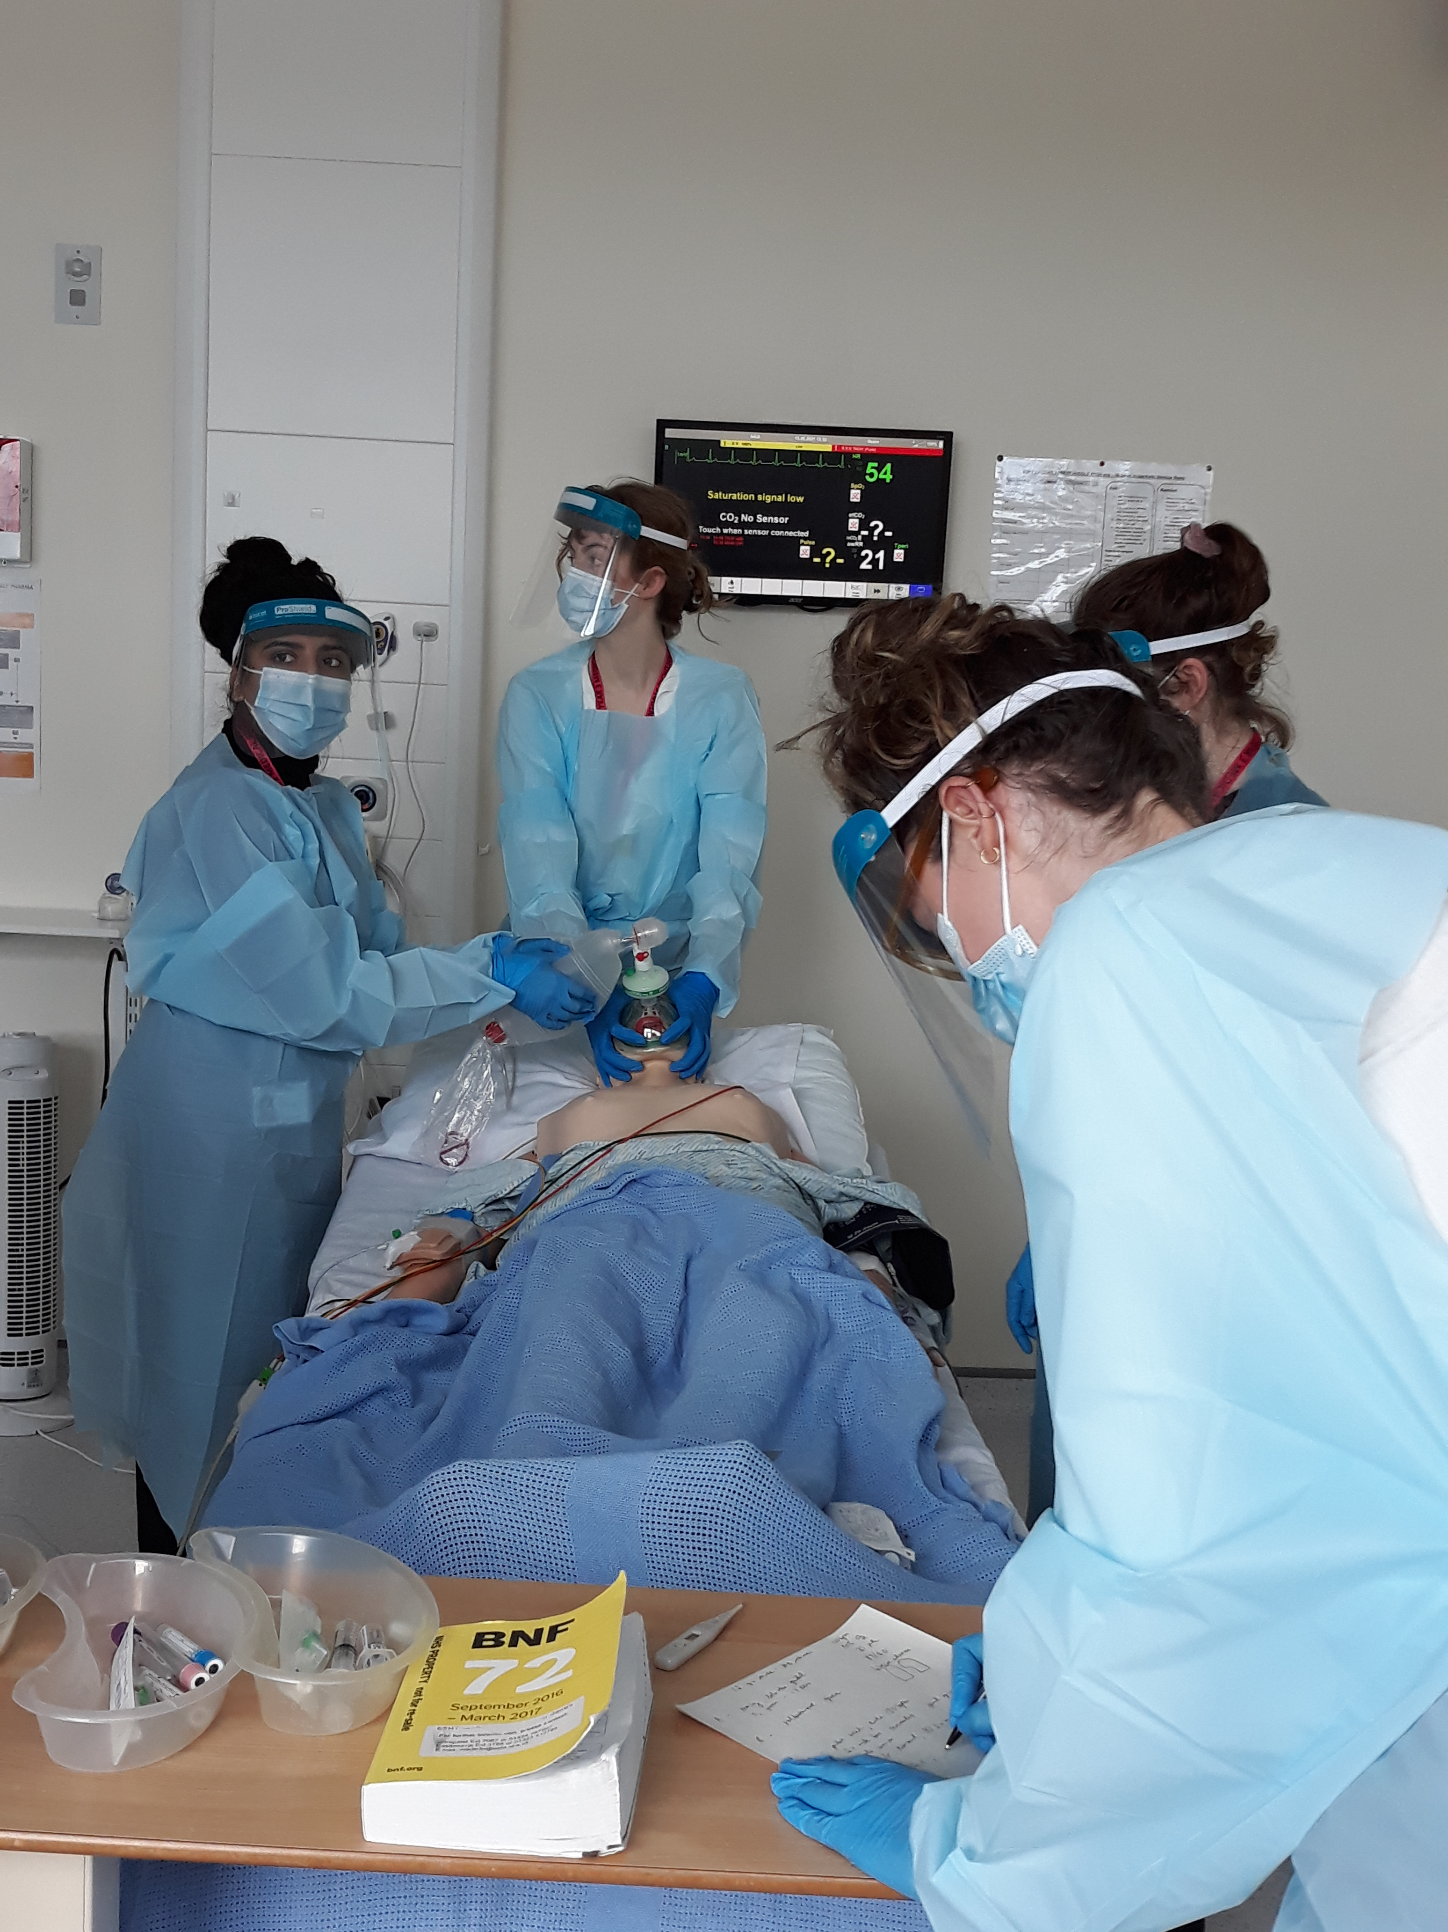
There will be a range of delivery styles:
SIM:
bedside teaching:
classroom teaching:
skills teaching;
review sessions;
clinics

Slide 5
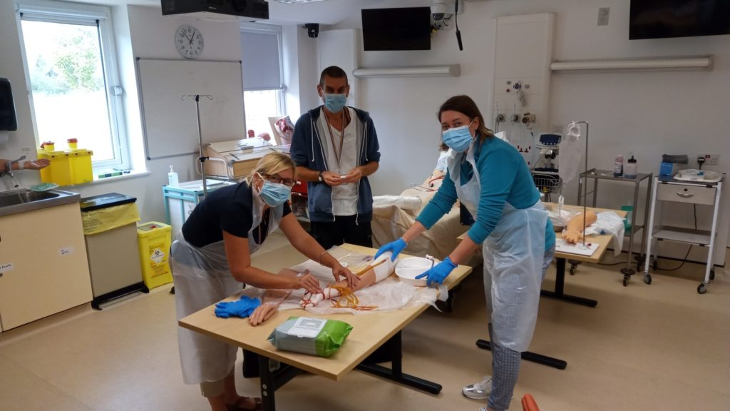
Structured Generic Teaching
Schwartz rounds
Clinics
Theatres
Ward Rounds
Simulation/ skills lab
Resus and acute care teaching
Foundation doctor-led teaching (Tues & Thurs)
Weekly Catch up sessions (Thursday afternoon)
Module Specific Teaching including Educational Fellows and Block Leads

Slide 6
Medical Student Leads
Role | Eastbourne | Conquest Hospital
KCL Sub Dean | Dr John Somarib johnsomarib@nhs.net | Dr Chris Scanlon
KCL Acute Care Block Lead: | Dr Mohammed Quraishi Mohammed.quraishi@nhs.net | Dr S Berliti stefano.berliti@nhs.net Mr Y El-Dhuawaib yesar.el-dhuwaib@nhs.net
KCL LTC Block Lead: | Dr R Nahas rannienahas@nhs.net | Dr T Christopherson thereza.christopherson1@nhs.net

Slide 7
Educational and Pastoral Fellows
Name |  | Site
Paul Gosling | Nurse Fellow | EDGH | paul.gosling@nhs.net
Jolie Wilkinson | Pastoral Fellow | EDGH/ CQ | Jolie.wilkinson@nhs.net
Dr Shabih Zahra | Emergency Medicine | EDGH | shabihzahra921@gmail.com
Dr Hannah Jawwad | Emergency Medicine | EDGH | hannah.jawwad@nhs.net
Dr Hani Khaldi | Acute Medicine / SDEC | EDGH | hani.khaldi@nhs.net
Dr Rahul Karuppannan | Emergency Medicine | EDGH | r.karuppannan@nhs.net
Dr Salwa Owasil | Rheumatology / SIM | EDGH | salwa.owasil@nhs.net
Dr Samuel Rose | Palliative Medicine | EDGH | Samuel.rose@nhs.net

Slide 8
Meeting your learning requirements:
safe and supported working environment for students
consultants, trainees, nursing staff
education fellows
RESUS and SIM team (manequins can be pre-booked for students’ own practice)
peer group study
voicing your educational needs
Logbooks / mandatory sign-offs
24/7 Library
Outpatient Clinics
– contact Catherine Watsham (Matron) on catherine.watsham@nhs.net

Slide 9
Mandatory Sign-Off Acute Care Block
Complete a comprehensive geriatric assessment
Draft a discharge summary for a patient
Observe the therapy team review a falls patient or perform a CBD on topic
Complete a medication reconciliation tutorial (TBD) or perform a CBD on topic
Attend an ENT or Urology Theatre Session
Perform a Case Based Discussion for an ITU Patient
Complete an Emergency Abdominal Pain Clerking in SAU
Attend the ACB Simulation Scenarios

Slide 10
Mandatory Sign-Off Long Term Conditions Block
8x Teaching Dates (Thursdays)
17th October
24th October
31st October
7th November
14th November
21st November
28th November
5th December

Slide 11
Recommended Educational Clinics for KCL Medical Students
Conquest SAU | SAU Ward Round CEPOD Theatre SAU Ambulatory Clinic
Urology | Handover at Urology Investigation Suite Seminar Room at 0800 Ward Round at Friston CT Led Ambulatory Clinic in Friston Daily 0900 Mr Quraishi Urology Investigation Suite Laser Clinic Thursday AM (Start 0815 sharp to be present and introduce to staff) Mr Quraishi Stone Clinic Friday AM (MKQ office, 1st Friday of Month in Main OPD) Mr Spiteri Kidney Clinic Monday AM. Main OPD Mr Spiteri Kidney Clinic Wednesday Area E OPD. (Basement) Mr Calleja/Rimmington Clinic
Breast | Mr Sangle Breast Clinic
ENT | Rapid Access Clinic – Morning (Area C OPD – Everyday)
General Surgery EDGH | Mr Al-Robaie Clinic Monday PM EDGH (Colorectal) Mr Al-Robaie Clinic Tuesday AM Conquest (General)

Slide 12
Start of Block/Handover Location for Acute Care Block
Conquest SAU | 0800 - Conquest Handover Room – Location to be Confirmed.
Urology | 0800 - Handover at Urology Investigation Suite Seminar Room (Level 3 Purple Zone)
ITU | 0800 Anaestehetic Seminar Room (in Anaesthetic Department – Level 3 Purple Zone)
ENT | 0800 - Handover in ENT office (first Door on Left in Friston Ward- Level 3 Purple Zone)
AMU | 0845 – AMU MDT Room (within AMU)

Slide 13
Mandatory Signs off for ACB
Falls Assessment | Please attend the office at Level 1 Door opposite to Staff Restaurant. Handover at morning – allocation of referrals at 0800. If unable to find – 0300 131 4527. Potentially able to perform on AMU – either observe Falls Team or perform under supervision of Resident Doctor.
Geriatric Assessment | Any patient undergoing admission in AMU who fits criteria of needing Geriatric assessment. Part of IPD Clerking in Friston Ward. Can be done under supervision of Resident Doctor.
ENT/Urology Theatres | Urology/ENT operate regularly. Multiple Theatres. Attend 0800 Hailsham Ward – introduce yourself to the surgeon and request permission to join in theatre.
ITU CBD | Any appropriate case, perform a deep review and understands the organ support requirements/ITUs role in ongoing management. This may include organ retrieval/withdrawal of Rx.
Medicine Reconciliation | Aiming for tutorial to be arranged with Dr John Somarib (TBC). Aim to observe pharmacist/technician performing on ward.

Slide 14
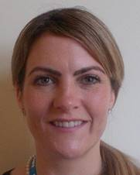


Pastoral Support
Pastoral Fellows:
Jodi Wilkinson and Paul Gosling
See student handbook for extensive list
of sources of support

Slide 15
Library (Knowledge Services)
The library is open Monday to Friday 8.30am to 5.00pm. Outside these hours users can access both libraries using their Trust swipe card for 24 hour access.
If you need to contact library please email them on:
esht.libraryservices@nhs.net
PCs are accessible in the library 24/7 using your Sussex username and password.

Slide 16

ASK and TELL
ASK us questions !
TELL us if something concerns you – PLEASE TELL US EARLY ON IF ANY CONCERNS/CHANGES WARRANTED.
Make the most of your learning experience ☺

Slide 17
Attendance
Let the education centre know if you are going to be absent or are off sick
Let your team know when not attending timetabled teaching
Register with a GP – see your handbook

Slide 18
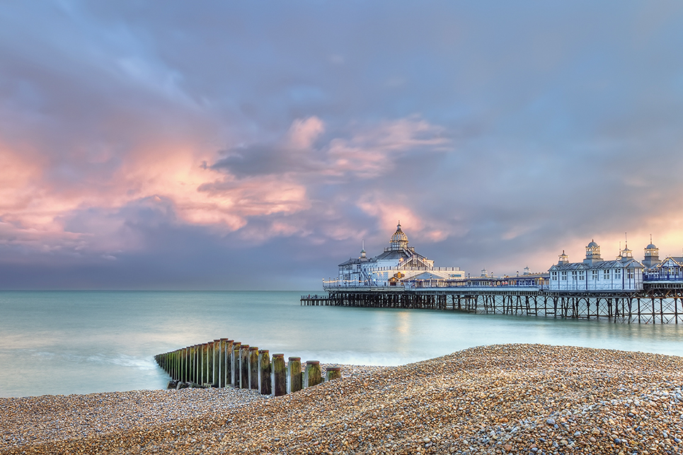
Places to visit in Eastbourne and surrounding areas
Where to go and places to visit please go to www.visiteastbourne.com

Slide 19
Questions?

