Slide 1
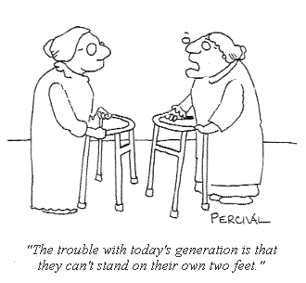
Falls and Immobility
Dr. Tilottama Barua
Internal Medicine SpR
EDGH

Slide 2
Please join in!

Slide 3
Introductions to topics (frailty, immobility, falls + others)
4 cases -
1 work through together
1 work through in pairs
1 work through alone
Time for questions
Need pen and paper/computer to write notes

Slide 4
What is frailty?
No universal definition
Widely accepted to be:
Reduced physiological reserve
Related to ageing
Increased vulnerability to outcomes
Dynamic and reversible (to an extent…)
Notes:
Complex concept
Highly prevalent
Not a normal part of ageing
Relevant to almost all specialties

Slide 5
Why is frailty relevant to this talk?
Conditions present atypically
Falls
Immobility
Delirium
Incontinence

Slide 6
What is a fall
According to Public Health England….
A fall is defined as an event which causes a person to unintentionally rest on the ground or lower level, and is not result of a major intrinsic event (such as a stroke) or overwhelming hazard.

Slide 7
Why are falls important
Common problem:
600 inpatient falls per day in England (5 falls in hospital/day)
1/3 >65 and ½ >80 fall at least once a year
½ of fallers will fall again in the next year
Why?
Unfamiliar environments
Acute illnesses
Decompensation of frailty
Slowed reaction time, slowed walking speed
Reduced muscle strength/mass
Reduced flexibility
Poor vision/ hearing impairment
Cognitive impairment
Loss of proprioception
Postural hypotension
Intravascular volume depletion
Changes to vascular compliance
Polypharmacy
Notes:
Impaired balance
Slowed reaction time
Increased sway
Reduced muscle strength
Reduced flexibility

Slide 8
Why are falls important
2. Significant effects:
Medical:
10% of falls lead to fractures
30% of those who fracture their hip die within a year
Death
over 1,500 people >65y die from accidental fall each year
Psychological:
Loss of confidence
Fear of falling
Social:
Need for equipment
Need for services/carers
Loss of independence: RH/NH/ Carers

Slide 9
Causes of falls
System | Causes
Sensory | Visual loss, hearing loss
CNS | Delirium, dementia, stroke, peripheral neuropathy, Parkinsonism, seizures
Cardiovascular | Postural hypotension, arrhythmias, valvular heart disease, Ischaemic heart disease
Respiratory | Infection, PE
GI | Constipation,
MSK | Sarcopenia, myopathies, arthritis
Endocrine | Hypoglycaemia
Iatrogenic | Polypharmacy, specific drugs
Environment | Carpets, lighting, furniture, footwear, toenails

Slide 10
“Multifactorial”

Slide 11
“Mechanical” fall?
An unhelpful term
Doesn’t describe what happened
If truly an accident call it one
Accidental fall : tripped / Slipped
Otherwise try and describe:
contributing factors
Acute medicine e.g. new doxazosin causing postural hypotentsion
Additional risk factors e.g. poor vision, dementia, OA both knees
Consequences
e.g. fractured radius limiting ability to self-care temporarily

Slide 12
Falls and medications
Drugs that change your cognition/alertness
Anticholinergics
Benzodiazepines
Z drugs
Opiates
Drugs that lower BP
Antihypertensives/ diuretics/ vasodilators
alpha-blockers
Drugs that reduce muscle function ie steroids
Drugs that cause hypos

Slide 13
So…. What do you NEED to do when you are on call in 8 months?
1. What to say to the person who has bleeped you…
2. What to do when you arrive…

Slide 14
“The Bleeper”
Establish any injuries/ LOC
Are OBS haemodynamically stable now/ NEWs score?
Ask to do Neuro OBS every 30 minutes until you arrive and bleep sooner if any change in condition or GCS
Estimate the time that you may be there (usually give in terms of 30 minute chunks)

Slide 15
“The arrival”

Slide 16
History
Before
Chest pain
Dizziness
During
LOC
Time on floor
After
How long until felt normal self?
Injuries?
SOB
Any symptoms during
Tongue biting/ limb movement
Head injury?
How did they get up?
How did they call for help?
Focal weakness
Vomiting
Amnesia
palpitations
What were they doing?
Was it witnessed?? Collateral history is crucial

Slide 17
Examination
CNS:
Conscious level: GCS
Confusion: AMTS
Focal neurology: Pronator drift, power 4 limbs and plantars
Evidence of head injury
C-Spine
MSK and Skin: Any injury/bruising – especially focus on hips (straight leg raise and feel over GTs)
Then:
CVS: Arrhythmia, murmurs
RS: Infection or hypoxia
GI: Constipation

Slide 18
Investigations as inpatient – only if relevant
Bloods
FBC/ U&E/ LFT / CRP
Blood cultures if temperature
(Specific in Elderly medicine: B12/Folate/ TSH/ Ca2+/ Vit D)
Urine dipstick/ M, C+S
ECG: arrhythmias, ischaemia
Imaging
XR: AP and Lateral of anything tender
CXR: Infection, malignancy
CT: As per NICE Guidelines

Slide 19
Bedside:
ECG – Sinus tachycardia – normal otherwise
Cap glucose – needed for all falls – glucose acceptable
Urine dip – possibly for blood (myoglobin) in rhabdomyolysis
Bloods:
FBC –white cells/neut for diarrhoea, Hb for tachycardia
U&E – creatinine – AKI? Na/K – loss in diarrhoea, Urea –dehydration
CRP – infection/inflammation
VBG – pH for acidosis
Creatine kinase (CK) –? rhabdomyolysis
LFT – metabolic state for drugs,
TFT
Microbiology:
M C and S if needed
Imaging/special tests:
AP and lateral if needed

Slide 20
NICE Guidelines CT Head
If head injury:
Within 1 hour:
Glasgow Coma Scale (GCS) <13 when first assessed or GCS <15 two hours after injury
Suspected open or depressed skull fracture
Post-traumatic seizure
Focal neurological deficit
>1 episode of vomiting
Within 8 hours:
All patients with a coagulopathy or on oral anticoagulants

Slide 21
Management
Short-term
Analgesics
Supportive therapy: hydration, bowels
Treat underlying cause eg antibiotics, slow heart rate etc
Ask for L+S BP
If head injury or LOC:
GCS 15: Every 30 mins for 2 hours, then 1hrly for 4 hours then every 2 hours “4,4,2”
If GCS <15: Every 30 minutes

Slide 22
Management
Long-term:
MDT input
Review drug chart for offending meds
Outpatient falls clinic or community team
Bone protection/Frax scores
Consider Other tests to fully investigate why fell:
Echo
24hr tape
Tilt table etc
Review drug chart

Slide 23
Documenting your plan
“Imp: Fall likely due to …. No injury sustained
Plan:
L+S BP
Analgesics
Neuro OBS every 30 minutes for 2h, hourly for 4 h
Bleep if any concerns or change in GCS by >1
Aim to move closer to nursing station/ use non slip socks etc”
“Team to consider……”

Slide 24
To summarise for your review
Give clear plans over the phone and documenting
Specifically remember neck, neuro and hips
Follow NICE guidelines if head injury
Neuro OBS “4,4,2”

Slide 25
Cases

Slide 26
Case 1 together) Jean Jowers, admitted via ambulance
88 year old female.
Ambulanced arrival at personal residence 13:00
Patient laying on bathroom floor, carer present, no evidence of injury but diarrhoea noted on floor and clothing. Able to stand with assistance of two. Clothes changed.
BG: hypertension, early Alzheimer’s dementia, Right #NOF 6/52 ago
Community DNACPR form
Observations:
RR 24, O2 sats 99 on air, HR 100, BP 101/70, temp 37.0, Alert, CBG 5.0

Slide 27
What would you like to know?

Slide 28
Clerking: PC = Fall and diarrhoea
When?
9am needed to open bowels – got up from chair and walked to toilet
What?
Before:
Felt lightheaded and legs gave way
Fell onto bathroom floor.
, no CP, palp, SOB,
legs felt wobbly, no unilateral weakness/vertigo
During:
No trip or slip
No LOC, saw self fall to ground.
After:
Could not get up
Bowels opened, and two further times
No urinary incontinence, tongue bite
No head, joint, back injury
On floor until carer arrived at 12pm, no careline

Slide 29
PMHx:
Hypertension
Alzheimer’s dementia
Right #NOF – operated 6/52 ago
Diverticular disease
Drug history:
Indapamide 2.5mg OM
Donepezil 10mg OM
Morphine Sulphate MR 10mg BD
Paracetamol 500mg QDS
Macrogol 2 sachets at night
Senna 15mg ON PRN
No recent changes
Allergies: None
Family Hx: Nil of note
Social Hx:
Retired secretary
Sheltered flat, ground floor
Interim TDS POC since hip #
morning wash & dress, midday meal and call at bedtime
Daughter local and helps
Mostly continent, pads at night (urine)
Flat bound
Zimmer frame mobility – 1 prior fall
Never smoked
No alcohol
System review:
No new findings

Slide 30
What will your examination focus on to rule in/out differentials?

Slide 31
On examination:
Observations: NEWS = 3
RR 24 Sats 99% on air
HR 100
Lying BP 115/77 Standing BP 94/60
Temp 36.9
CBG 5.0
Alert on AVPU
General inspection:
Dry mucous membranes
No stigmata of chronic disease
Cardiovascular:
Pulse regular
JVP not seen
HS I-------II-------I no murmurs heard
No oedema
No clinical DVT
Respiratory:
No accessory muscle use, trachea central
Equal expansion
Resonant
AE right =left
Chest clear
Abdominal:
Soft, non-tender, non-distended
No masses, organomegaly, ascites
Normal bowel sounds
PR with chaperone
External nil
Normal tone and sensation
Empty rectum, no blood or mucous
Neuro:
AMTS 8/10 – no new confusion
No focal neurology, no CN pathology
Joint and skin:
Normal spine and joint examination
Pressure areas intact

Slide 32
What is your problem list of why she fell based on this information?

Slide 33
Fall
PMHx:
Hypertension
Alzheimer’s dementia
Right #NOF – operated 6/52 ago
Diverticular disease
No Hx of MI, stroke, diabetes, epilepsy
Drug history:
Indapamide 2.5mg OM
Donepezil 10mg OM
Morphine Sulphate MR 10mg BD
Paracetamol 500mg QDS
Macrogol 2 sachets at night
Senna 15mg ON PRN
No recent changes
Social Hx:
Interim TDS POC since hip #
morning wash & dress, midday meal and call at bedtime
Mostly continent, pads at night (urine)
Zimmer frame mobility – 1 prior fall
Fall:
9am needed to open bowels – got up from chair and walked to toilet
Felt lightheaded and legs gave way
Fell onto bathroom floor.
Before:
As above, no CP, palp, SOB,
legs felt wobbly, no unilateral weakness/vertigo
During:
No trip or slip
No LOC, saw self fall to ground.
After:
Could not get up
Bowels opened, and two further times
No urinary incontinence, tongue bite
No head, joint, back injury
On floor until carer arrived at 12pm

Slide 34
Problem list
Multifactorial Fall due to
Postural hypotension
Diarrhoea, Intravascular depletion
Interstitial gastroenteritis
Contributing falls risk factors
opiates, polypharmacy, hip #, walking aid, Alzheimer’s, Frailty
Long lie
?AKI

Slide 35
What tests does this person need and why?

Slide 36
Investigations:
FBC:
Hb 136 (115-165)
MCV 90 (83-101)
WCC 9.0 (4-10)
Neut 4.0 (2-7)
Plts 225 (150-410)
LFT:
Albumin 41 (35-52)
Total protein 70 (66-87)
Globulin 20 (18-36)
ALP 60 (35-104)
Bilirubin 5 (0-21)
ALT 18 (0-33)
CRP:
CRP 4 (0-5)
Creatine Kinase:
CK 100 (30-300)
INR:
INR 1.0
TFT:
Normal
Urine dip:
Normal
U&E now:
Na 128 (136-145)
K 2.8 (3.5-5.1)
Urea 10.6 (2.8-8.1)
Creat 120 (44-80)
eGFR 40 (60-80)
U&E 6/52 ago:
Na 136 (136-145)
K 3.5 (3.5-5.1)
Urea 7.0 (2.8-8.1)
Creat 50 (44-80)
eGFR >60 (60-80)

Slide 37
Why might this have happened? Would you like any more bloods?

Slide 38
Venous blood gas:
pH: 7.28 (7.35-7.45)
pCO2: 3.6 (4.6 – 6.4 kPa)
pO2: 8.0 (11.0 – 14.4 kPa)
BE -6.4 (-2– 2)
HCO3 18 (22-26 mEq/L)
Lactate 2.8 (<2)

Slide 39
Venous blood gas:
pH: 7.28 (7.35-7.45)
pCO2: 3.6 (4.6 – 6.4 kPa)
pO2: 8.0 (11.0 – 14.4 kPa)
BE -6.4 (-2– 2)
HCO3 18 (22-26 mEq/L)
Lactate 2.8 (<2)
Uncompensated metabolic acidosis
Partial compensation with low PaCO2 but not able to correct pH to normal
High lactate reflects poor tissue perfusion

Slide 40
Final Problem list
Fall
Postural hypotension
Diarrhoea leading to intravascular volume depletion
Exacerbated by indapamide and possibly denepezil
Inter-current illness – gastroenteritis
Hyponatraemia
(Contributing falls risk factors -opiates, polypharmacy, hip #, walking aid, Alzheimer’s)
Long lie with no evidence rhabdomyolysis
Acute kidney injury with metabolic acidosis
Pre-renal – volume loss from diarrhoea (+ indapamide)
Hyponatraemia and hypokalaemia
Electrolyte loss from diarrhoea (+ indapamide)
High lactate – dehydration and poor tissue perfusion

Slide 41
What should we do for this person and why?

Slide 42
Management: should reflect your problem list
Diarrhoea:
Admit – side room, barrier nursing – diarrhoea may be infectious
Await stool cultures – no antibiotics indicated
Stop laxatives
Hyponatraemia, hypokalaemia, AKI and metabolic acidosis:
Low Na - extra tests may help
Blood: serum osmolality, cortisol, thyroid function
Urine: osmolality, sodium (paired with blood)
Stop indapamide (postural hypotension, lowers Na and K, nephrotoxic)
Volume deplete so give fluids – 0.9% sodium chloride – will help postural BP
Add potassium chloride (KCl) 40mmol to the fluids
Daily U&E to check resolution of AKI
if no improvement USS KUB to exclude obstruction (bladder scan on ward to exclude retention)
MDT input regarding fall

Slide 43
Case 2 in pairs: Inpatient fall
You are the F1 on call. You are called by nurses at 01.00 as they heard a noise and found a patient lying on the floor. Patient appears confused and nurses say he has been more confused throughout the day.
Fred Jones, 84Male. Admitted with 4 days shortness of breath and wheeze, treated for an exacerbation of COPD.
PMH: COPD, Osteoarthritis, T2DM, Hypertension, Aortic stenosis. IHD
SH: Lives at home, has TDS package of care, walks with a stick, needs assistance with washing and dressing.
DH: Salbutamol neb 0.5mg QDS, Ipratropium 500microgram neb QDS, Prednisolone 40mg OD for 5 days, doxycycline 100mg OD for 5 days, Furosemide 40mg OD, Bisoprolol 5mg OD, Ramipril 2.5mg OD, metformin 500mg BD, aspirin 75mg OD

Slide 44
Why might he have fallen?
What is your initial management?
What is the long term management?
Does the patient have frailty syndrome?
Which scoring systems are you aware of to assess for this?
He has a comprehensive geriatric assessment (CGA) as part of his management, which areas should be covered?

Slide 45
You are the F1 on call. You are called by nurses at 01.00 as they heard a noise and found a patient lying on the floor. Patient appears confused and nurses say he has been more confused throughout the day.
Fred Jones, 84Male. Admitted with 4 days shortness of breath and wheeze, treated for an exacerbation of COPD.
PMH: COPD, Osteoarthritis, T2DM, Hypertension, Aortic stenosis. IHD
SH: Lives at home, has TDS package of care, walks with a stick, needs assistance with washing and dressing.
DH: Salbutamol neb 0.5mg QDS, Ipratropium 500microgram neb QDS, Prednisolone 40mg OD for 5 days, doxycycline 100mg OD for 5 days, Furosemide 40mg OD, Bisoprolol 5mg OD, Ramipril 2.5mg OD, metformin 500mg BD, aspirin 75mg OD
Obs: bp 110/70, HR 60, T36.9, Sats 92% 28%oxygen, BM 5.3
Why might he have fallen?
What is your initial management?
What is the long term management?
Does the patient have frailty syndrome?
Which scoring systems are you aware of to assess for this?
He has a comprehensive geriatric assessment (CGA) as part of his management, which areas should be covered?

Slide 46
Why might he have fallen?
Postural hypotension: Drinking less in hospital, hypoadrenalism on longterm steroids, dehydrated if has infection (insensible loss)/ confused and not drinking, ? diarrhoea from antibiotics
Delirium: ?hypoxia ? retention/constipation as on anticholinergics and steroids, ?related to infection ? related to pain ?electrolyte disturbance/AKI
Deconditioning
Myocardial infarction/ arrhythmia

Slide 47
Management
Initial management
How do you get someone onto the bed: Hoists, chair
When do we put out a trauma call?
What examination do you do: head CN, peripheral neuro, chest, abdomen, joints
What investigations: Bloods (?AKI), XR anything tender
When do you CT: NICE guidelines
Neuro obs/ advice to nurses: No published consensus. Advise 15mins for 1hr then every 1hr for 4 hr then every 2- 4hr until 12h. Bleep if GCS change by >1.
What to document
Medication review
What is the long term management?
MDT input
Outpatient falls clinic
Echo
24hr tape
Other tests: Tilt table etc ? needs SST
Bone protection/Frax scores

Slide 48
Does the patient have frailty syndrome? Yes
Which scoring systems are you aware of to assess for this?

Slide 49
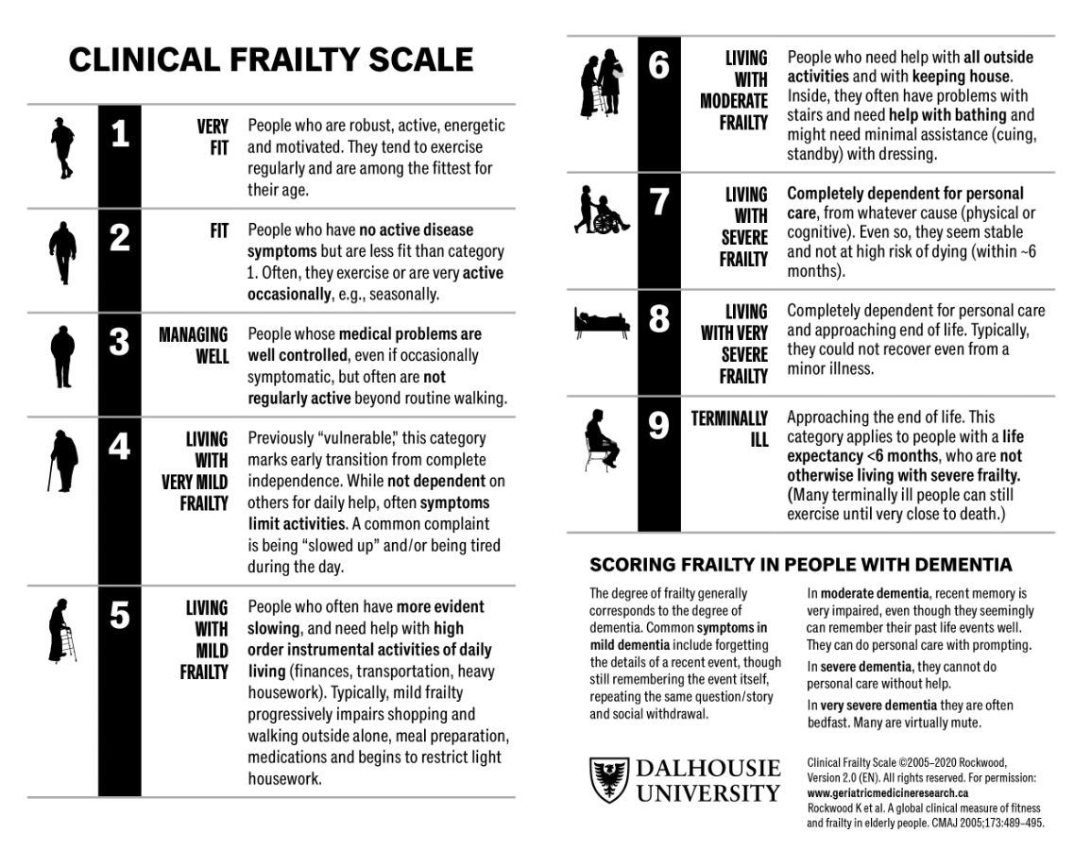

Slide 50
Management: CGA
Gold standard intervention for frailty
Is interdisciplinary and mutidimentional (medical, psychological, social, functional)
Produces problem lists and integrates plan for treatment, rehab, long term care
Person with frailty who receives CGA by MDT more likely to be alive and living in own home 6 months after acute illness ( as well as less falls)
(NNT 33 to prevent one unnecessary death or institutionalisation compared to general medical care)
(Compared to NNT 79 aspirin/ischaemic stroke to avoid death and dependency avoided or NNT 143 to prevent repeat stroke)
See: BGS Comprehensive Geriatric Assessment Tool Kit for Primary Care Practitioners
https://www.bgs.org.uk/sites/default/files/content/resources/files/2019-02-08/BGS%20Toolkit%20-%20FINAL%20FOR%20WEB_0.pdf
Notes:
NNT 1/140 with antiplatelets to prevent stroke, 1/100 antihypertensives to prevent MI

Slide 51
CGA Template
Physical assessment
all systems
Functional, social, environmental assessment
(Often by MDT members)
Psychological components
Mood and cognition
Medication review
Compliance, ability to take, requirement, side effects
Collateral is crucial
Including gait, weight, feet, L&S BP

Slide 52
Case 3
76M, admitted following a fall when shopping
Known Parkinson's disease 3 years, recent covid vaccination 4 days ago
PMH: Parkinson's disease, reflux, T2DM
DH: Madopar 62.5mg TDS,Gliclazide 80mg BD, Metofrmin 1g BD, omeprazole 20mg OD
SH: Lives with wife, BD POC to assists with dressing/washing, CFS 5

Slide 53
What else would you like to know?
Which key parts to examine?
Which investigations?

Slide 54
Uh Oh

Slide 55
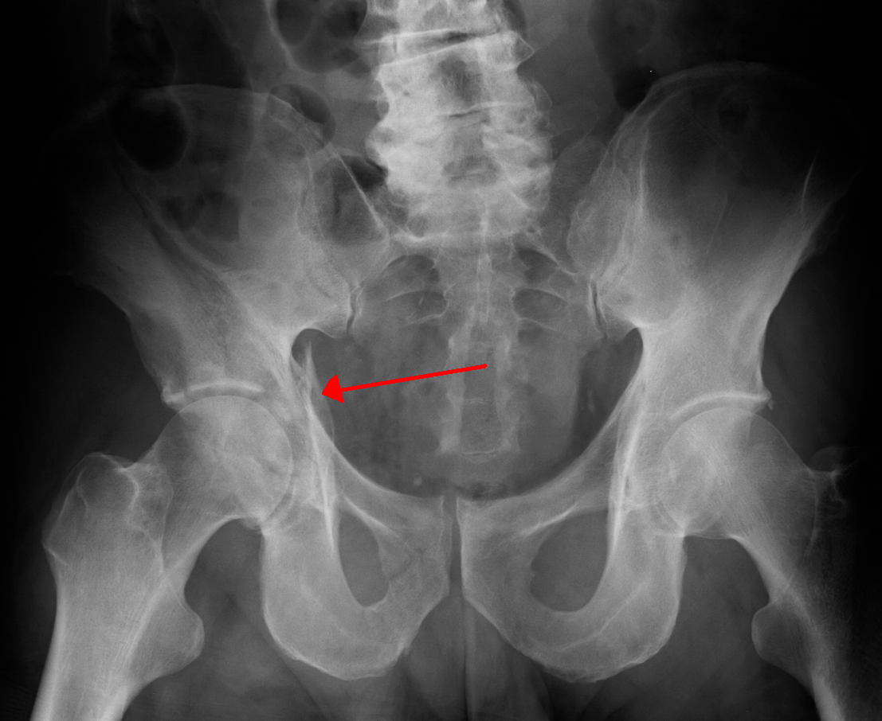

Slide 56
Management
Of the NOF #
Of the fall acutely
Longterm

Slide 57
Osteoporosis
Reduced bone density and micro-architectural deterioration of bone
Primary and secondary prevention
FRAX scores
DEXAs: T scores and Z scores
NOGG – look up summary
Options put simply are treat, don’t treat, scan and then decide
Age, frax score and life expectancy as well as Cis to medications play into these decisions
Bisphosphonates (inhibit osteoclasts)
CI CKD, oesophageal diseas
Denusomab (rank ligand inhibitor)

Slide 58
Frax

Slide 59
Take home message
Whether a patient presents with fall or immobility or another frailty syndrome, that is not the diagnosis and you need to find the reason(s) why.

Slide 60
Summary
Falls
Before, during, after
Remember people with frailty have atypical symptoms ie a NOF or injury may not be obvious
Management is hyperacute, acute and longterm
Make your problem list using information you have
Make your management plan based on your problem list
You will see many people with falls

Slide 61
Any questions?

