Slide 1
Welcome to East Sussex Healthcare Trust

Slide 2
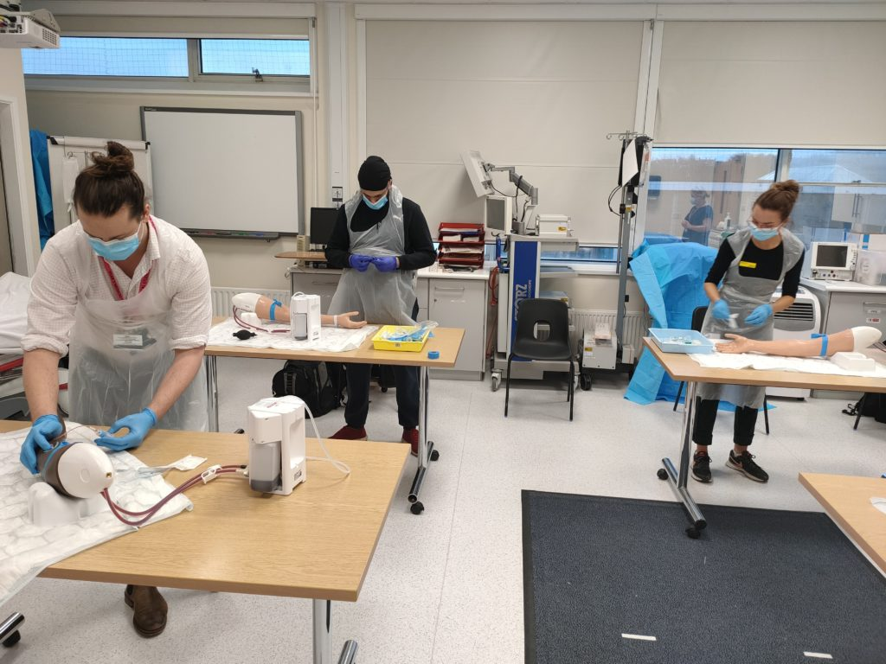
Medical Students’ Induction
Welcome
Year 3 Lead – Dr Abier Elzein
Undergraduate Administrator – Angela Geoghegan
Education Fellows
Pastoral Fellow - Paul Gosling
Tour of the hospital

Slide 3
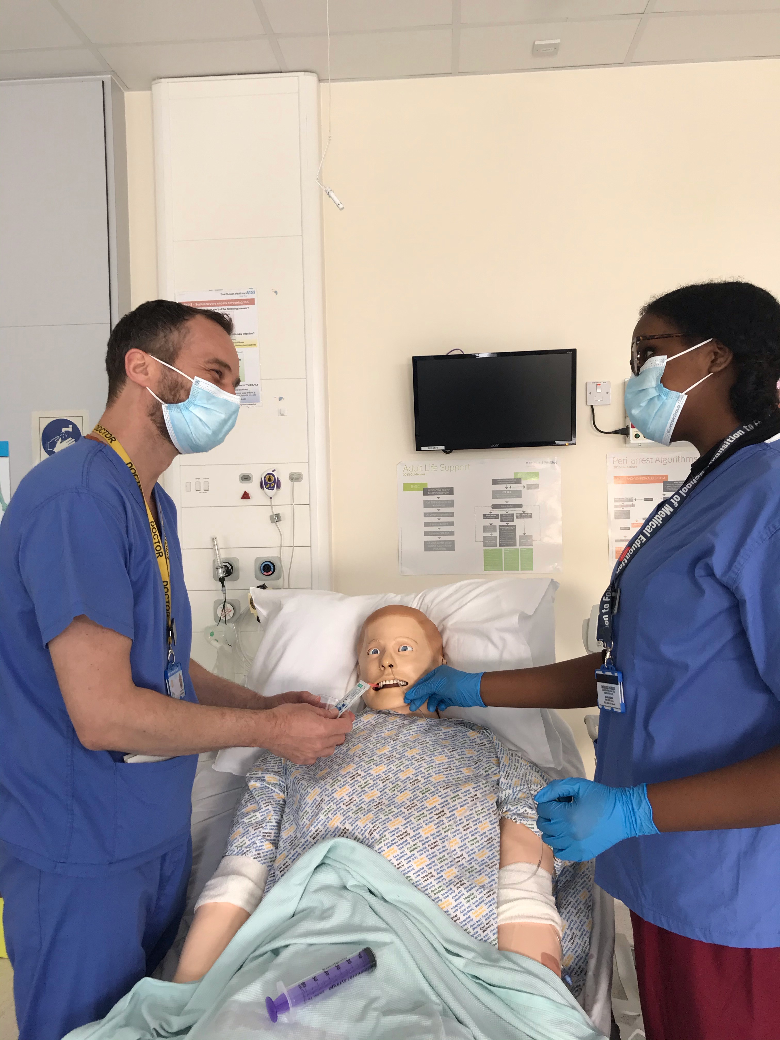
We aim to make your stay enjoyable, educational and productive whilst at East Sussex Healthcare NHS Trust.

Slide 4
Educational and Pastoral Fellows
Name | Department | Site | NHS email
Dr Sadia Afrose | Emergency Medicine | Conquest | sadia.afrose@nhs.net
Dr Yasmin Alagaratnam | Palliative Medicine | Conquest | yasmin.alagaratnam1@nhs.net
Dr Ibrahim Elsherbini | General Surgery/Simulation | Conquest | ibrahimelsherbini@gmail.com
Dr Basim Fraz | Acute Medicine/SDEC | Conquest | basimfraz@gmail.com
Dr Tristan Holt | General Surgery | Conquest | tristan.holt2@nhs.net
Dr Tanzia Latifi | Emergency Medicine | Conquest | t.latifi@nhs.net
Dr Mehzabeen Mishma | Medicine (Rotational) | Conquest | mehzabeen.mishma@nhs.net
Dr Krishna Tavrawala | Medicine (Rotational) | Conquest | krishna.tavrawala@nhs.net
Dr Mahmoud A I Ahmed | Cardiology | EDGH | mahmoud.ahmed12@nhs.net
Dr Alessandra Cantaloni | Cardiology | EDGH | alessandra.cantaloni@nhs.net
Dr Hannah Jawwad | Emergency Medicine | EDGH | hannah.jawwad@nhs.net
Dr Rahul Karuppannan | Emergency Medicine | EDGH | r.karuppannan@nhs.net
Dr Hani Khaldi | Acute Medicine/SDEC | EDGH | hani.khaldi@nhs.net
Dr Salwa Owasil | Rheumatology/Simulation | EDGH | salwa.owasil@nhs.net
Dr Samuel Rose | Palliative Medicine | EDGH | samuel.rose@nhs.net
Dr Shabih Zahra | Emergency Medicine | EDGH | shabih.zahra@nhs.net

Slide 5
Meeting your learning requirements:
safe and supported working environment for students
consultants, trainees, nursing staff
education fellows
RESUS and SIM team (manequins can be pre-booked for students’ own practice)
peer group study
voicing your educational needs
logbooks
24/7 Library

Slide 6
Structured Teaching
Ward rounds and bedside teaching
Grand rounds/ Schwartz rounds
Clinics
Simulation/ skills lab
Resus and acute care teaching
Foundation doctor-led teaching
(Tues & Thurs)

Slide 7
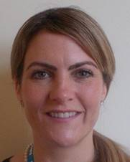
Pastoral Support
Nurse Pastoral Fellows:
Jodi Wilkinson and Paul Gosling
See student handbook for extensive list
of sources of support

Slide 8
ASK and TELL
ASK us questions
TELL us if something concerns you
Make the most of your learning experience

Slide 9
Attendance
Please let the education centre know if you are going to be absent or are off sick
Please let your team know when not attending timetabled teaching
Please register with a GP – see your handbook

Slide 10
Library
The library is open Monday to Friday 8.30am to 5.00pm. Outside these hours users can access both libraries using their Trust swipe card for 24 hour access.
If you need to contact library please email them on esh-tr.libraryservices@nhs.net
PCs are accessible in the library 24/7 using your Sussex username and password.

Slide 11
Places to visit in Eastbourne and surrounding areas
Where to go and places to visit please go to www.visiteastbourne.com

Slide 12
Q&A
Questions

