Slide 1
TTF1 Induction
27th January 2025
Welcome to East Sussex Healthcare Trust

Slide 2
Induction John Cook Room Monday 27th January 2025
08.30 | Registration and Welcome by Kings Sub Dean Dr John Somarib and consultants (breakfast / refreshments provided) Dr John Somarib (KCL Sub Dean) Dr Kamil M Quraish KCL Acute Care Block Lead) Dr Rannie Nahas(KCL –LTC Block Lead) Undergraduate Administrator – Angela Geoghegan Education Fellows Pastoral Fellow - Paul Gosling
8.40 | Welcome by Natalia Jackson (KCL)
09.15 | Welcome by Ed Fellows Rahul Karuppannan and Salwa Owasil Power Point Presentation and teaching schedule FY1s to attend
09.45 | FY1 volunteers to take TTF1 students to their respective wards for the rest of the morning- students to return at 12.00
12.00 | MDU Lunch John Cook Room

Slide 3
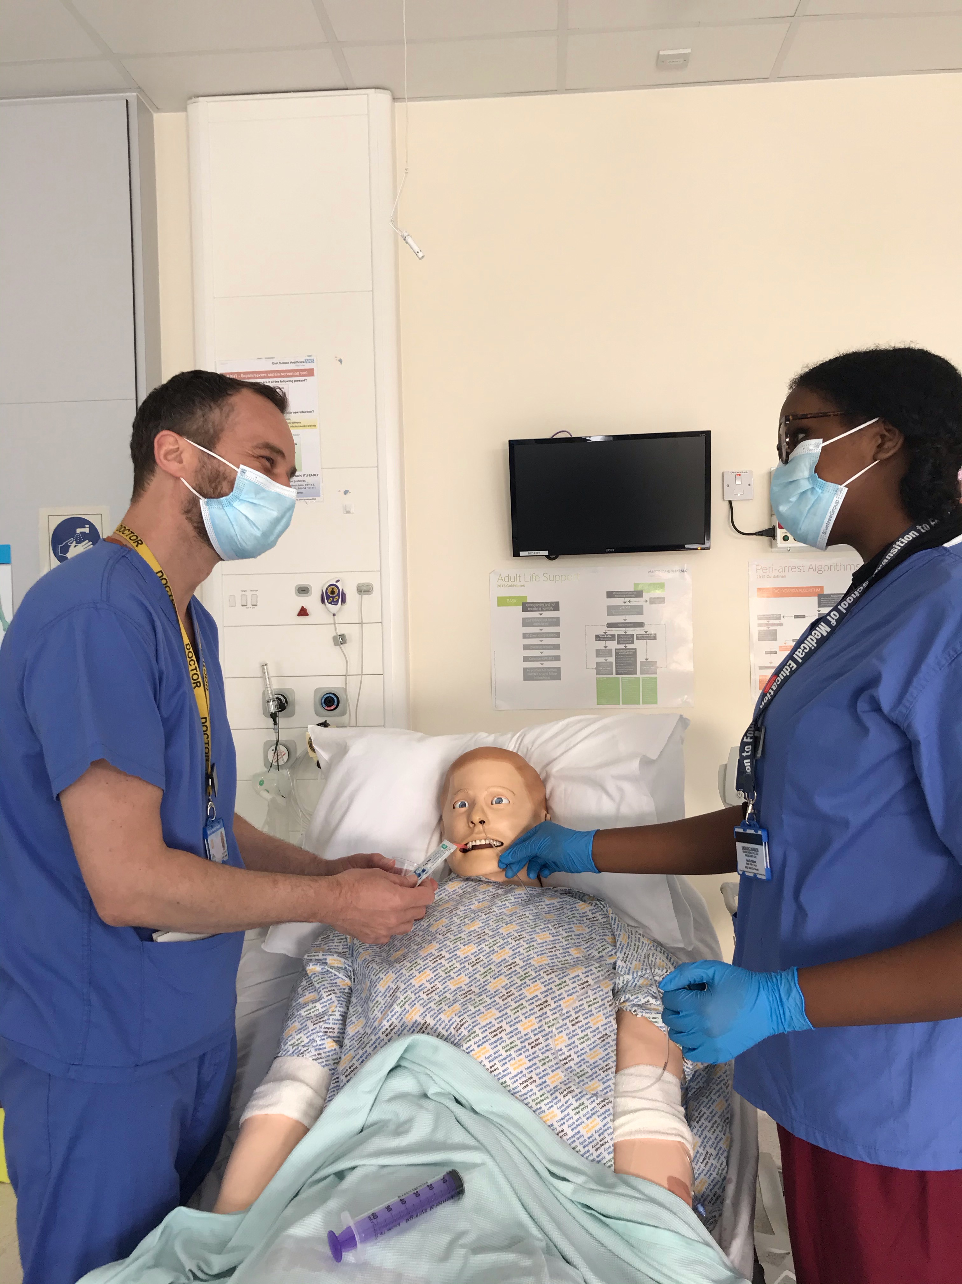
We aim to make your stay enjoyable, educational and productive whilst at East Sussex Healthcare NHS Trust.

Slide 4
Medical Student Leads
Role | Eastbourne | Conquest Hospital
KCL Sub Dean | Dr John Somarib johnsomarib@nhs.net | Dr Chris Scanlon
KCL Acute Care Block Lead: | Dr Kamil Mohammed QURAISHI, <mohammedkamil.quraishi@nhs.net | Dr S Berliti stefano.berliti@nhs.net Mr Y El-Dhuawaib yesar.el-dhuwaib@nhs.net
KCL LTC Block Lead: | Dr R Nahas rannienahas@nhs.net | Dr T Christopherson thereza.christopherson1@nhs.net

Slide 5
Educational and Pastoral Fellows
Name | Department | Email
Dr Mahmoud A I Ahmed | Cardiology | mahmoud.ahmed12@nhs.net
Dr Alessandra Cantaloni | Cardiology | alessandra.cantaloni@nhs.net
Dr Hannah Jawwad | Emergency Medicine | hannah.jawwad@nhs.net
Dr Rahul Karuppannan | Emergency Medicine | r.karuppannan@nhs.net
Dr Hani Khaldi | Acute Medicine/SDEC | hani.khaldi@nhs.net
Dr Salwa Owasil | Rheumatology/Simulation | salwa.owasil@nhs.net
Dr Samuel Rose | Palliative Medicine | samuel.rose@nhs.net
Dr Shabih Zahra | Emergency Medicine | shabih.zahra@nhs.net

Slide 6
Structured Teaching/Learning opportunity
Ward rounds and bedside teaching – Fy1
Grand rounds/ Schwartz rounds
Structured teaching/lectures
Clinics and on-Calls
Allocation to Fy1
Simulation/ skills lab
Resus and acute care teaching
voicing your educational needs
logbooks
24/7 Library
Foundation doctor-led teaching
(Tues & Thurs)

Slide 8
Time table

Slide 9
Grand Rounds on Mondays- 12:30pm lunch for 1pm Talk. Lecture Theatre
MONDAY GRAND ROUND
Timetable for Presenting Teams
1300 – 1330 Presentation
(lunch 1230)
JAN | 27th | ‘Iron Deficiency Amaneia ‘The IDA Treatment Pathway’ Tom Banner confirmed
FEB | 03rd | MDU Confirmed
 | 10th | Palliative Care Dr Farida Malik
 | 17th | HALF TERM
 | 24th | Barbara Hare & MDU Confirmed Marie Francis ‘Raising awareness of Hepatitis Services’
MAR | 03rd | Dr Alexander Confirmed Frailty
 | 10th | Dr N Sharma Respiratory
 | 17th | Dr Sebastian Gastro

Slide 10
Virtual On Call and Simulation
20th March 2pm with Dr Salwa Owasil
Mr Mohammed Kamil Quraishi

Slide 11
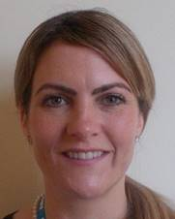
Pastoral Support
Nurse Pastoral Fellows:
Jodi Wilkinson and Paul Gosling
See student handbook for extensive list
of sources of support

Slide 12
Library
The library is open Monday to Friday 8.30am to 5.00pm. Outside these hours users can access both libraries using their Trust swipe card for 24 hour access.
If you need to contact library please email them on esh-tr.libraryservices@nhs.net
PCs are accessible in the library 24/7 using your Sussex username and password.

Slide 13
ASK and TELL
ASK us questions
TELL us if something concerns you
Make the most of your learning experience

Slide 14
Attendance
Please let the education centre know if you are going to be absent or are off sick
Please let your team know when not attending timetabled teaching
Please register with a GP – see your handbook

Slide 15
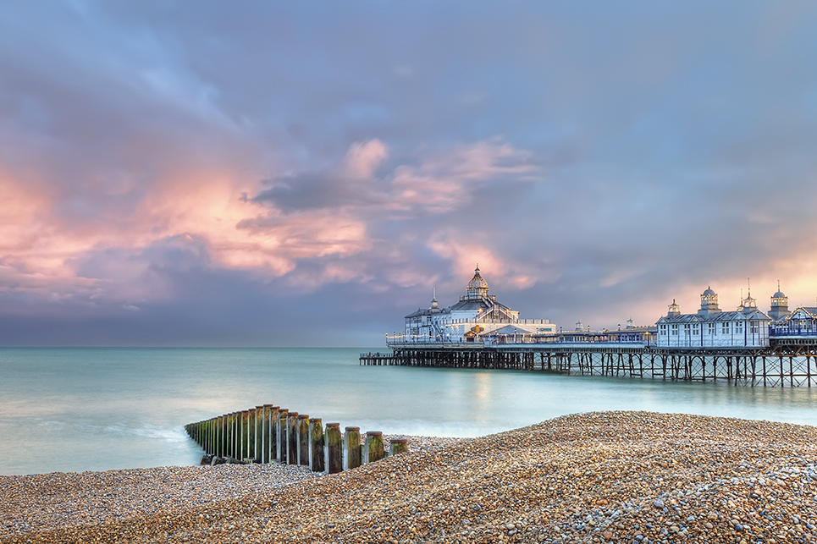
Places to visit in Eastbourne and surrounding areas
Where to go and places to visit please go to www.visiteastbourne.com

Slide 16
Q&A
Questions

