Slide 1
Horus e-portfolio
Dr Salwa Owasil
Education Fellow, Rheumatology

Slide 2
Things you’re familiar with… (hopefully)
Mini-CEX
CBD
DOPS (clinical skills) N.B rotations + suitable DOPS
PDP (before each rotation)
Reflections (1x per rotation)
QIP involvement (1x per year)
Beginning and End of Rotation Clinical Supervisor/Educational Supervisor reports

Slide 3
Other SLEs
LEADER (clinical leadership work-based review) (optional)
LEARN (learning encounter and reflection note (optional)
Developing the clinical teacher (mandatory)
All involve some form of reflection

Slide 4
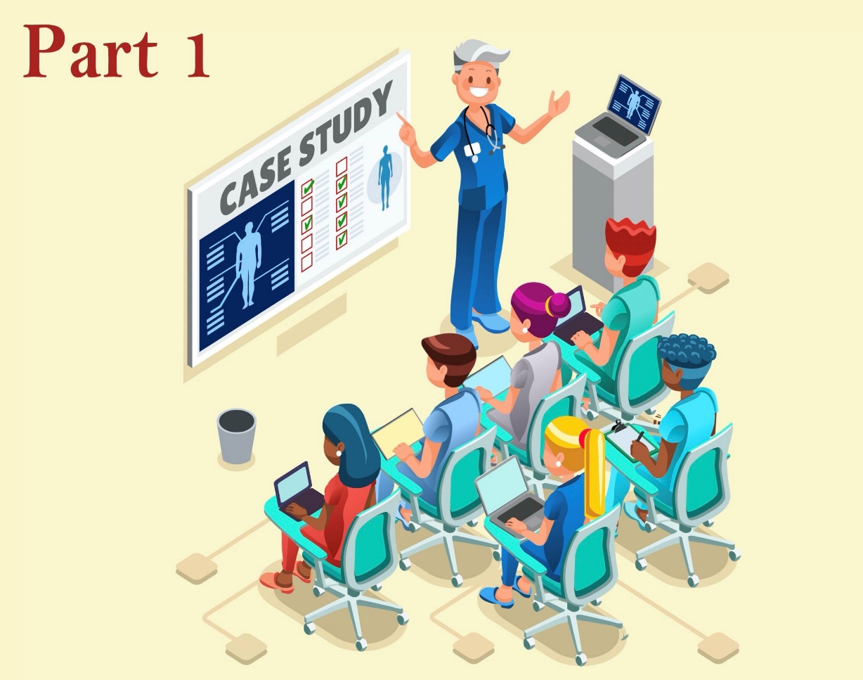
Developing the clinical teacher
Aids the development of a foundation doctor's skills in teaching and/or making a presentation
Medical students cannot sign form
Another doctor, nurse, pharmacist etc.
Record a brief, anonymous description
Gain feedback on the behaviours observed during the teaching event
Agreed action
Small reflection

Slide 5
LEADER
Leadership in a team: personal qualities, responsibilities and roles in team, effective use of team, using different leadership styles for different situations, overcoming challenges
Effective services: supervision, guidelines, feedback, time management, effective use of resources
Acting in a team: Team working, respect for others, contribution to meetings, delegating or accepting
work/responsibilities
Direction Setting: Exploring decision making skills, examining judgement, supporting others
Enabling improvement: Quality of care, patient safety, service improvements, problem solving

Slide 6
LEARN
On any clinical experience (e.g. breaking bad news)
What did I do well? What were my challenges? What was interesting or notable about this experience?
How does this reflect my current abilities?
What next? Where should I go next? What do I need to do to get there?

Slide 7
How many of each?
Depends on the Trust
Can clarify with medical education department or FPTD
Usually get helpful reminders around ARCP (Trust-dependent!)
ESHT

Slide 8
Higher learning outcomes (3)

Slide 9
Curriculum Summary Narratives
1x per HLO
Total of 13 Foundation Programme Competencies (FPCs)
Can map each SLE/learning event to a FPC
Small paragraph where you explain why/how you’ve met the relevant FPCs

Slide 13
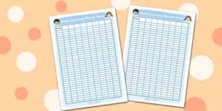
Personal learning log
A record of all the teaching you have attended
Minimum of 60 hours of learning
At least 30 hours must be core learning (mandatory)
FY1 Mandatory teaching weekly
Mandatory e-learning modules
Rest is non-core (or additional/supplementary)

Slide 14
Feedback
Placement Summary Group (PSG) 1x – your educational/clinical supervisor sends this out to various members of the team
Team Assessment of Behaviour (TAB) 1x – you send to various members of your team:
2x consultants
1x doctor F2 and above
2x senior nurses
2x allied health professionals (dieticians, physios, ward clerks)

Slide 15
Extras
Courses
Conferences
Taster weeks
Publications/presentations

Slide 16
ARCP
Around May (will vary depending on Trust)
FTPD will look through your portfolio, ensure you have met all the minimum requirements
Satisfactory completion will allow you to progress to FY2
Avoid leaving things to last minute, chasing signs off will be stressful!

Slide 17
Thank you. Any questions?
Dr Salwa Owasil

