Slide 1
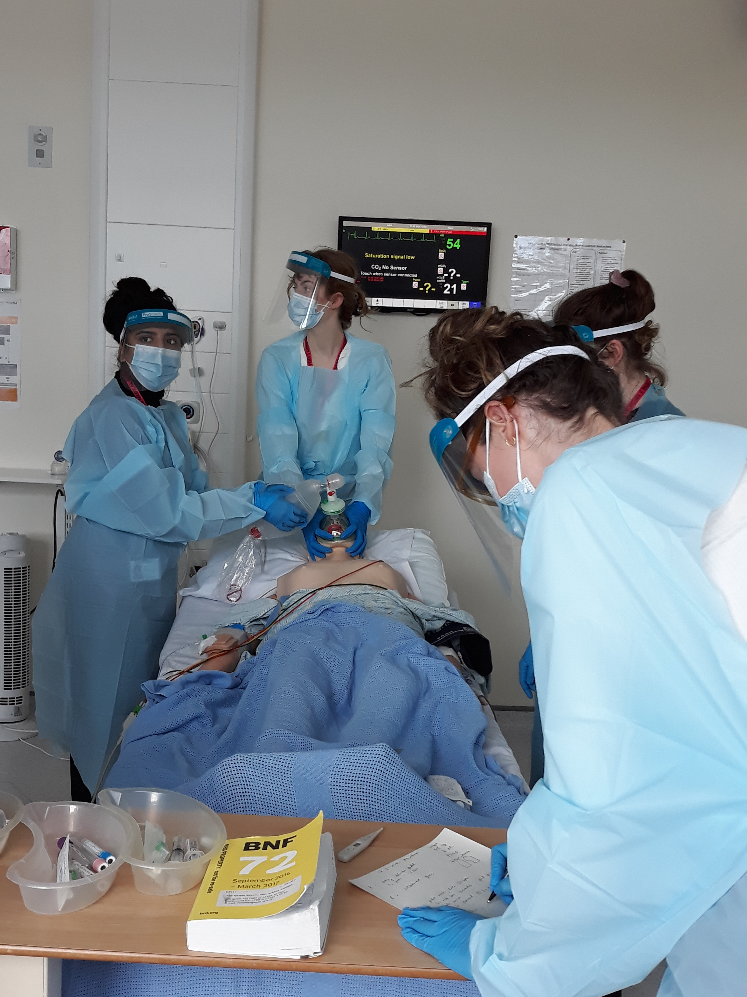
TTF1 Induction
22nd April2025
Welcome to East Sussex Healthcare Trust

Slide 2

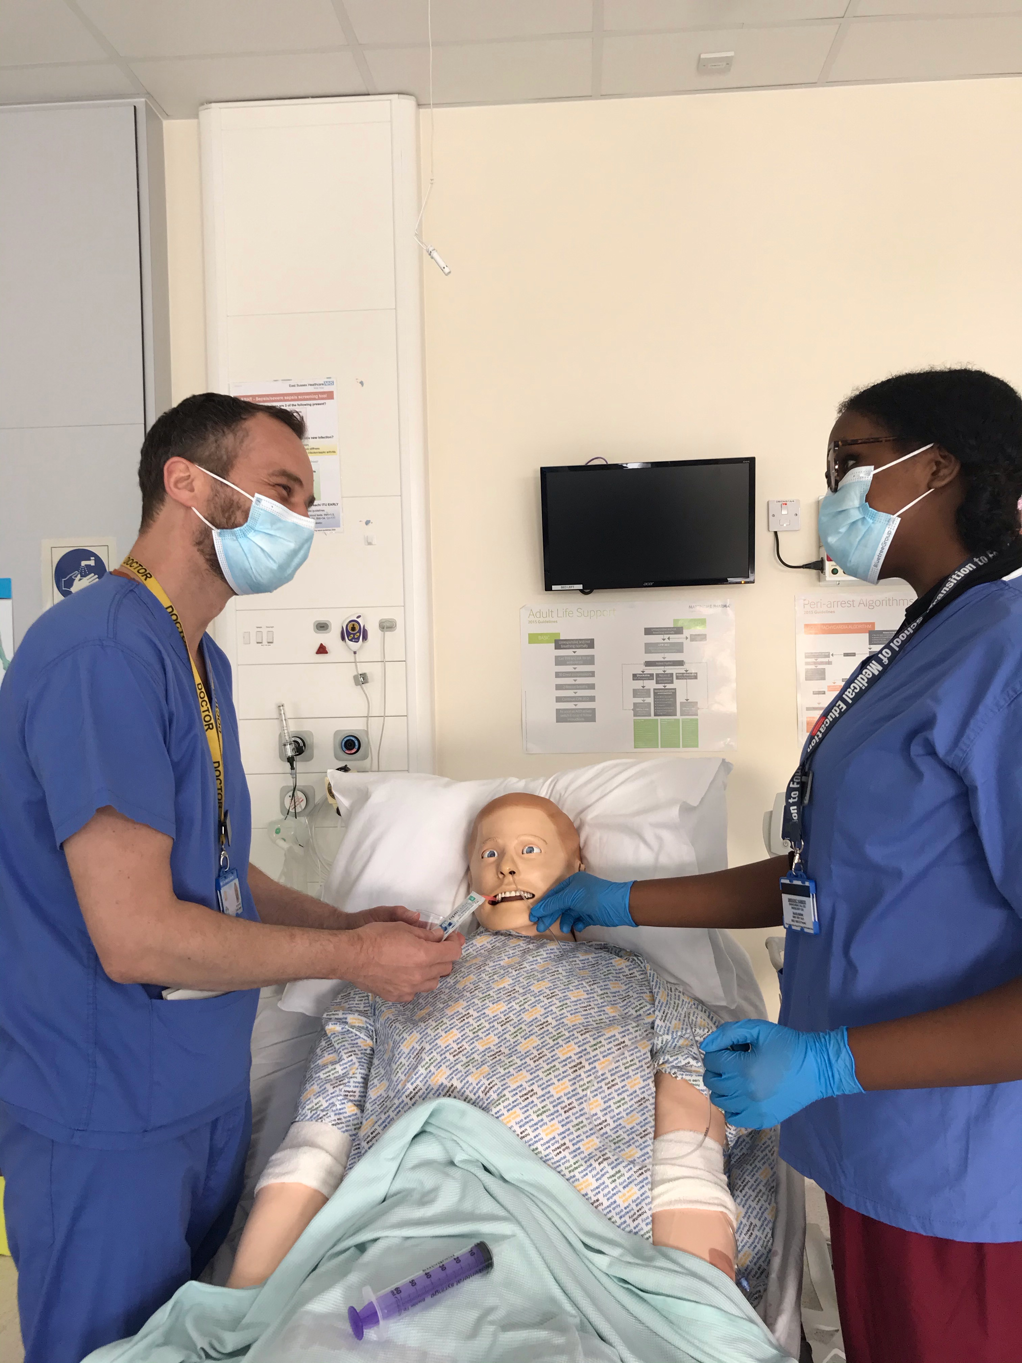
We aim to make your stay enjoyable, educational and productive whilst at East Sussex Healthcare NHS Trust.

Slide 3
Medical Student Leads
Role | Eastbourne | Conquest Hospital
KCL Sub Dean | Dr John Somarib johnsomarib@nhs.net | Dr Chris Scanlon
KCL Acute Care Block Lead: | Dr Kamil Mohammed QURAISHI, <mohammedkamil.quraishi@nhs.net | Dr S Berliti stefano.berliti@nhs.net Mr Y El-Dhuawaib yesar.el-dhuwaib@nhs.net
KCL LTC Block Lead: | Dr R Nahas rannienahas@nhs.net | Dr T Christopherson thereza.christopherson1@nhs.net

Slide 4
Educational and Pastoral Fellows
Name | Department | Email
Dr Mahmoud A I Ahmed | Cardiology | mahmoud.ahmed12@nhs.net
Dr Alessandra Cantaloni | Cardiology | alessandra.cantaloni@nhs.net
Dr Hannah Jawwad | Emergency Medicine | hannah.jawwad@nhs.net
Dr Rahul Karuppannan | Emergency Medicine | r.karuppannan@nhs.net
Dr Hani Khaldi | Acute Medicine/SDEC | hani.khaldi@nhs.net
Dr Salwa Owasil | Rheumatology/Simulation | salwa.owasil@nhs.net
Dr Samuel Rose | Palliative Medicine | samuel.rose@nhs.net
Dr Shabih Zahra | Emergency Medicine | shabih.zahra@nhs.net

Slide 5
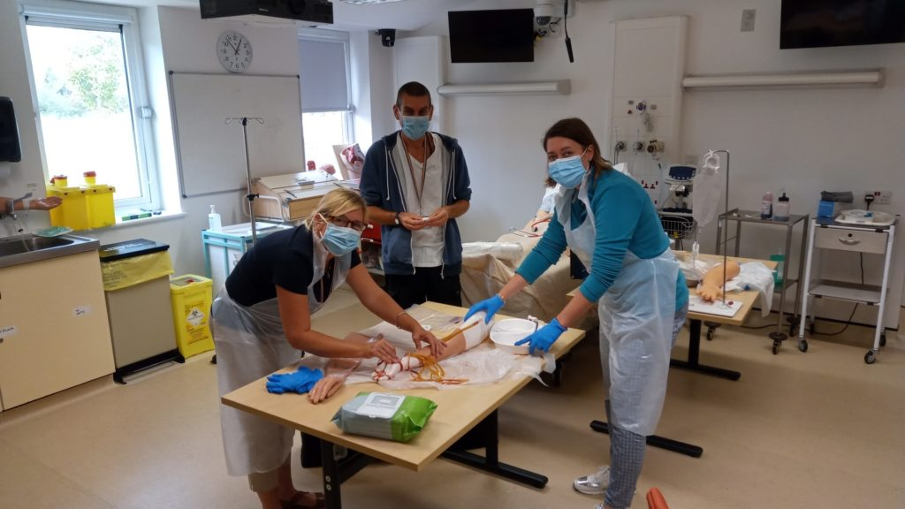
Structured Teaching/Learning opportunity
Ward rounds and bedside teaching – Fy1
Grand rounds/ Schwartz rounds
Structured teaching/lectures
Clinics and on-Calls
Allocation to Fy1
Simulation/ skills lab
Resus and acute care teaching
voicing your educational needs
logbooks
24/7 Library
Foundation doctor-led teaching
(Tues & Thurs)

Slide 6
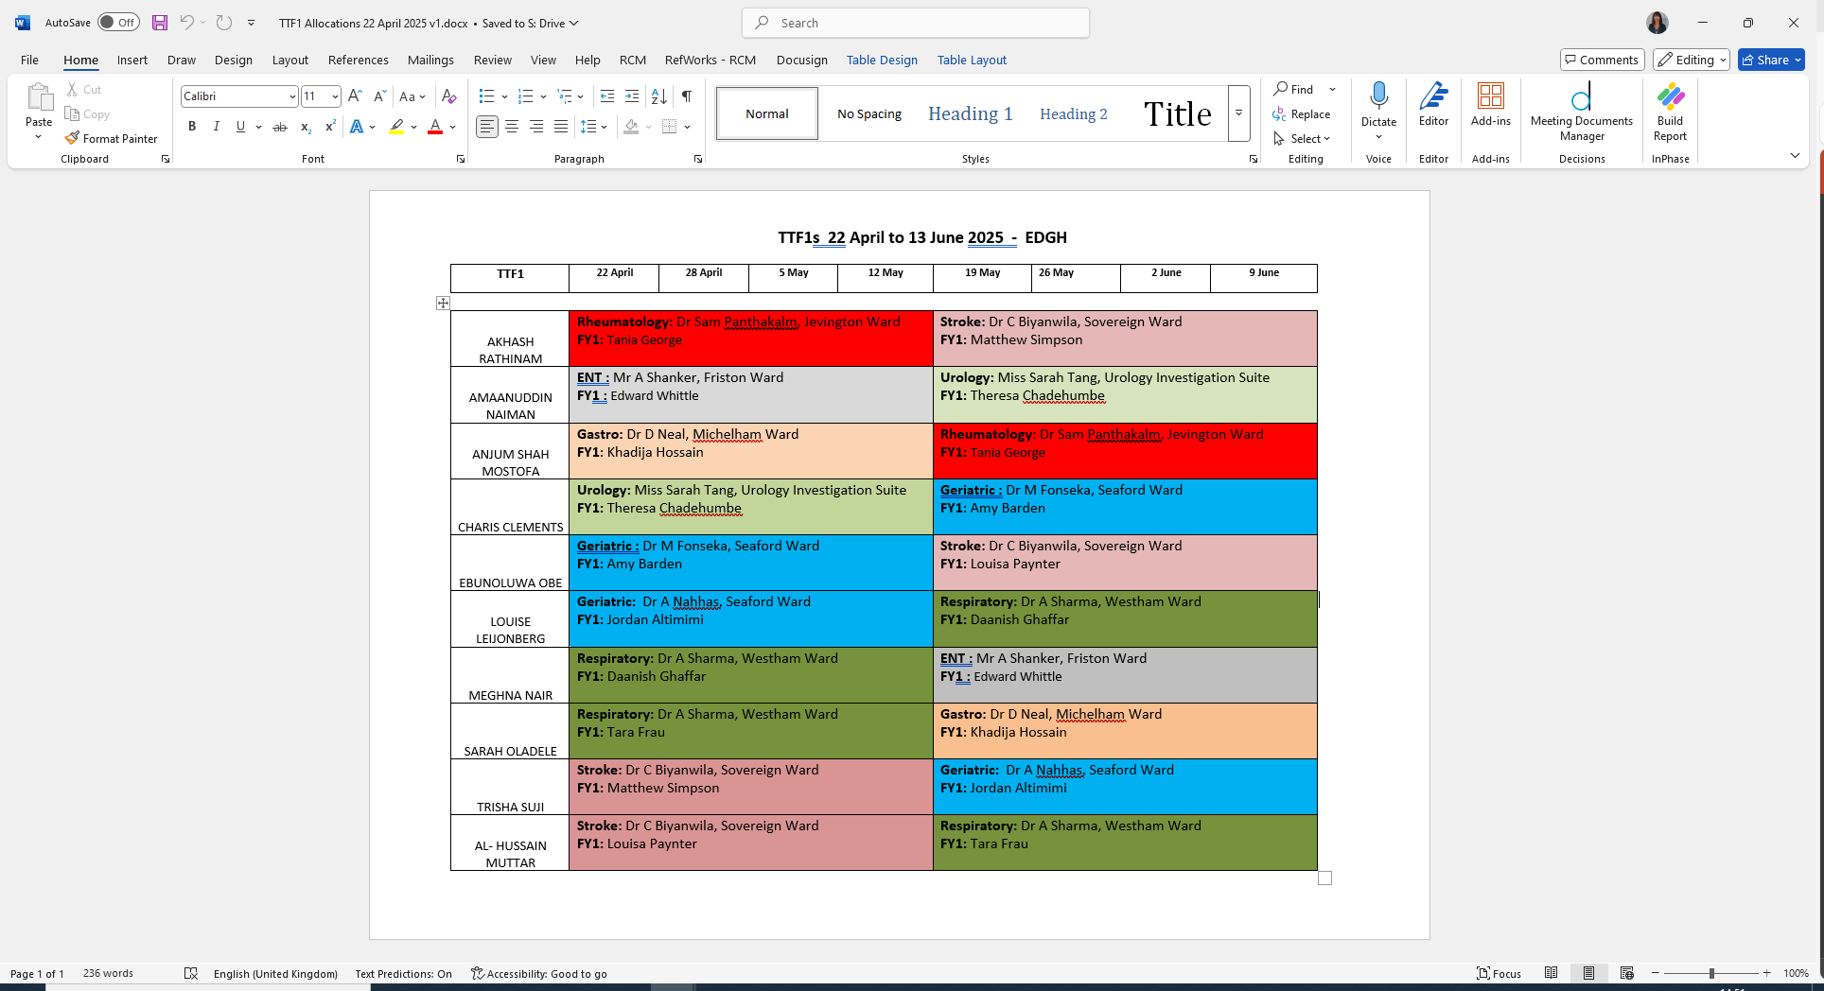

Slide 7
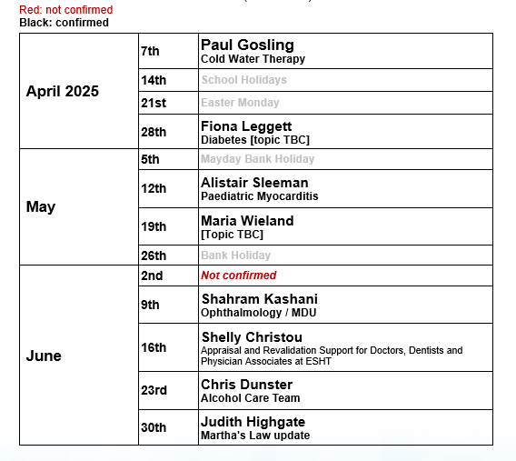
Grand Rounds on Mondays- 12:30pm lunch for 1pm Talk. Lecture Theatre
MONDAY GRAND ROUND
Timetable for Presenting Teams
1300 – 1330 Presentation
(lunch 1230)

Slide 8
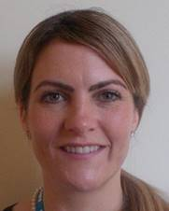



Pastoral Support
Nurse Pastoral Fellows:
Jodi Wilkinson and Paul Gosling
See student handbook for extensive list
of sources of support

Slide 9
Library
The library is open Monday to Friday 8.30am to 5.00pm. Outside these hours users can access both libraries using their Trust swipe card for 24 hour access.
If you need to contact library please email them on esh-tr.libraryservices@nhs.net
PCs are accessible in the library 24/7 using your Sussex username and password.

Slide 10

ASK and TELL
ASK us questions
TELL us if something concerns you
Make the most of your learning experience

Slide 11
Attendance
Please let the education centre know if you are going to be absent or are off sick
Please let your team know when not attending timetabled teaching
Please register with a GP – see your handbook

Slide 12
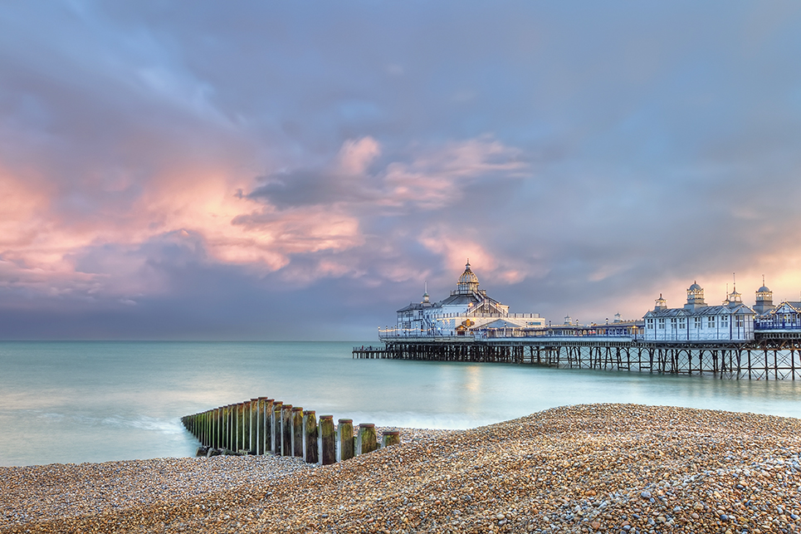
Places to visit in Eastbourne and surrounding areas
Where to go and places to visit please go to www.visiteastbourne.com

Slide 13
Q&A
Questions

