Slide 1
Library services for medical students

Slide 2
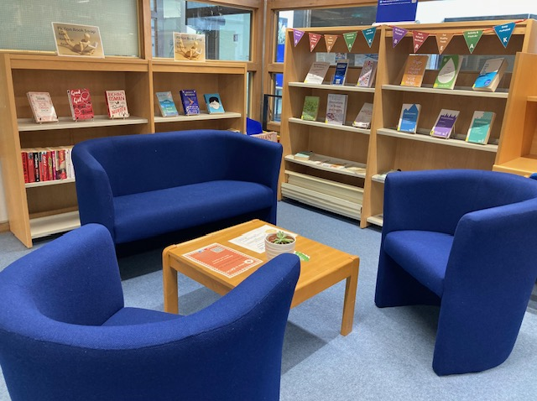
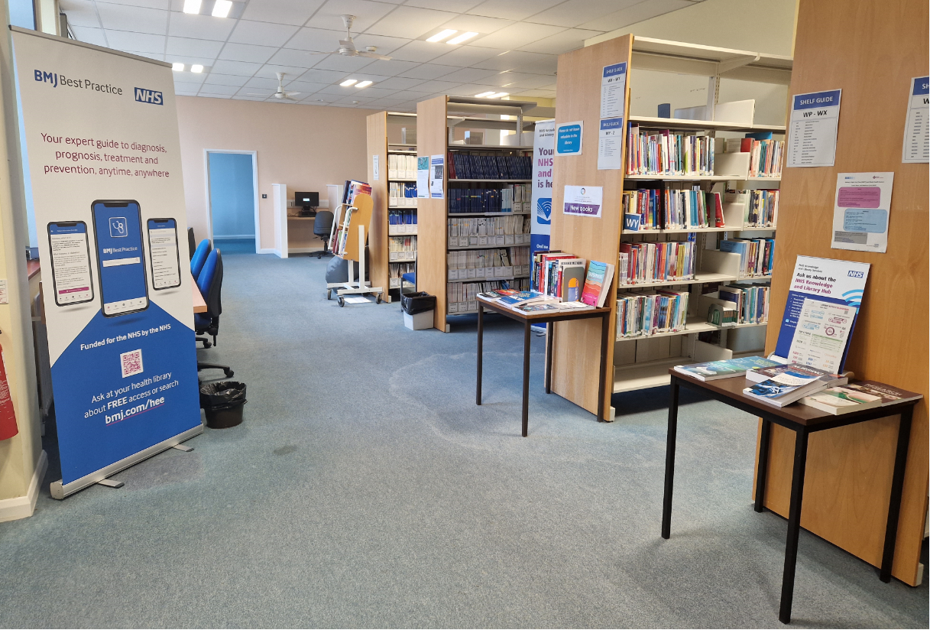
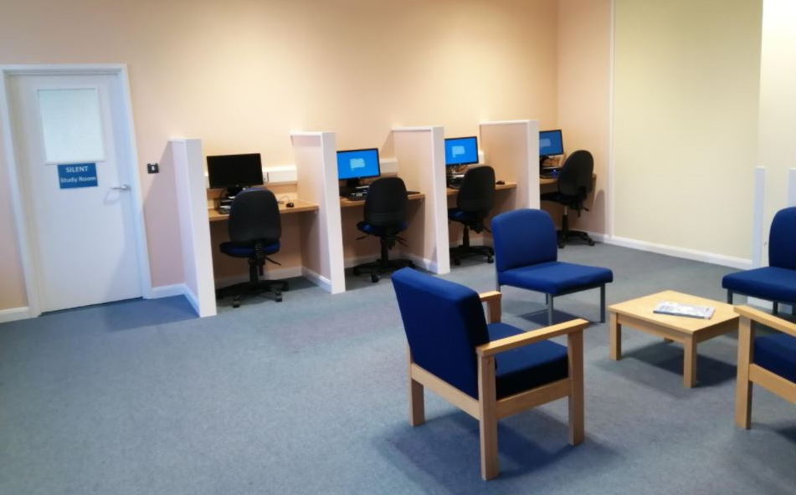
Library locations and details
Conquest library
Eastbourne DGH library
Libraries are situated in the Education Centres at both sites
Staffed Monday – Friday (8.30am – 5pm)
Use your trust ID badge to swipe in for 24/7 access

Slide 3
Useful information
Select NHS Wi-Fi
Printers located near the library issue desks
(print, scan or photocopy)
Collect printing by clicking on the ‘AD Login’ icon on the printer (enter your PC username and password)

Slide 4
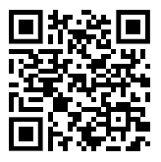
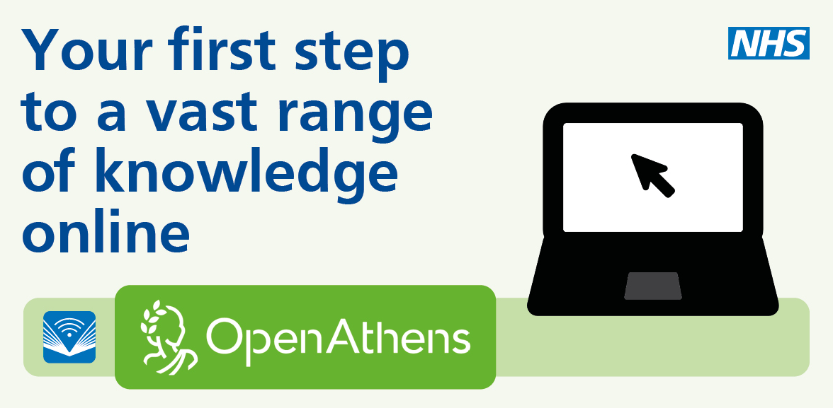
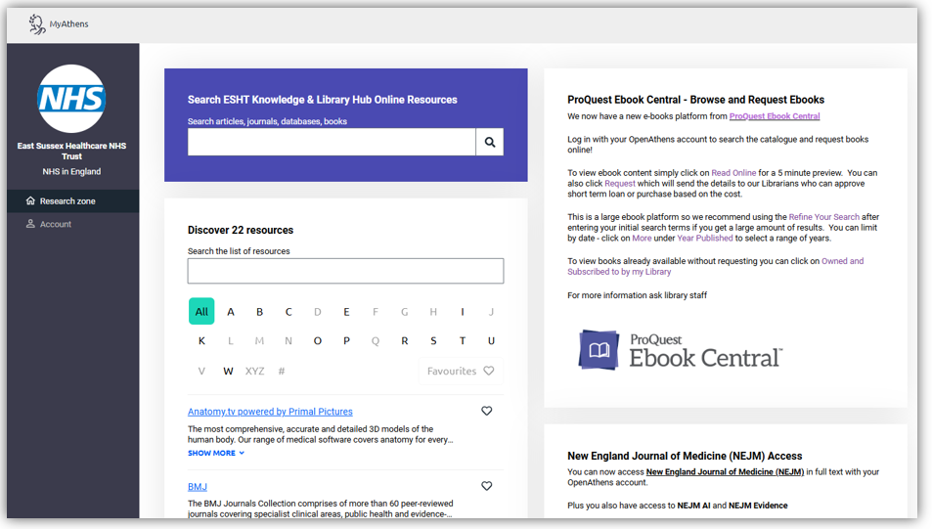
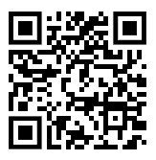
OpenAthens
Register for an NHS OpenAthens account
Access a range of online resources
Visit MyAthens to explore

Slide 5
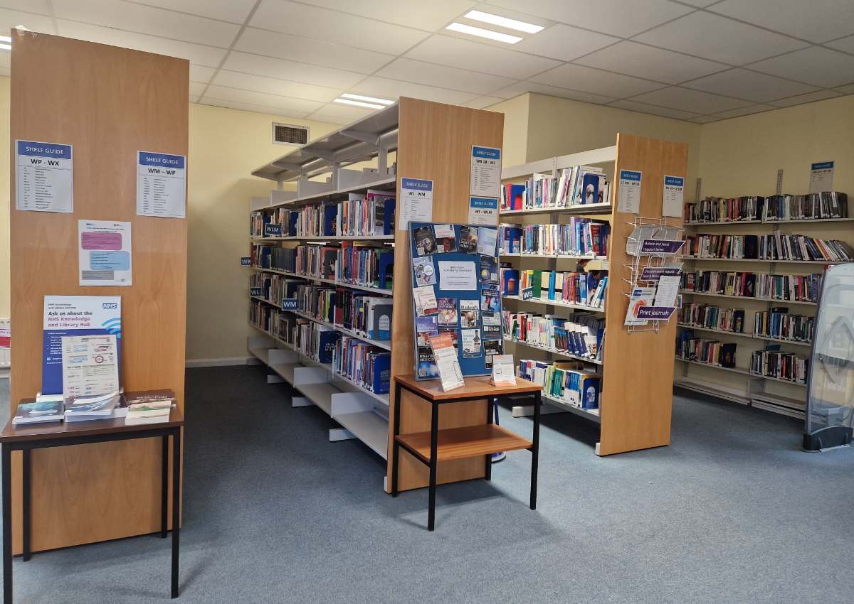
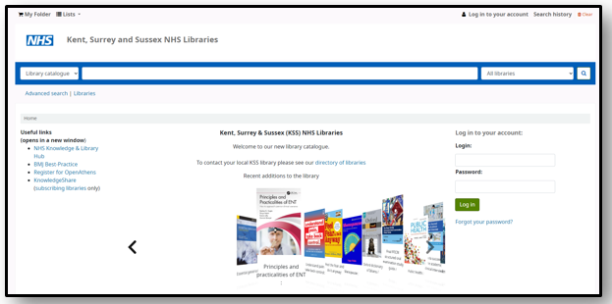
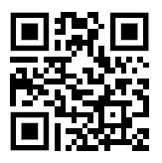
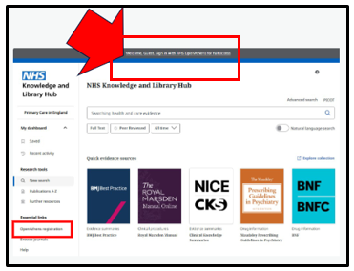
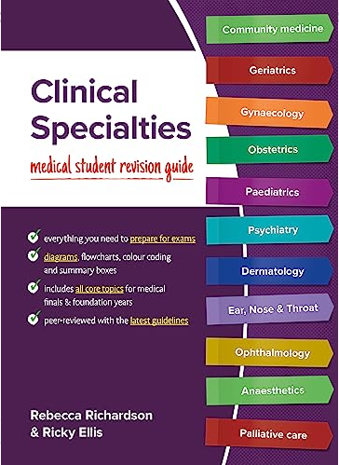
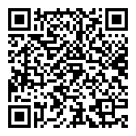
Library resources - books
Access:
physical and e-books
Search the library catalogue or the
NHS Knowledge and Library Hub:

Slide 6
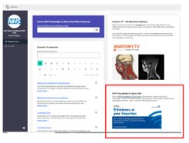
Knowledge and Library Hub
Visit the NHS Knowledge and Library Hub:​
via MyAthens or at https://library.nhs.uk/eastsussex

Slide 7
Knowledge and Library Hub
Searching the NHS Knowledge and Library Hub:​

Slide 8
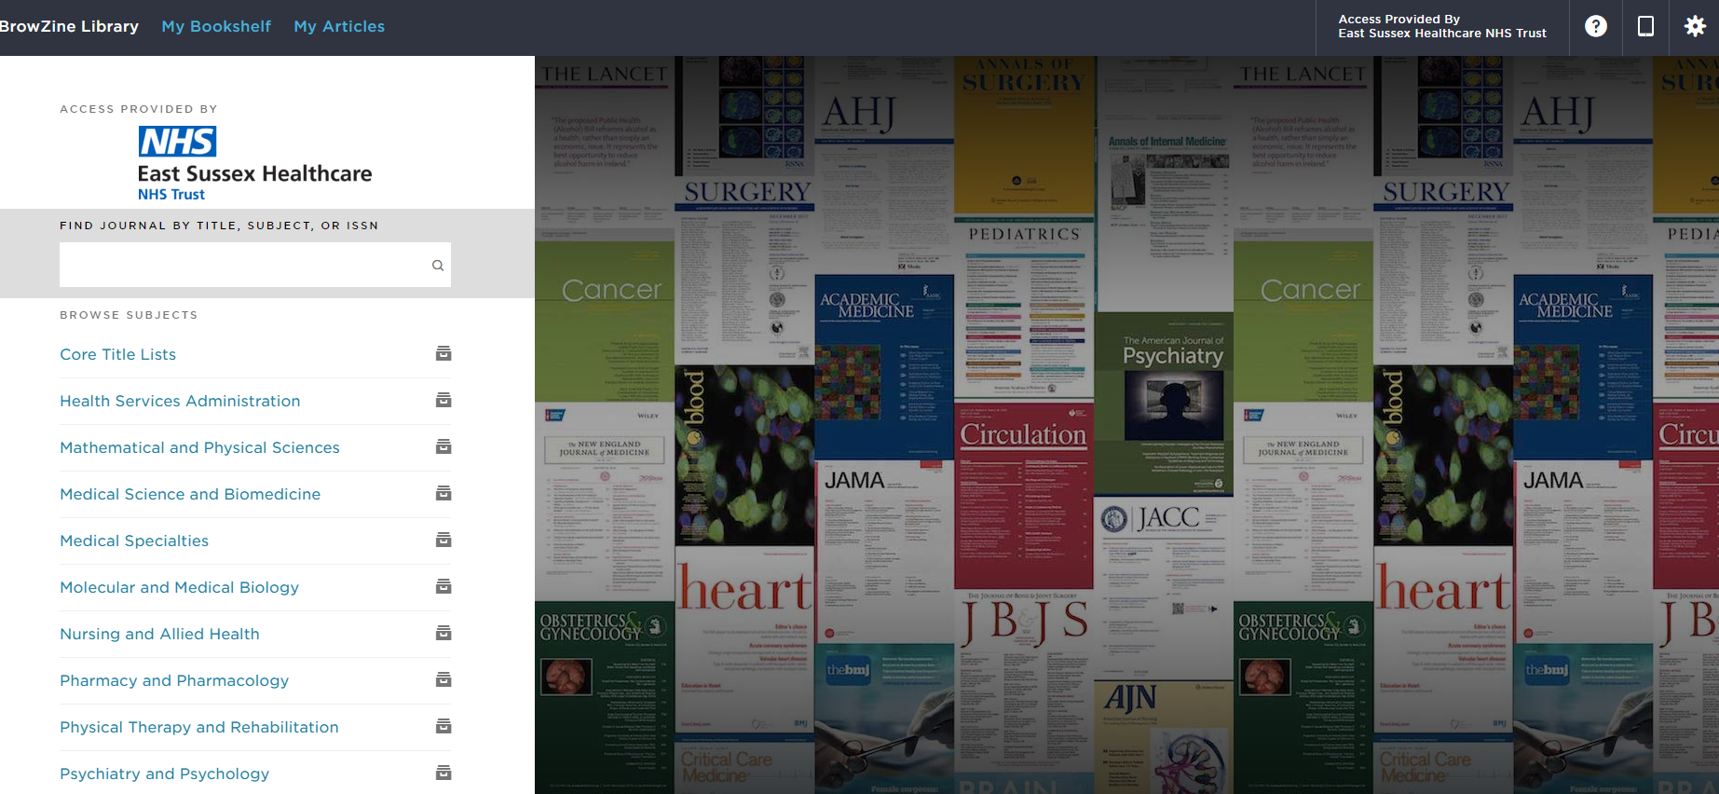
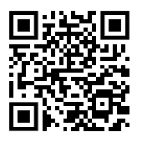
Library resources - articles
Search for articles in the NHS Knowledge and Library Hub
Request full-text articles from the library
Browse and search for journals in Browzine
Sign-up for a Browzine account to add journals to your personal bookshelf, to
save articles and to download the mobile app
Find journals by subject, title or ISSN

Slide 9
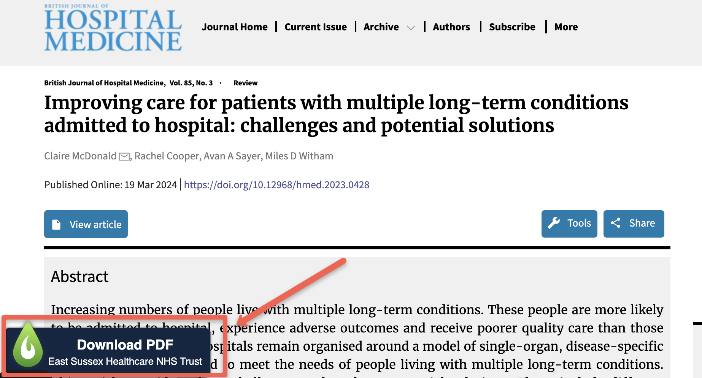
LibKey Nomad
Provides instant, free access to research articles online
Works on journal sites and PubMed
Safe, secure access to journal content through the Library
Easy install: libkeynomad.com (choose East Sussex from list)
No more paywalls or creating publisher site accounts!

Slide 10
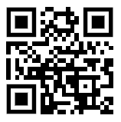
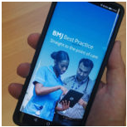
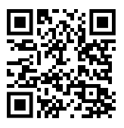
Clinical Decision Support Tools
Utilise these resources to access clinical overviews, treatment options, differential diagnosis and much more:
Both clinical decision support tools have accompanying mobile apps

Slide 11
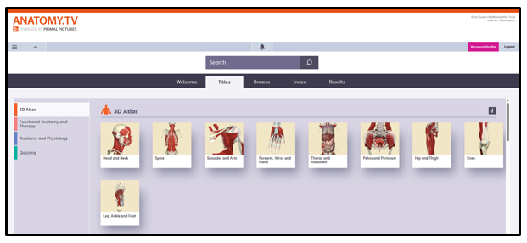
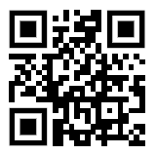
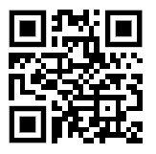
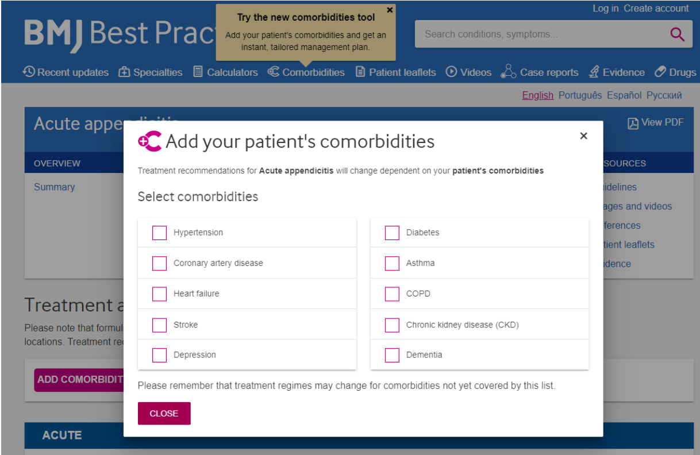
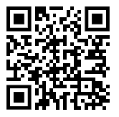
Additional resources
Anatomy TV
BMJ Case Reports
(ask for our fellowship code to submit a case report)
Comorbidities Manager on BMJ Best Practice

Slide 12
In-depth searching
Find links to the databases on the NHS Knowledge and Library Hub:
Medline
PubMed

Slide 13
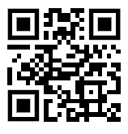
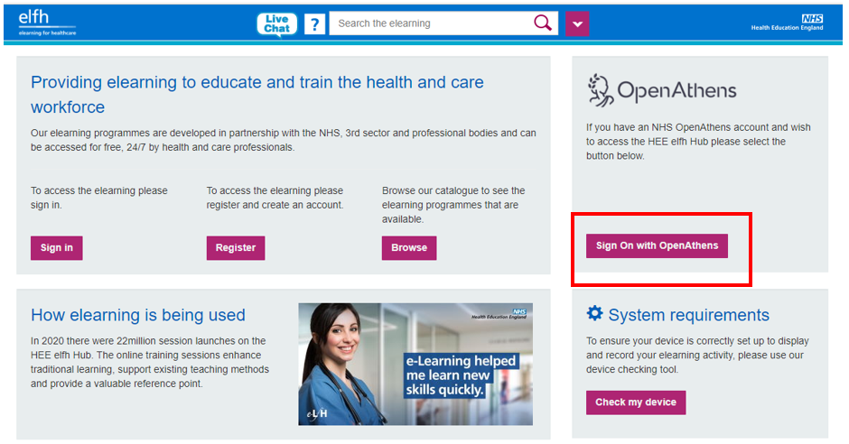
Library services
Literature searches
Training sessions (can be either face-to-face or via Microsoft Teams)
Access e-learning modules on E-learning for Healthcare
Modules include:
critical appraisal
literature searching

Slide 14
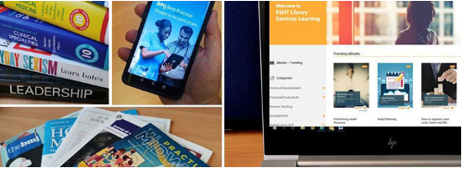
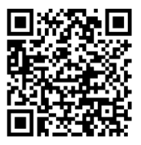
Join the library
Join online or complete our registration forms
Borrow up to 10 books for 4 weeks with 2 auto-renewals
Request journal articles
Receive current awareness bulletins and Table of Contents alerts
Register for NHS OpenAthens or update your account
Download mobile apps
Access the physical spaces 24/7

Slide 15
Contact details
The Education Centre, Conquest Hospital ☎️ 0300 131 5221 Ext: 770493
The Education Centre, Eastbourne DGH ☎️ 0300 131 4500 Ext: 770593
​
📧 esht.libraryservices@nhs.net

