Slide 1

Acute Care Block Induction
Dr. Amrita Kiran (A&E Educational Fellow)
Dr. Mohammed Quraishi, Consultant Urologist (Acute Care Block Lead; KCL)

Slide 2
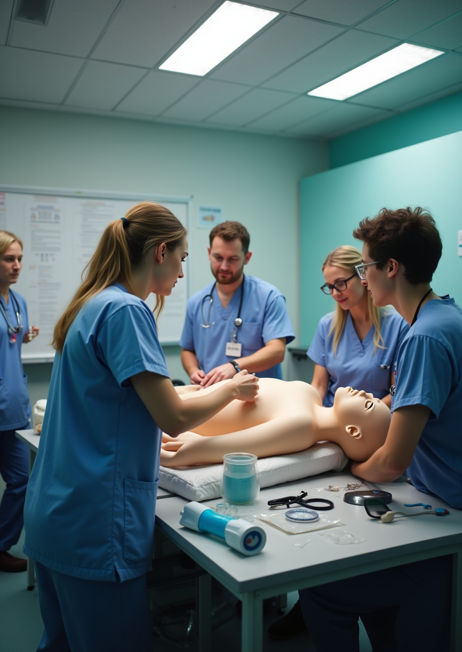
Block Overview
•Interactive Lessons on acute medical surgical emergencies
•Simulation (SIM) sessions
•OSCE preparation
•Case-Base Discussions (CBDs)
•Regular bedside teaching
•Weekly catch-up meetings

Slide 3
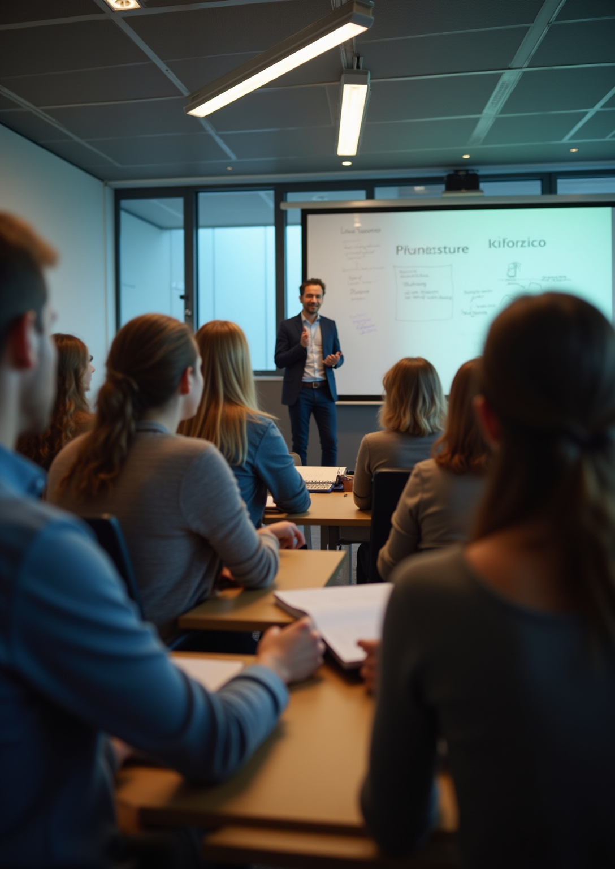
Attendance Policy
Ensure you attend all compulsory lessons and sessions!

Slide 4
Teaching Timetable (August)
•21 Aug: Acute Abdominal Pain - Dr Mayas Rddah, 2–3:30pm, Clinical Skills Room
•22 Aug: All-Day SIM, 8:15am, Education Centre (Mandatory Sign-Off)
•26 Aug: Pharmacy/Prescription Teaching - Dr Rwan Adi, 11–12, DH2 (Mandatory)

Slide 5
Teaching Timetable (September)
•04 Sep: Prescription Talk - Dr Nahhas, 3–4pm (Mandatory Sign-Off)
•09 Sep: Resus Training - Steve Rochester, 2–3pm, Resus Room
•22 Sep: Joint Examination - Dr Jacob, Debrief Room (Mandatory Sign-Off)
•25 Sep: Chest Pain - Dr Amrita, 9–11am, JC
•30 Sep: Respiratory Emergencies - Dr Amrita

Slide 6
Teaching Timetable (October)
•02 Oct: SIM session, 9–11:30am, LT
•03 Oct: Surgical Emergencies - Dr Mayas Rddah, 9–11am, DH1
•03: Upper GI Bleed - Dr Amrita, 1:30–3:30pm, DH1
•06 Oct: CBDs - Dr Amrita, 9–12, SR3

Slide 7
Points of contact
For educational support and clinical supervision during the block, contact :
-Dr. Amrita Kiran (A&E Educational Fellow)
-Dr. Mohammed Quraishi, Consultant Urologist (Acute Care Block Lead; KCL)

Slide 8
“Your F1 Rehearsal Starts Here”
📅 Every ward round, every bedside teaching, every SIM is a safe rehearsal for next year.
👏 Engage fully, and you’ll walk into F1 ready, resilient, and confident.
🌟 Make this block your turning point.

Slide 9

Thank you!
Do you have any questions?

