Slide 1

KCL Y5 LTC Programme Block 6
Dr Kashmira Jeeva
Educational Fellow, KCL LTC Lead
Kashmira.jeeva1@nhs.net
Consultant Block lead: Dr Rannie Nahas
rannienahas@nhs.net

Slide 2
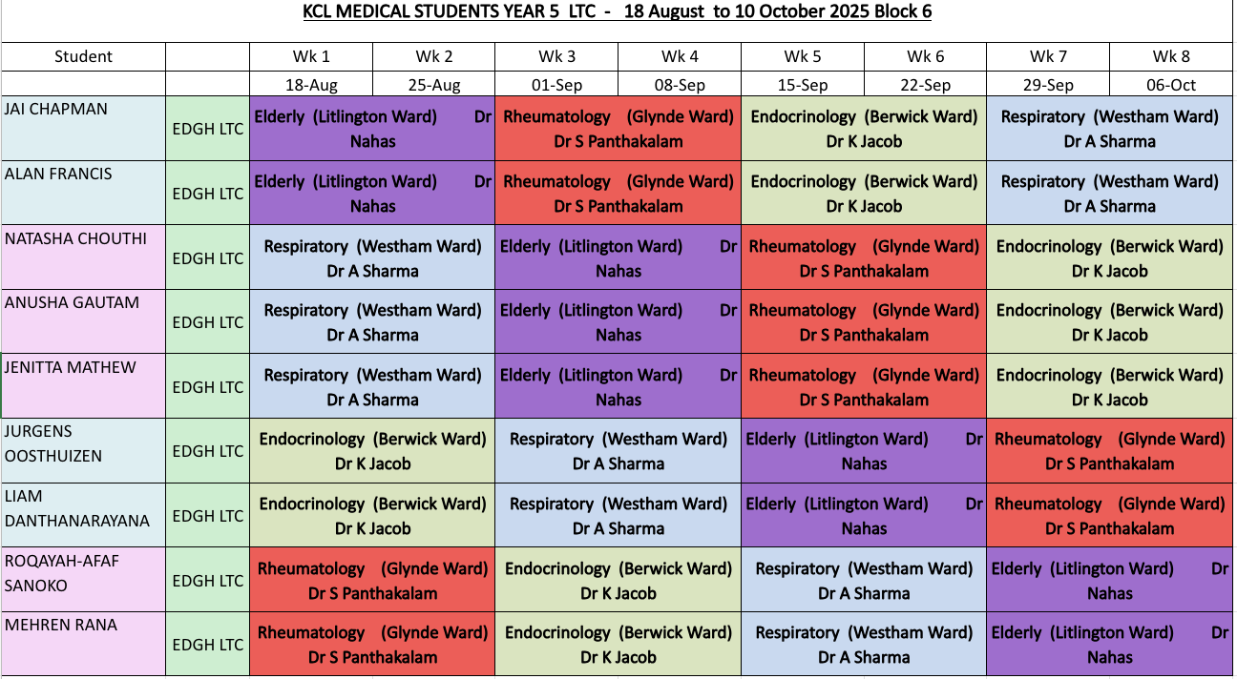

Slide 3
Workplace based Monitored Sign offs (Mandatory)
Catherine Watsham
Matron in Outpatients
catherine.watsham@nhs.net
Wendy Fletcher.
EDGH General Outpatient Administrator
wendy.fletcher1@nhs.net
Notes:
Catherube watsham – matron in outpatients
Make a list of clinics, changes weekly
Chemotherapy – pevensey

Slide 4
Classroom/ Lecture based Monitored Sign offs (Mandatory)
Lecture on chronic diseases 1:
Attendance ensures sign off
Lecture on chronic diseases 2 :
Attendance ensures sign off
Lecture on Prescribing done
Attendance ensures sign off
Lecture on Palliative care in long term/End stage diseases
Attendance ensures sign off

Slide 5
Patient case presentation
Dr Kashmira Jeeva (Litlington ward) Kashmira.jeeva1@nhs.net | Natasha Chouthi Anusha Gautham Jenitta Matthew
Dr Ami Davies (Glynde ward) ami.davies1@nhs.net | Roqayah-Afaf Sanoko Mehren Rana
Dr Ayesha Sarwar (Berwick ward) ayesha.sarwar@nhs.net | Jurgens Oosthuizen Liam Danthanarayana
Dr Ahmed Osman (Westham ward) ahmed.osman37@nhs.net | Jai Chapman Alan Francis

Slide 6
Weekly Tutorials
21/08/2025 Frailty | Dr Francesca | 2-3pm Duncan House TR1
02/09/2025 Prescribing * | Rwan Adi | 11am-12 noon Duncan House Room 2
04/09/2025 Prescribing Practice | Dr Rannie Nahas | 3-4pm John Cook
11/09/2025 Parkinson's * | Dr Rannie Nahas | 3-4pm Seminar Room 3
18/09/2025 Palliative Care in Long Term/ End Stage Diseases * | Dr Ella/ Kash | 3-4pm Clinical Skills Room
25/09/2025 COPD * | Dr Mariam | 3-4pm Clinical Skills Room
02/10/2025 Diabetes Mellitus | Dr Osman (SHO) or James Corner | 3-4pm Seminar Room 3
09/10/2025 Rheumatoid Arthritis | Dr Kashmira Jeeva | 3pm - 4pm Clinical Skills Room
* Mandatory session
Notes:
Preacribing practice – more for guidelines and hands on, scenarios 8 mins

Slide 7
Bedside teaching
Once a week, PM session – 2pm
19/8/25 | Dr Jeeva (Litlington) Jai Chapman Alan Francis Liam Danthanarayana Dr Nejma (SDEC) Roqayah-Afaf Sanoko Mehren Rana Jurgens Oosthuizen Dr Rand (Glynde ward) Natasha Chouthi Anusha Gautham Jenitta Matthew
28/8/25
2/9/25
9/9/25
16/9/25
23/9/25
30/9/25
7/10/25

Slide 8
Mock OSCEs
CBDs
8/9/25 | Chronic Fatigue Syndrome or Myalgic Encephalomyelitis | Kash | TBC
15/9/25 | Multiple myeloma | Kash | TBC
29/9/25 | Occupational lung disease | Clarissa (FY2) | TBC
1/9/25 | Rhiannon (F2), Osman (SHO) | TBC
22/9/25 | Sofia(F1), Safia (F1) | TBC
6/10/25 | Sofia(F1), Ella (SHO) | TBC
Notes:
Mock osce - Not a circuit!!!!!!!!!!!!
Ask angela if can extend session – making it 3 hours

Slide 9
Simulation session
12/9/25 LTC SIM - SIM room
Purely for leaning, No assessment!
Notes:
Delirium
COPD exacerbation
HHS/DKA
GCA – Headache
*make scenarios
Change date to 12/9 for block 6

Slide 10
Resus training
9/9/25 - 2-3pm with Steve Rochester, RESUS Training Room
s.rochester@nhs.net
Notes:
RESUS – e-mail steve rochester regarding content covered for these sessions. Just to explain to students what will be covered

Slide 11
Weekly catch-up sessions with Dr John Somarib
Each Thursday lunch time – usually MSTEAMS
Notes:
maybe add guidance to what expect and what we want to hear from them (there is a list Angela might have: points asked on the day to students

Slide 12
SBA Questions
Material has been emailed, so you can study self-guided. If you’ve any questions, get back to me.

Slide 13
Industrial Action
Any teaching is expected to be cancelled/ rescheduled.
You will be notified from the Education team.

Slide 14
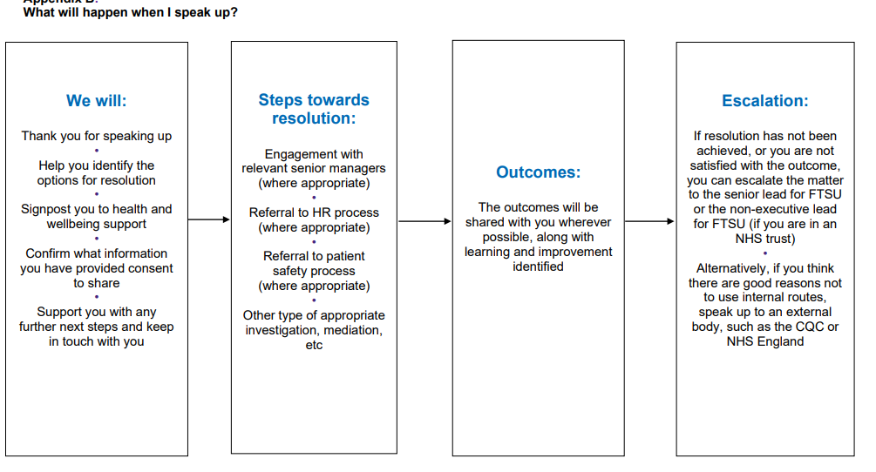
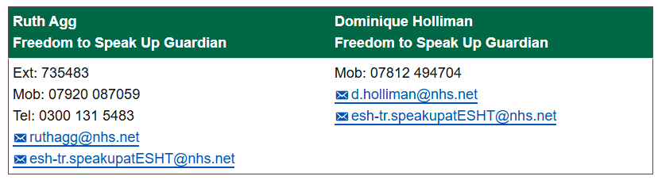
If you experience bullying, harassment or inappropriate comments
Speak to someone you trust – you are not alone
Speak to me or other fellows
Supervisors
Freedom to Speak up Guardian
Notes:
Add a slide to sign post what to do in case (bullying/harassment/in appropriate comments) - there a chart at the freedom to speak guardian you can justuse.

Slide 15
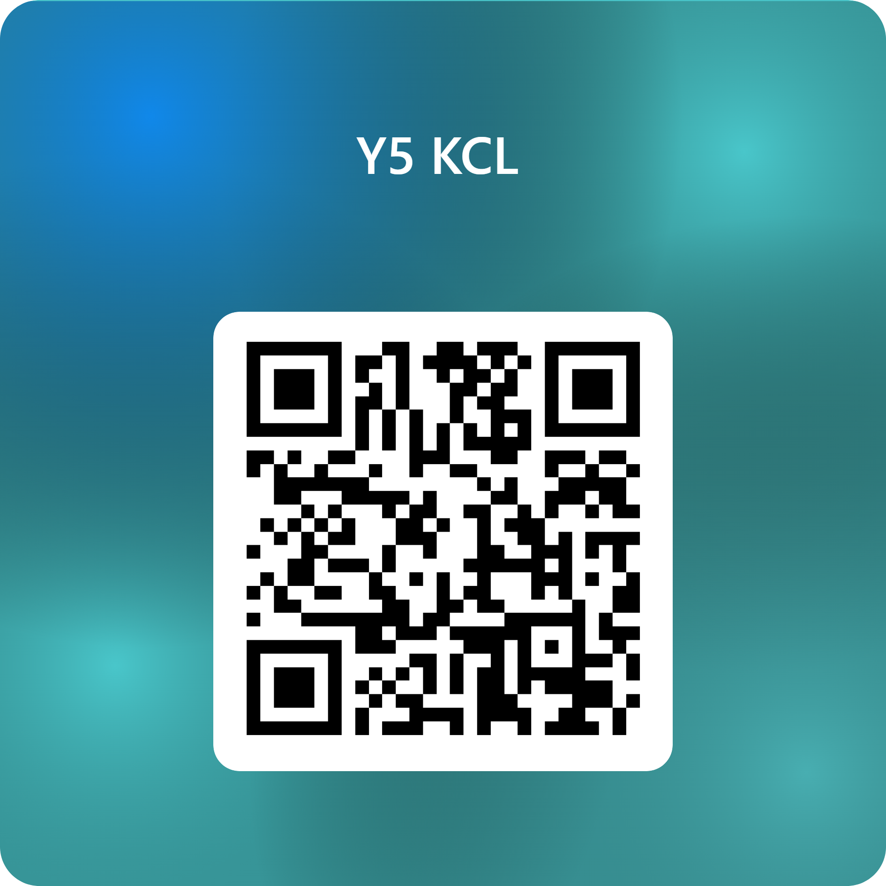
Enjoy your placement at EDGH! ☺
Do complete this form!
Notes:
Put an extra slide about industrial action – sessions likely to be cancelled and rescheuled – you'll be notified
Make lession plan? Basically listing objectives (e-mail dawn regarding lesson plan template, discussed with dr rannie)
Make an extra slide – what do you want covered – would you attend ABG interpretation
https://forms.office.com/e/s1iYT3bR0g

