Slide 1

KCL Y5 LTC Programme Block 7
Dr Kashmira Jeeva
Educational Fellow, KCL LTC Lead
Kashmira.jeeva1@nhs.net
Consultant Block lead: Dr Rannie Nahas
rannienahas@nhs.net

Slide 2
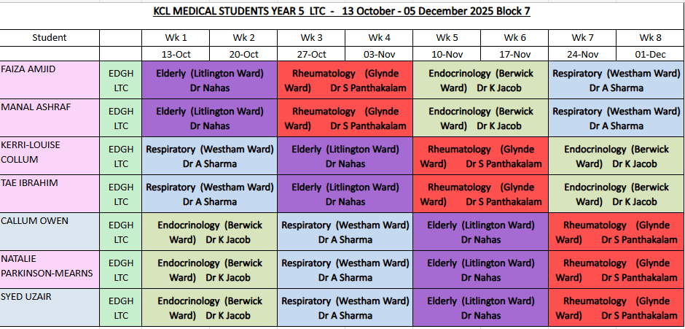

Slide 3
Workplace based Monitored Sign offs (Mandatory)
Catherine Watsham
Matron in Outpatients
catherine.watsham@nhs.net
Notes:
Catherube watsham – matron in outpatients
Make a list of clinics, changes weekly
Chemotherapy – pevensey

Slide 4
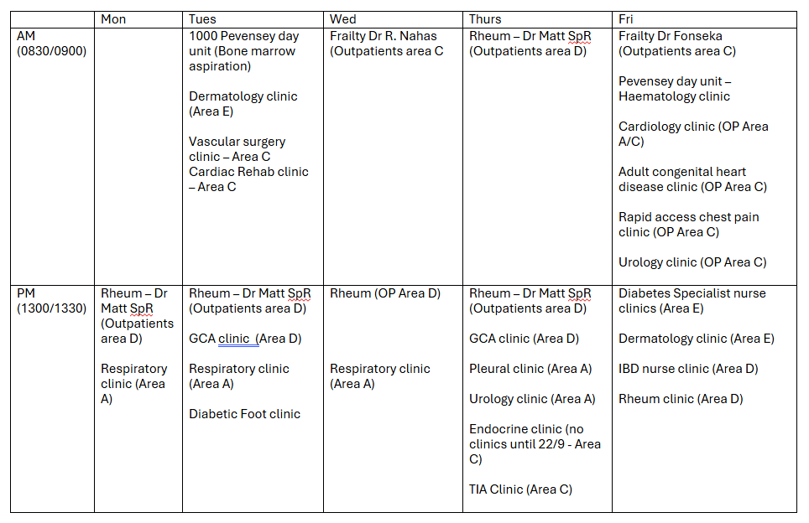

Slide 5
Classroom/ Lecture based Monitored Sign offs
Lecture on chronic diseases 1: COPD
Attendance ensures sign off
Lecture on chronic diseases 2 : Parkinson's
Attendance ensures sign off
Lecture on Prescribing (Rwan Adi)
Attendance ensures sign off
Lecture on Palliative care in long term/End stage diseases
Attendance ensures sign off

Slide 6
Patient case presentation
Dr Kashmira Jeeva (Litlington ward) Kashmira.jeeva1@nhs.net | FAIZA AMJID MANAL ASHRAF SYED UZAIR
Dr Ami Davies (Glynde ward) ami.davies1@nhs.net | KERRI-LOUISE COLLUM TAE IBRAHIM
Dr Ayesha Sarwar (Berwick ward) ayesha.sarwar@nhs.net | CALLUM OWEN NATALIE PARKINSON-MEARNS

Slide 7
Weekly Tutorials
23/10/2025 Frailty | Dr Manali Sankhe | 1400 DH TR2
14/10/25 Prescribing * | Rwan Adi | 10.30-11.30 Lecture Theatre
30/10/2025 Prescribing Practice | Dr Rannie Nahas | 3-4pm John Cook
18/11/2025 Parkinson's * | Dr Rannie Nahas | 1530- 1630 Sara Hampson
4/12/2025 Palliative Care in Long Term/ End Stage Diseases * | Dr Ella | 3-4pm Clinical Skills Room
13/11/2025 COPD * | Dr Mariam | 4-5pm Clinical Skills Room
28/10/2025 Diabetes Mellitus | Dr James Corner | 3-4pm Seminar Room 3
6/11/2025 Rheumatoid Arthritis | Dr Kashmira Jeeva | 3pm - 4pm Seminar Room 3
* Monitored sessions
Notes:
Preacribing practice – more for guidelines and hands on, scenarios 8 mins

Slide 8
Bedside teaching
Once a week, PM session, likely every tuesday

Slide 9
Mock OSCEs
CBDs
27/10/25 | Chronic Fatigue Syndrome or Myalgic Encephalomyelitis | Kash | Sara Hampson
10/11/25 | Multiple myeloma | Kash | Sara Hampson
24/11/25 | Occupational lung disease | Clarissa (FY2) | Sara Hampson
3/11/25 | Mock OSCE 1 | SR3 room
17/11/25 | Mock OSCE 2 | CS room
27/11/25 | Mock OSCE 3 | CS room
Notes:
Mock osce - Not a circuit!!!!!!!!!!!!
Ask angela if can extend session – making it 3 hours

Slide 10
Simulation session
7/11/25 LTC SIM - SIM room
Purely for learning, no assessment!
Notes:
Delirium
COPD exacerbation
HHS/DKA
GCA – Headache
*make scenarios
Change date to 12/9 for block 6

Slide 11
Resus training
23/1/25 1-2pm with Steve Rochester, RESUS Training Room
s.rochester@nhs.net
Notes:
RESUS – e-mail steve rochester regarding content covered for these sessions. Just to explain to students what will be covered

Slide 12
Weekly catch-up sessions with Dr John Somarib
Each Thursday lunch time – usually MSTEAMS
Notes:
maybe add guidance to what expect and what we want to hear from them (there is a list Angela might have: points asked on the day to students

Slide 13
SBA Questions
Material has been emailed, so you can study self-guided. If you’ve any questions, get back to me.

Slide 14
Industrial Action
Any teaching is expected to be cancelled/ rescheduled.
You will be notified from the Education team.

Slide 15
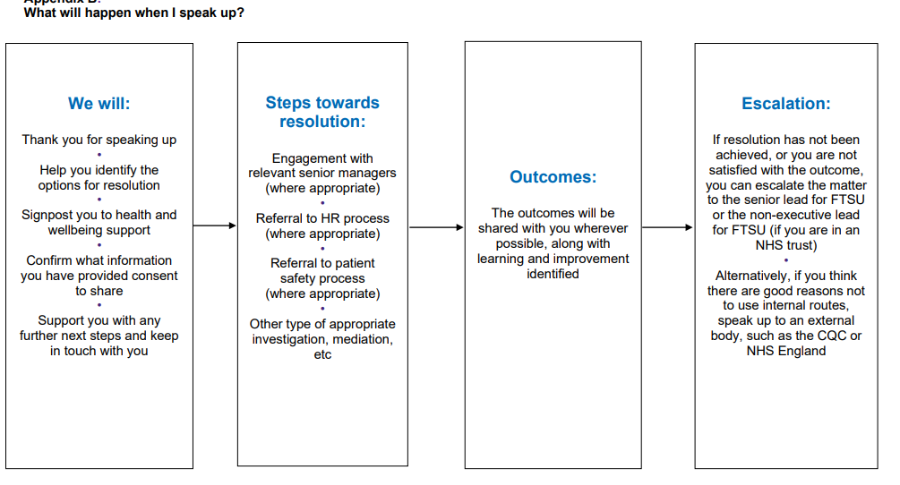

If you experience bullying, harassment or inappropriate comments
Speak to someone you trust – you are not alone
Speak to me or other fellows
Supervisors
Freedom to Speak up Guardian
Notes:
Add a slide to sign post what to do in case (bullying/harassment/in appropriate comments) - there a chart at the freedom to speak guardian you can justuse.

Slide 16

Enjoy your placement at EDGH! ☺
Do complete this form!
Notes:
Put an extra slide about industrial action – sessions likely to be cancelled and rescheuled – you'll be notified
Make lession plan? Basically listing objectives (e-mail dawn regarding lesson plan template, discussed with dr rannie)
Make an extra slide – what do you want covered – would you attend ABG interpretation
https://forms.office.com/e/s1iYT3bR0g

