Slide 1
Welcome to Eastbourne District General Hospital
KCL Year 5 Medical Students
^{13th} Oct 2025

Slide 2
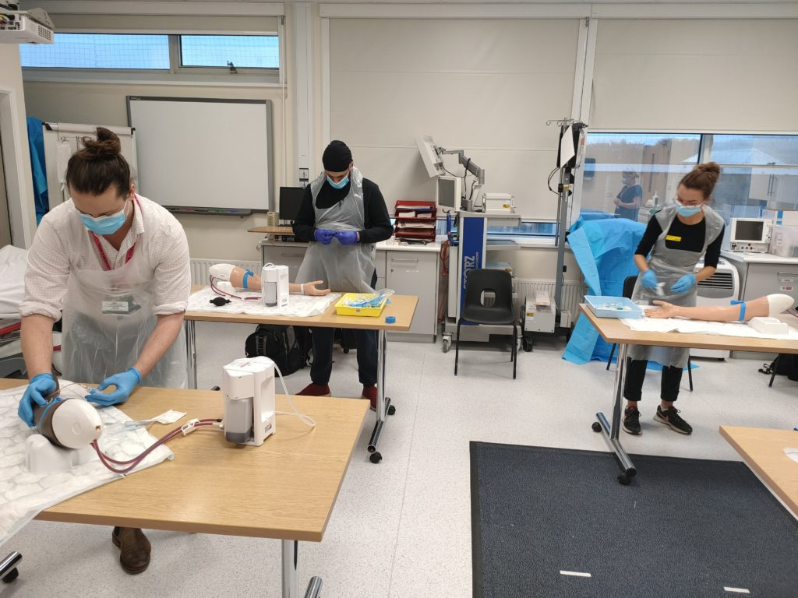
Medical Students’ Induction
Welcome
Dr John Somarib (KCL Sub Dean)
Dr Mohammed Kamil Quraishi (KCL Acute Care Block Lead)
Dr Rannie Nahas(KCL LTC Block Lead)
Undergraduate Administrator – Angela Geoghegan
Education Fellows
Pastoral Fellow - Paul Gosling Tour of the hospital

Slide 3
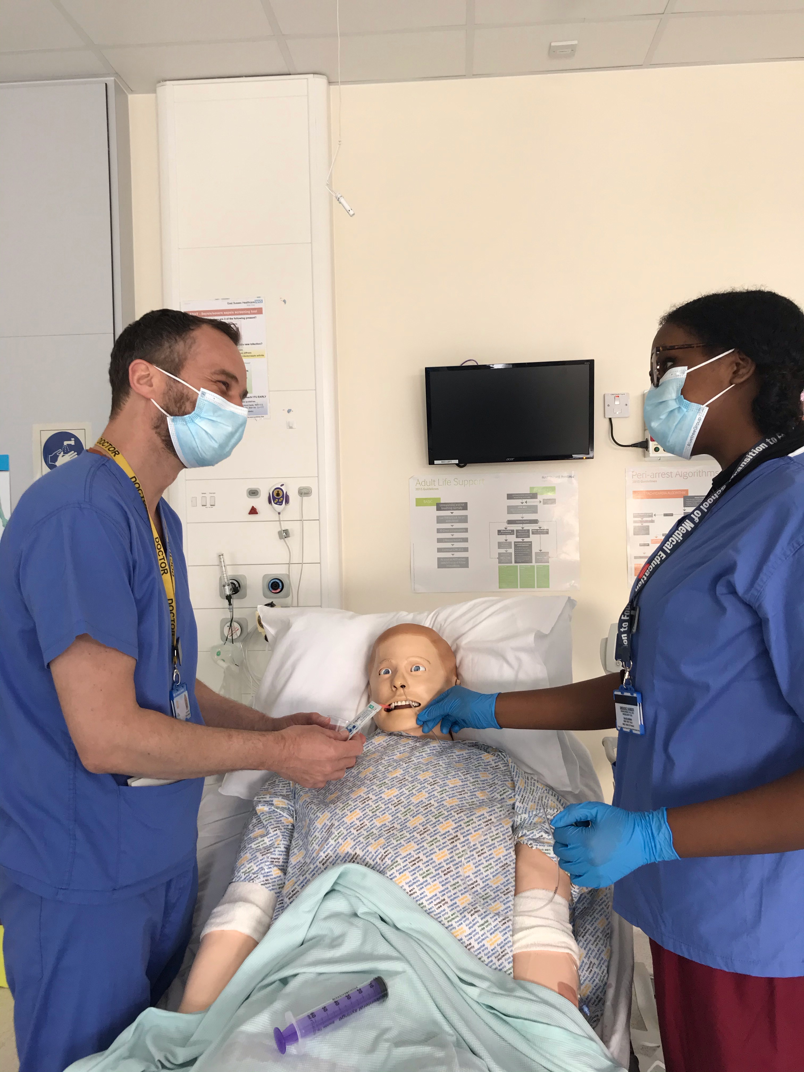
We aim to give you a fantastic learning experience at ESHT
which will be enjoyable and help boost your confidence in a medical profession

Slide 4
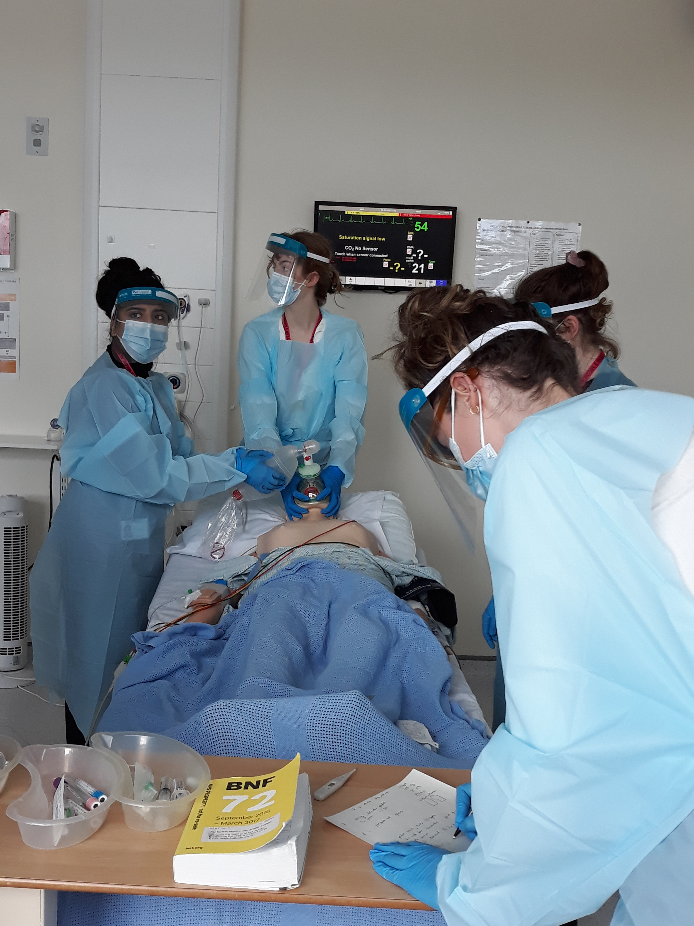
There will be a range of delivery styles:
SIM:
bedside teaching:
classroom teaching:
skills teaching;
review sessions;
Clinics
Tutorials/CBDs

Slide 5
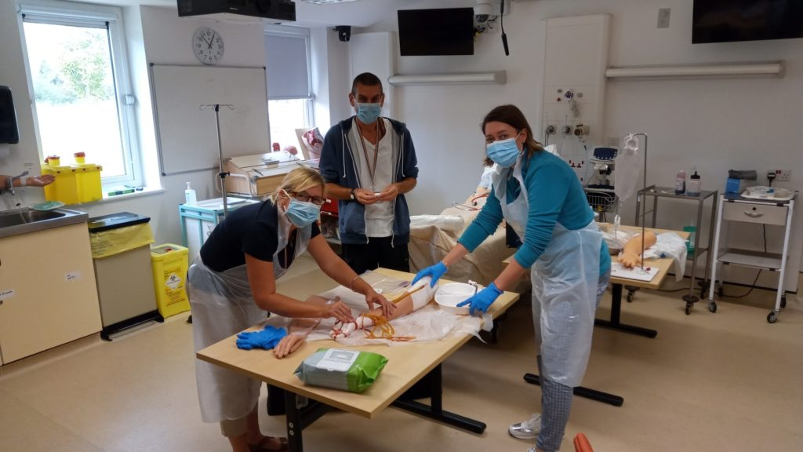
Structured Generic Teaching
Schwartz rounds
Clinics
Theatres
Ward Rounds
Simulation/ skills lab
Resus and acute care teaching
Foundation doctor-led teaching (Tues & Thurs)
Weekly Catch up sessions (Thursday afternoon)
Module Specific Teaching including Educational Fellows and Block Leads

Slide 6
Medical Student Leads
Role | Eastbourne | Conquest Hospital
KCL Sub Dean | Dr John Somarib johnsomarib@nhs.net | Dr Chris Scanlon
KCL Acute Care Block Lead: | Dr Mohammed Quraishi Mohammed.quraishi1@nhs.net | Dr S Berliti stefano.berliti@nhs.net Mr Y El-Dhuawaib yesar.el-dhuwaib@nhs.net
KCL LTC Block Lead: | Dr R Nahas rannienahas@nhs.net | Dr T Christopherson thereza.christopherson1@nhs.net

Slide 7
Meeting your learning requirements:
safe and supported working environment for students
consultants, trainees, nursing staff
education fellows
RESUS and SIM team (manequins can be pre-booked for students’ own practice)
peer group study
voicing your educational needs
Logbooks / mandatory sign-offs
24/7 Library
Outpatient Clinics
– contact Catherine Watsham (Matron) on catherine.watsham@nhs.net

Slide 8
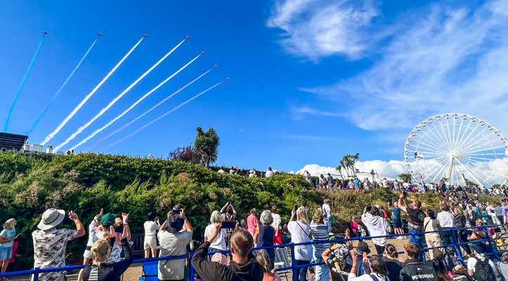
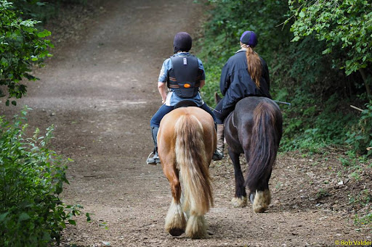
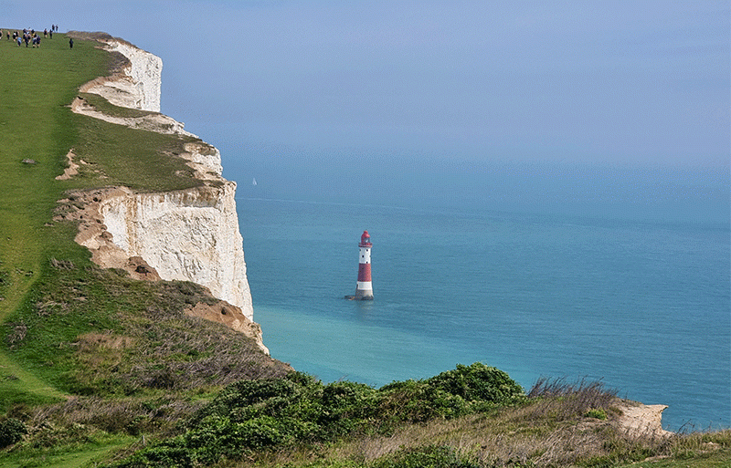
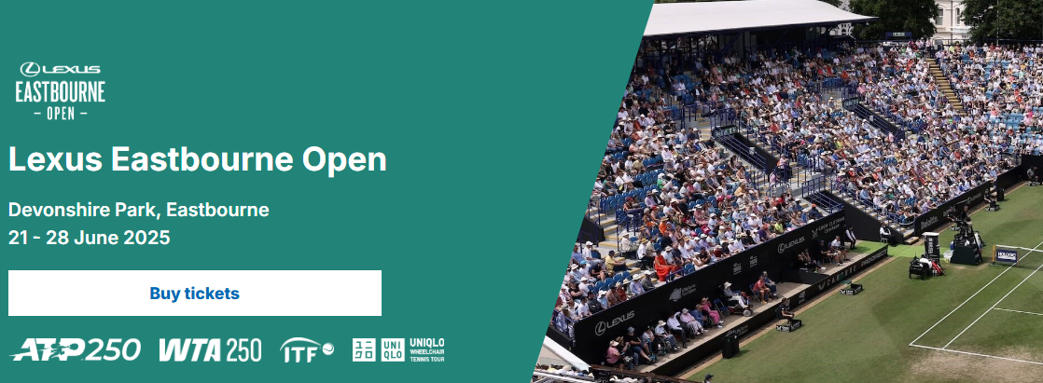
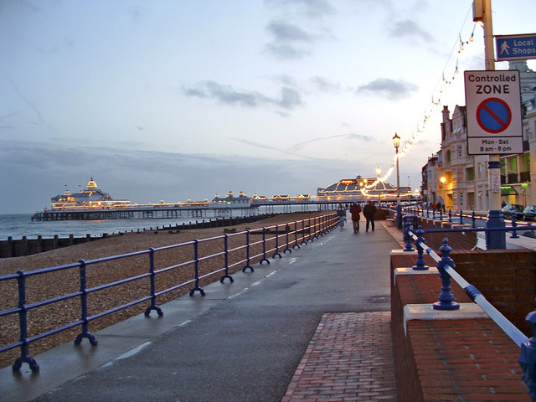
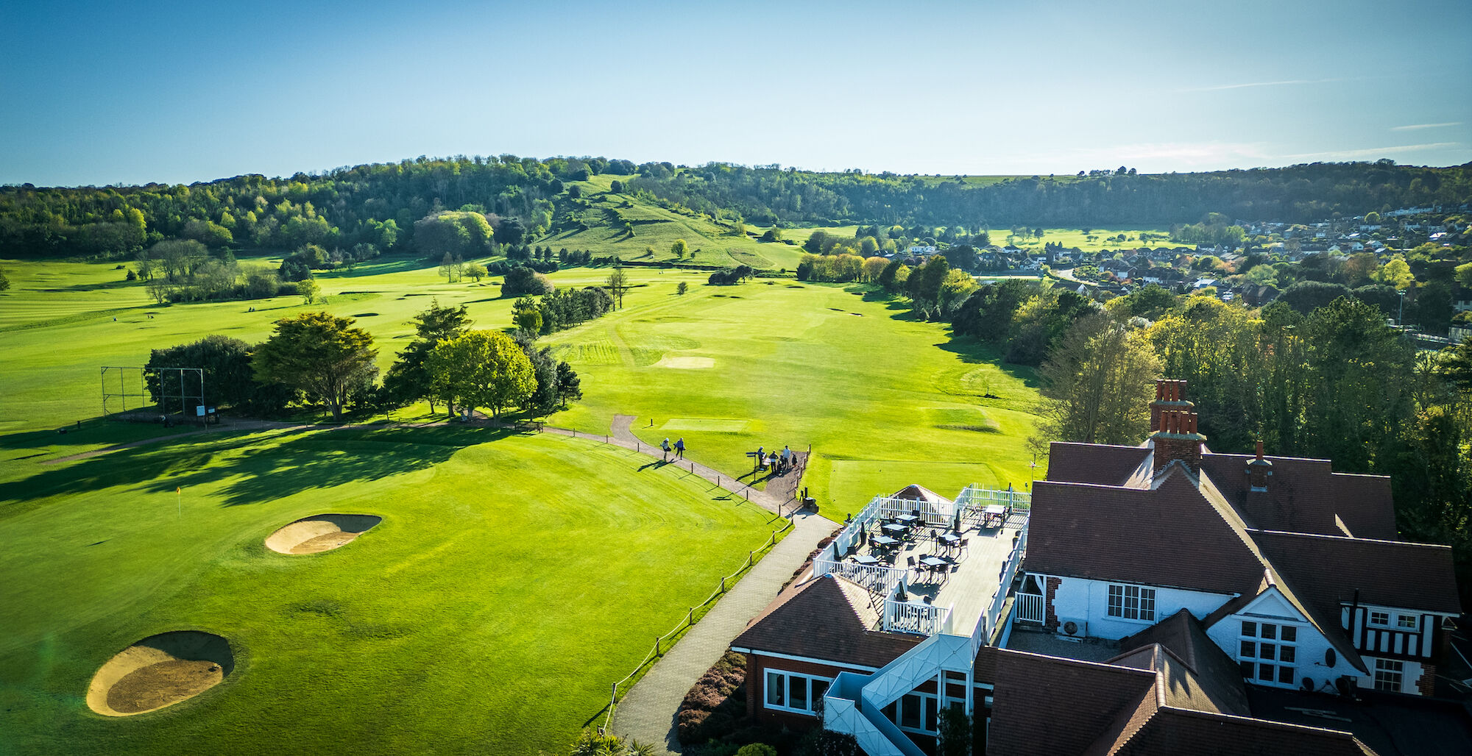
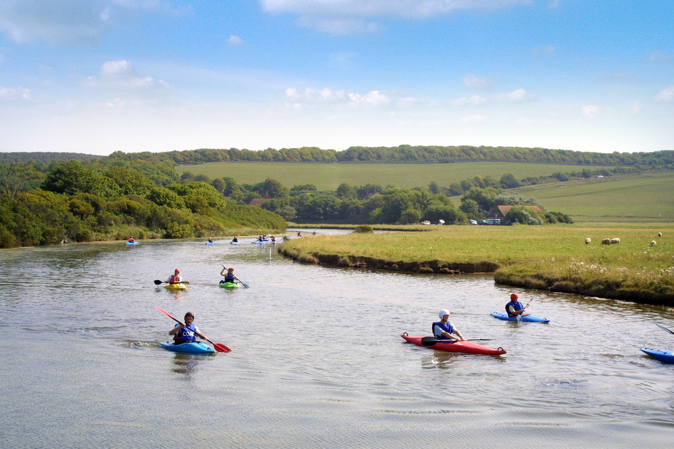
Acute Care Block
Introduction

Slide 9
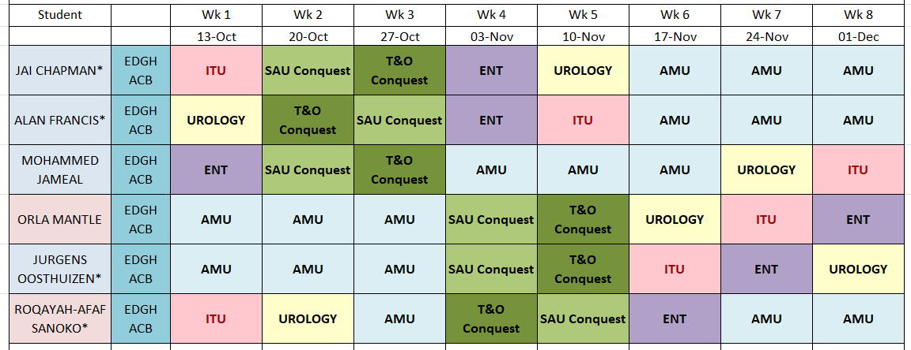

Slide 10
Changes/Tips in Acute Care Block
Mandatory Sign Offs
Acute General Surgery – Transport to CQ
Trauma & Orthopaedics – Transport to CQ
Simulation in ACB
Use the Live Timetable / Whatsapp Group – Evolving.
Escalate Concerns Early
Wednesday Mornings Centralised Teaching
New Accomodation / Wifi
3x CBDs
OSCE Sessions
Complete Reflective Logs/Assessments throughout Block
1x SBA Session
Weekly Thursday Afternoon Catch Up with Faculty
Crash Bleep Experience

Slide 11
Start of Block/Handover Location for Acute Care Block
Conquest SAU | 0800 – Conquest Surgical Library in Surgical Consultants Office Corridor (Opposite Endoscopy Entrance)
Conquest T&O | 0800 – Trauma Meeting Room (in Corridor Opposite Benson and Everton Wards) at CQ
Urology | 0800 - Handover at Urology Investigation Suite Seminar Room (Level 3 Purple Zone) Wards – Friston & Hailsham
ITU | 0800 Anaesthetic Seminar Room (in Anaesthetic Department – Level 3 Purple Zone)
ENT | 0800 - Handover in ENT office (first Door on Left in Friston Ward- Level 3 Purple Zone) Wards – Friston & Hailsham
AMU | 0845 – AMU MDT Room (within AMU)

Slide 12
Mandatory Signs off for ACB
Attend Medical Ward Round | Can be signed off during your AMU Block
Attend Pharmacy Teaching | Any Prescribing Teaching. Prescribing Teaching scheduled 14th October
Attend SDEC Shift | Attend SDEC Shift (attached to AMU)
Theatres | Attend any CEPOD/Trauma Theatre List
Joint Assessment | Attend Joint Assessment Teaching – 24th Nov
Specific Teaching | Acute Care Block Simulation Day – 24th October
Shadow Medical Take Team | To be done during AMU Block – day or night shift
Assess Surgical Patient on Surgical Take | Clerk an Acute Surgical Patient in SAU

Slide 13
Recommended Educational Opportunities for KCL Medical Students
Conquest T&O | Trauma Ward Round - Trauma Meeting Room Clinics & Fracture Clinics Daily in Clinic Area (Opposite Radiology in CQ) Orthopaedic Theatres are 3,4,5 and 8. Please introduce yourselves early in the morning to the surgical team.
Breast | Mr Sangle Breast Clinic
ENT | Rapid Access Clinic – Morning (Area C OPD – Everyday) Ward Round Friston Ward
General Surgery EDGH | Mr Al-Robaie Clinic Monday PM EDGH (Colorectal) Mr Al-Robaie Clinic Tuesday AM Conquest (General)

Slide 14
Recommended Educational Opportunities for KCL Medical Students
Conquest Surgery | SAU Ward Round – Richard Ticehurst CEPOD Theatre 7 Elective Surgical Theatres 1 & 2 SAU Ambulatory Clinic (SACC) Gardener Ward (Ward Round Elective Patients) Endoscopy Unit
Urology | Handover at Urology Investigation Suite Seminar Room at 0800 Ward Round at Friston Ward CT Led Ambulatory Clinic in Friston Daily 0900 Mr Quraishi Urology Investigation Suite Laser Clinic Thursday AM (Start 0825 sharp to be present and introduce to staff) Mr Quraishi Stone Clinic Friday AM (MKQ office, 1st Friday of Month in Main OPD) Mr Spiteri Kidney Clinic Monday AM. Main OPD Mr Spiteri Kidney Clinic Wednesday Area E OPD. (Basement) Mr Calleja Clinic - Date/Times to be confirmed.

Slide 15
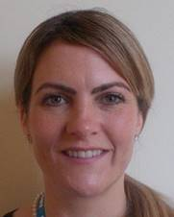


Pastoral Support
Pastoral Fellows:
Jodi Wilkinson and Paul Gosling
See student handbook for extensive list
of sources of support

Slide 16
Library (Knowledge Services)
The library is open Monday to Friday 8.30am to 5.00pm. Outside these hours users can access both libraries using their Trust swipe card for 24 hour access.
If you need to contact library please email them on:
esht.libraryservices@nhs.net
PCs are accessible in the library 24/7 using your Sussex username and password.

Slide 17

ASK and TELL
ASK us questions !
TELL us if something concerns you – PLEASE TELL US EARLY ON IF ANY CONCERNS/CHANGES WARRANTED.
Make the most of your learning experience ☺

Slide 18
Attendance
Let the education centre know if you are going to be absent or are off sick
Let your team know when not attending timetabled teaching
Register with a GP – see your handbook

Slide 19
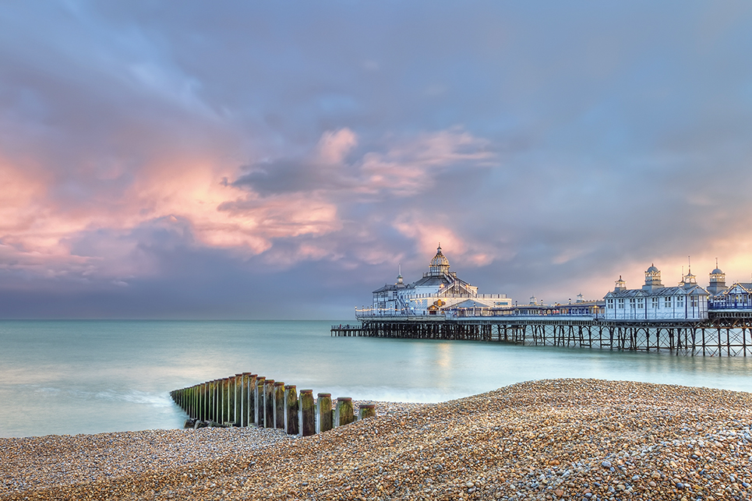
Places to visit in Eastbourne and surrounding areas
Where to go and places to visit please go to www.visiteastbourne.com

Slide 20
Questions?

