Slide 1
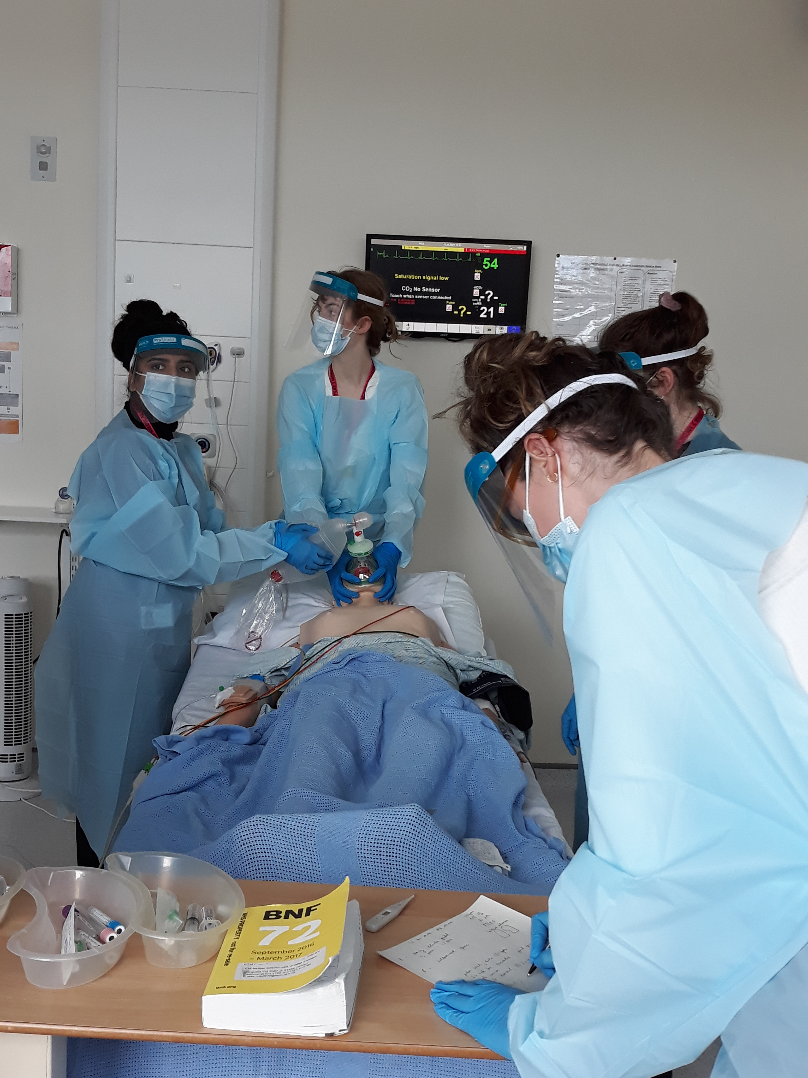
Welcome to East Sussex Healthcare NHS Trust

Slide 2

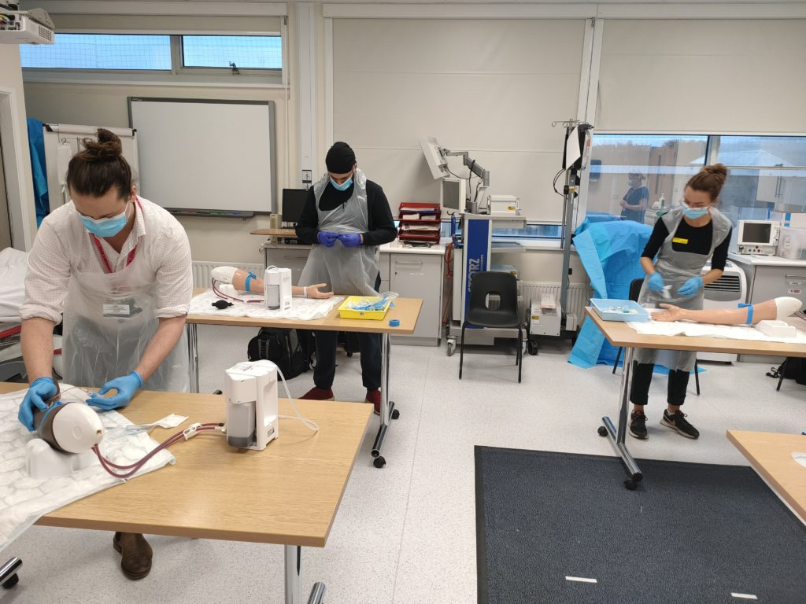
Medical Students’ Induction
Welcome
Year 3 Lead – Dr Abier Elzein (EDGH)
Undergraduate Administrator – Angela Geoghegan
Education Fellows
Pastoral Fellow - Paul Gosling
Tour of the hospital

Slide 3
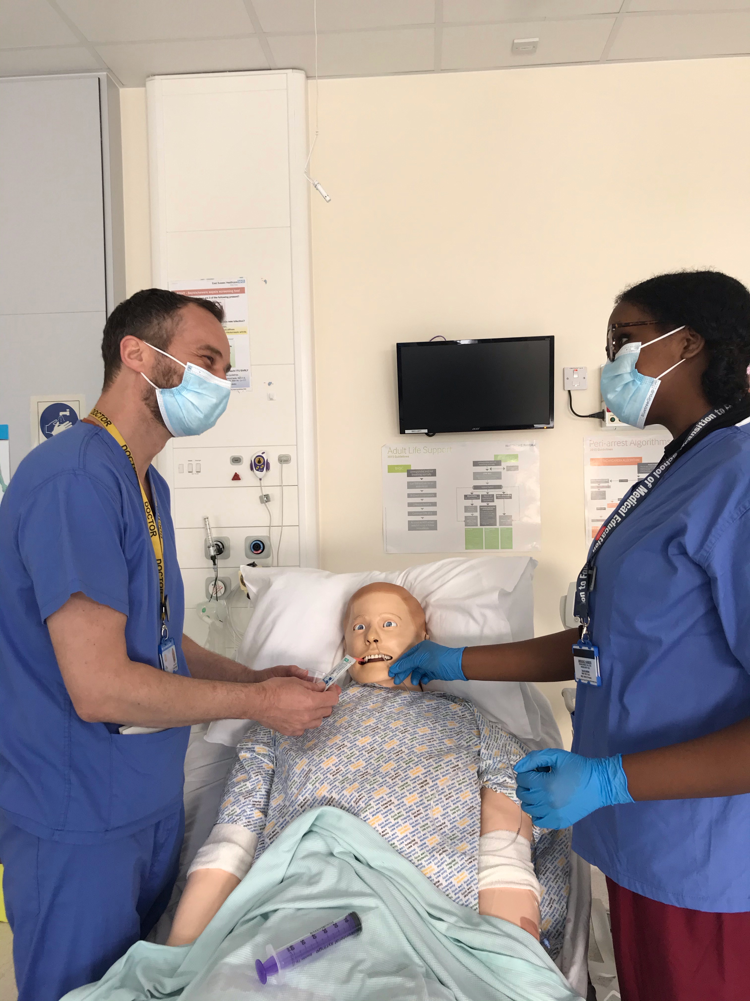
We aim to make your stay enjoyable, educational and productive whilst at East Sussex Healthcare NHS Trust.
https://www.esht.nhs.uk/medical-education/

Slide 4
BSMS Student Leads
 | EDGH | Conquest
BSMS UG Lead Cross Site | Dr Umesh Dashora u.dashora@nhs.net
BSMS Year 5 Lead | Dr N Sargant Nigel.sargant@nhs.net | Dr S Berliti Stefano.berliti@nhs.net
BSMS Year 3 Lead | Dr Abier Elzein abier.elzein@nhs.net | Dr Ariful Islam Ariful.islam@nhs.net
Module 306 Elderly Care | Dr R Nahas | Dr H McIntyre
Module 306 Stroke | Dr C Biyanwila at EDGH For your week in the Stroke Speciality will be at Eastbourne.
BSMS Year 4 Lead | Miss Mini Nair mininair@nhs.net

Slide 5
Educational Fellows
Name | Department | Site | NHS email
Dr Sadia Afrose | Emergency Medicine | Conquest | sadia.afrose@nhs.net
Dr Aparna Senjuti | Emergency Medicine | Conquest | aparna.senjuti@nhs.net
Dr Basma Taher | Emergency Medicine | Conquest | basma.taher@nhs.net
Dr Beth Asante | Palliative Medicine | Conquest | beth.asante1@nhs.net
Dr Sabrana Rahman | Rotational Medicine | Conquest | sabrana.rahman@nhs.net
Dr Mishma Mehzabeen | Rotational Medicine | Conquest | mehzabeen.mishma@nhs.net
Dr Oyeronke Oyerinde | Acute Medicine/SDEC | Conquest | oyeronke.oyerinde1@nhs.net
Dr Ibrahim Elsherbini | Surgery | Conquest | i.elsherbini@nhs.net
Dr Catherine Bent | Surgery | Conquest | catherine.bent2@nhs.net
Dr Maddie Runagall | Simulation | Cross-site | maddie.runagall@nhs.net
Dr Thomas Nicholls | Palliative Medicine | EDGH | thomas.nicholls4@nhs.net
Dr Rossul Al Bahadili | Emergency Medicine | EDGH | rossul.al-bahadili@nhs.net
Dr Jacob Smith | Emergency Medicine | EDGH | Jacob.Smith8@nhs.net
Dr Hani Khaldi | Acute Medicine/SDEC | EDGH | hani.khaldi@nhs.net
Dr Ami Davies | Rheumatology | EDGH | ami.davies1@nhs.net
Dr Kashmira Jeeva | Frailty | EDGH | kashmira.jeeva1@nhs.net
Dr Manali Prabhakar Sankhe | Frailty | EDGH | manali.sankhe@nhs.net

Slide 6
Meeting your learning requirements:
safe and supported working environment for students
consultants, trainees, nursing staff
education fellows
RESUS and SIM team (mannequins can be pre-booked for students’ own practice)
peer group study
voicing your educational needs
CBD practice week
logbooks
24/7 Library

Slide 7
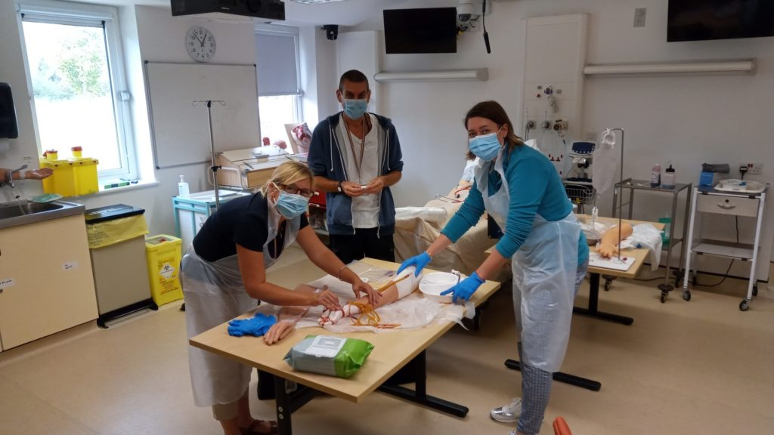
Structured Teaching
Ward rounds and bedside teaching
Grand rounds/ Schwartz rounds
Departmental teaching/MDTs
Clinics
Simulation/ skills lab
Phlebotomy sessions
Resus and acute care teaching

Slide 8
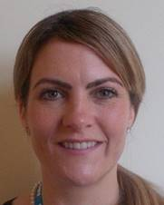



Pastoral Support
Nurse Pastoral Fellows:
Jodi Wilkinson and Paul Gosling
See student handbook for extensive list
of sources of support

Slide 9

ASK and TELL
ASK us questions
TELL us if something concerns you
(see the “My Learning Review” form)
Make the most of your learning experience

Slide 10
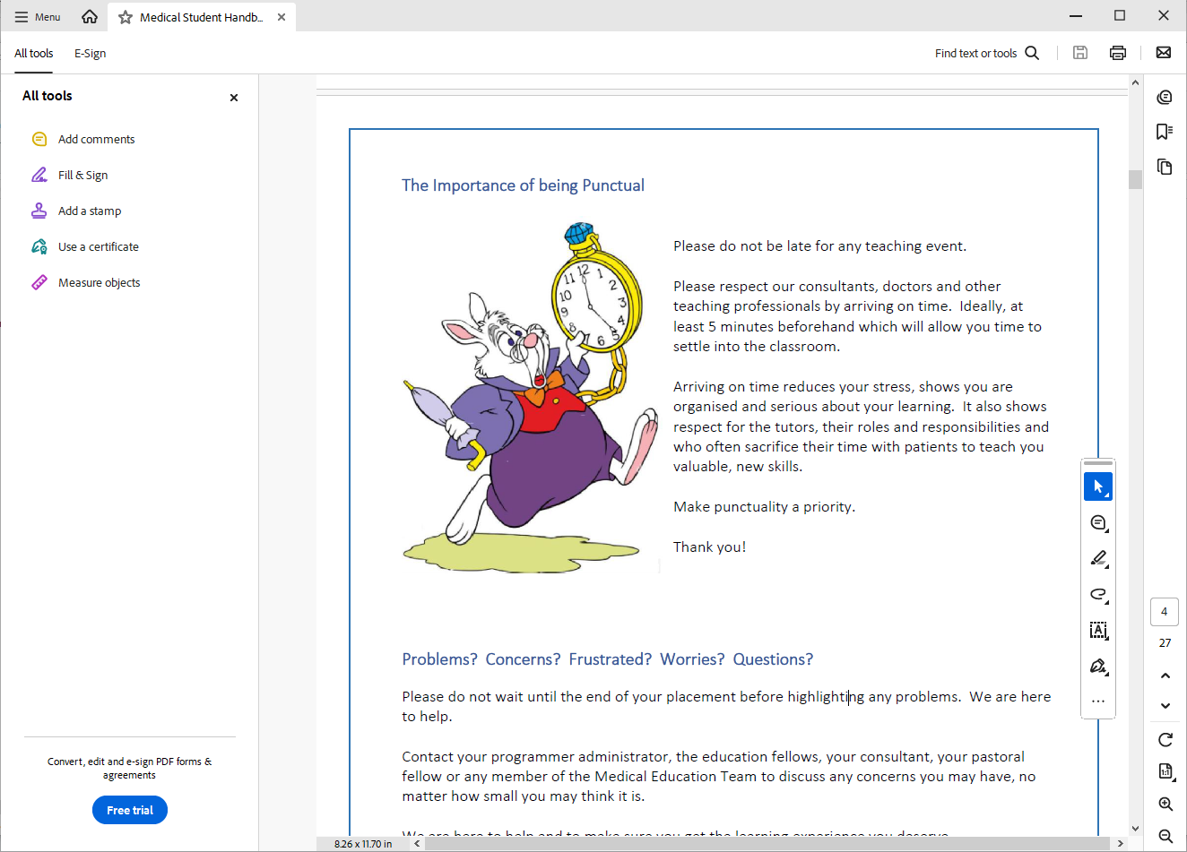
Attendance and Review
Please :
Let the education centre know if you are going to be absent or are off sick
Let your team know when not attending timetabled teaching
Register with a GP – see your handbook
Frequent reviews with Block Lead
Mandatory
Fortnightly or as requested
Let us know if you are unable to attend

Slide 11
Library
The library is open Monday to Friday 8.30am to 5.00pm. Outside these hours users can access both libraries using their Trust swipe card for 24 hour access.
If you need to contact library please email them on esh-tr.libraryservices@nhs.net
PCs are accessible in the library 24/7 using your Sussex username and password.

Slide 12

Places to visit in Eastbourne and surrounding areas
Where to go and places to visit please go to www.visiteastbourne.com

Slide 13
Q&A
Questions

