Slide 1
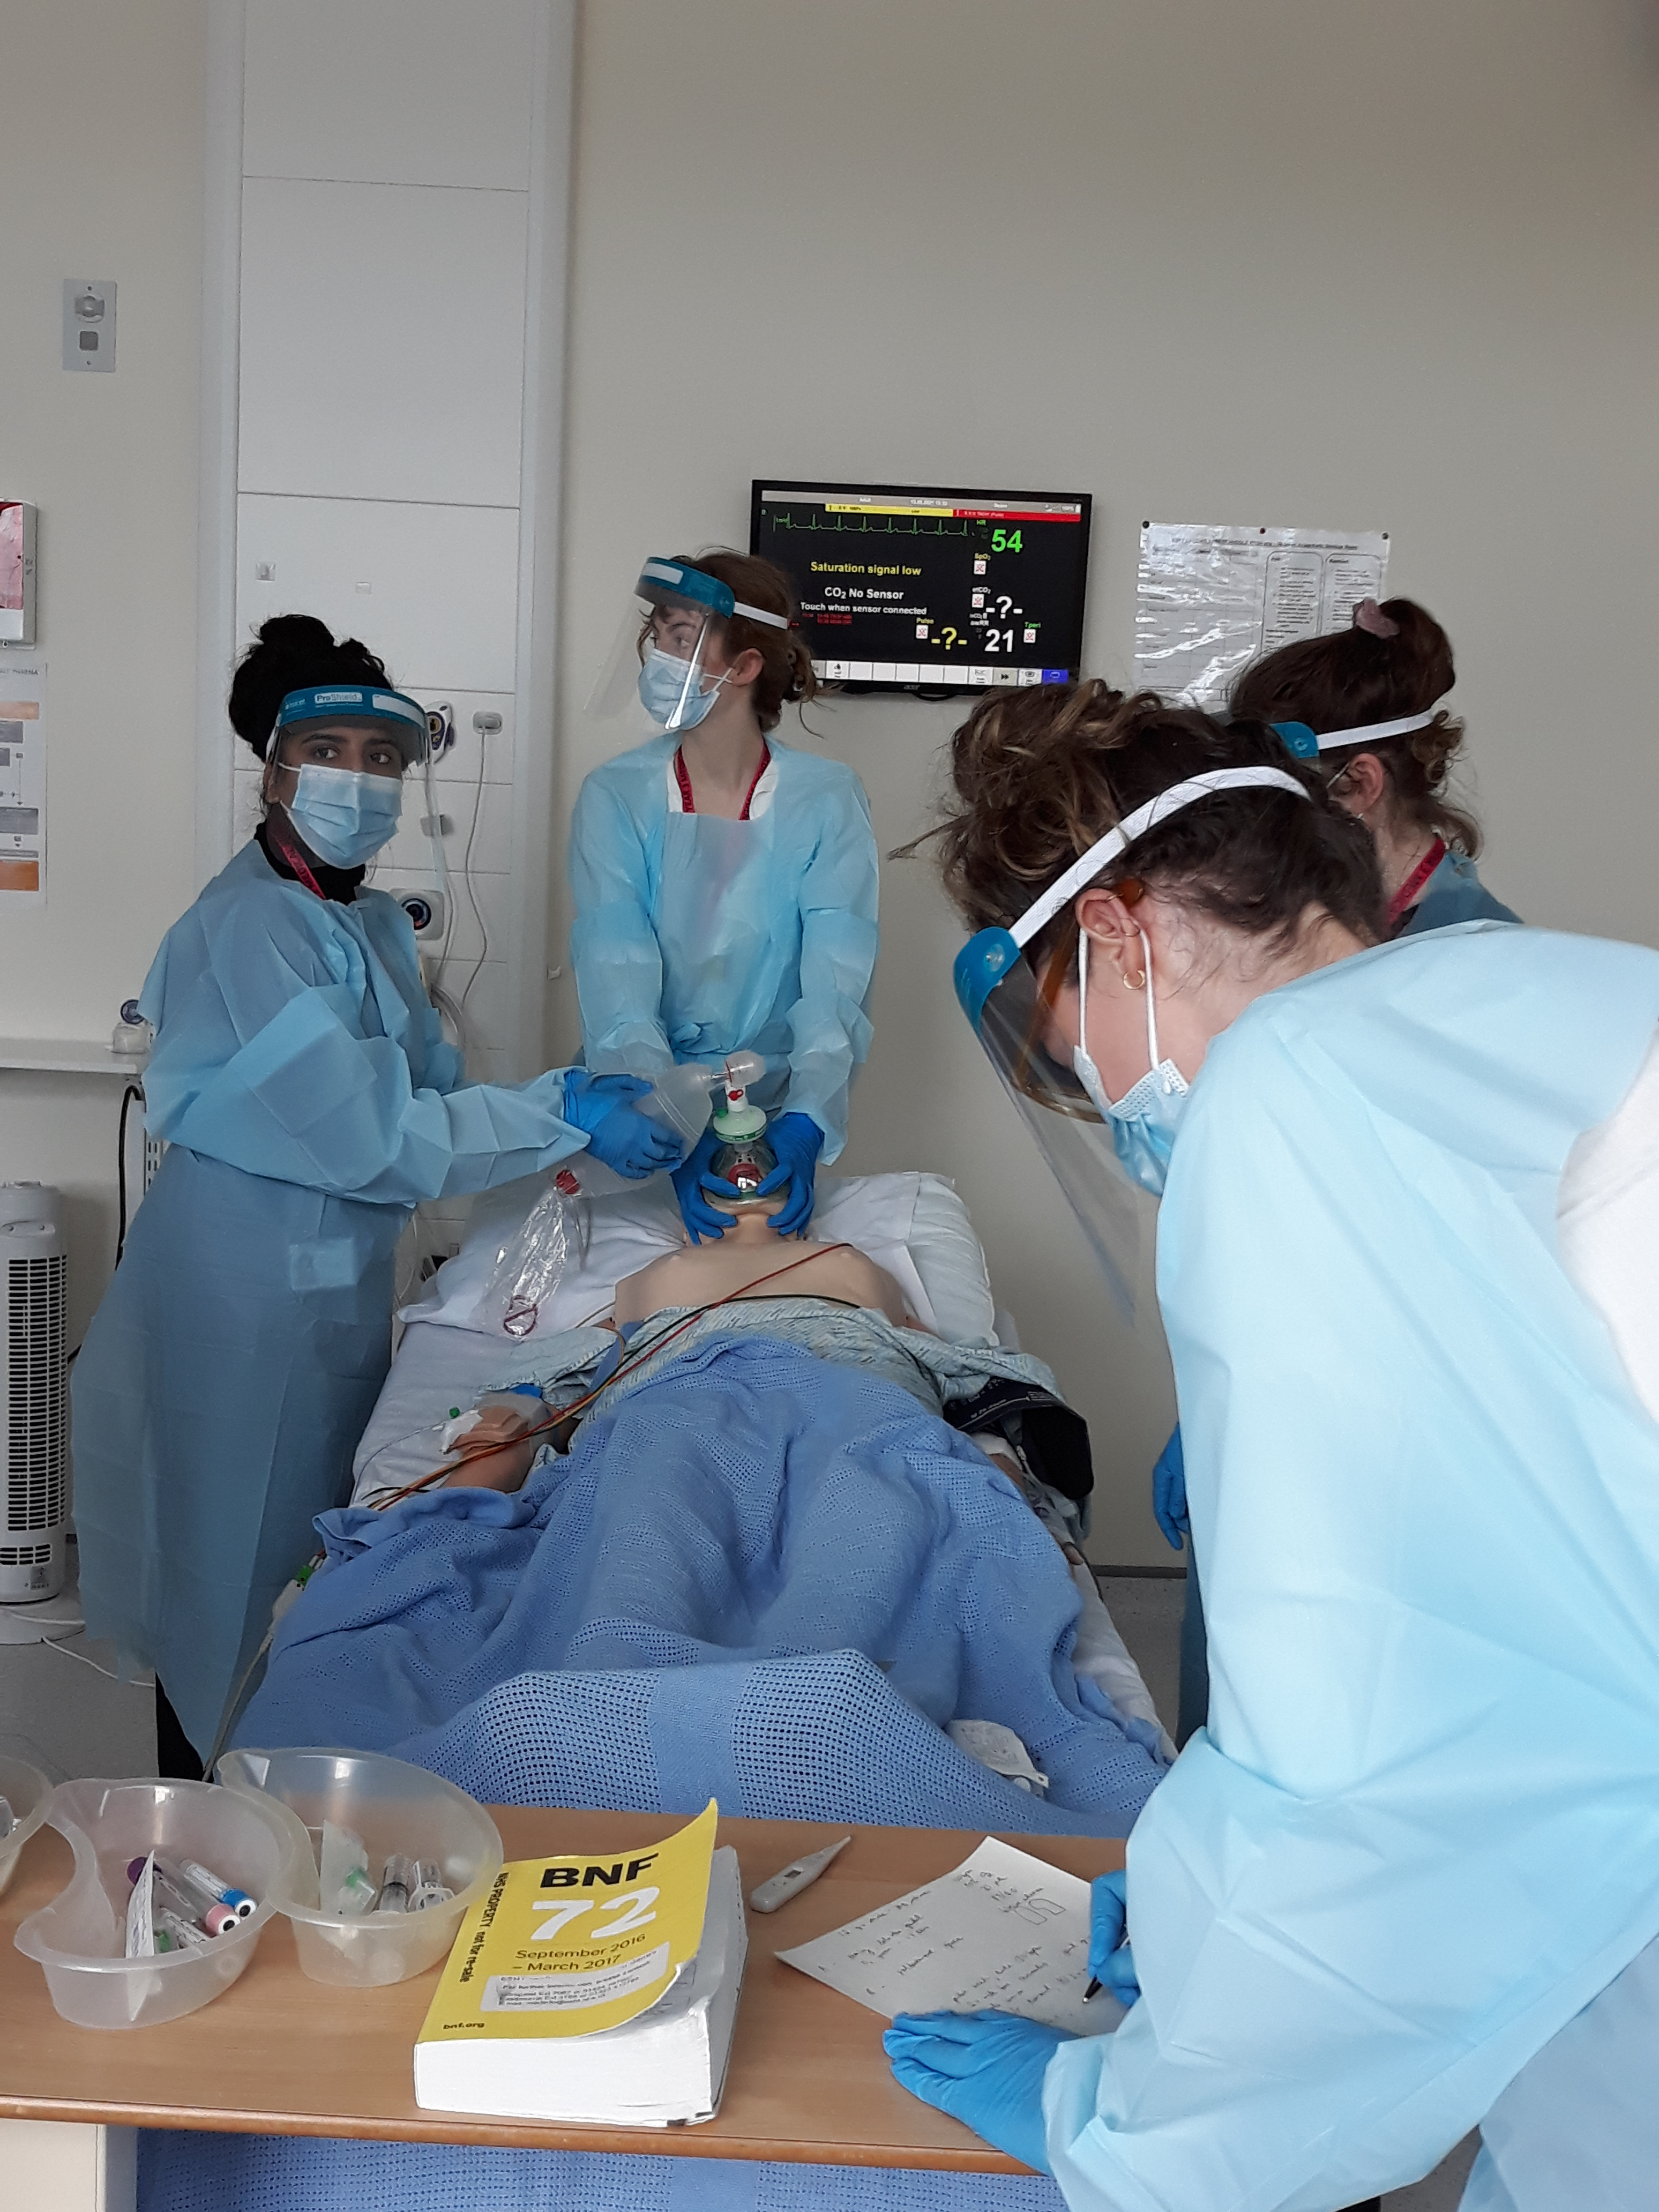
Welcome TTF1s to East Sussex Healthcare Trust
January 2026

Slide 2

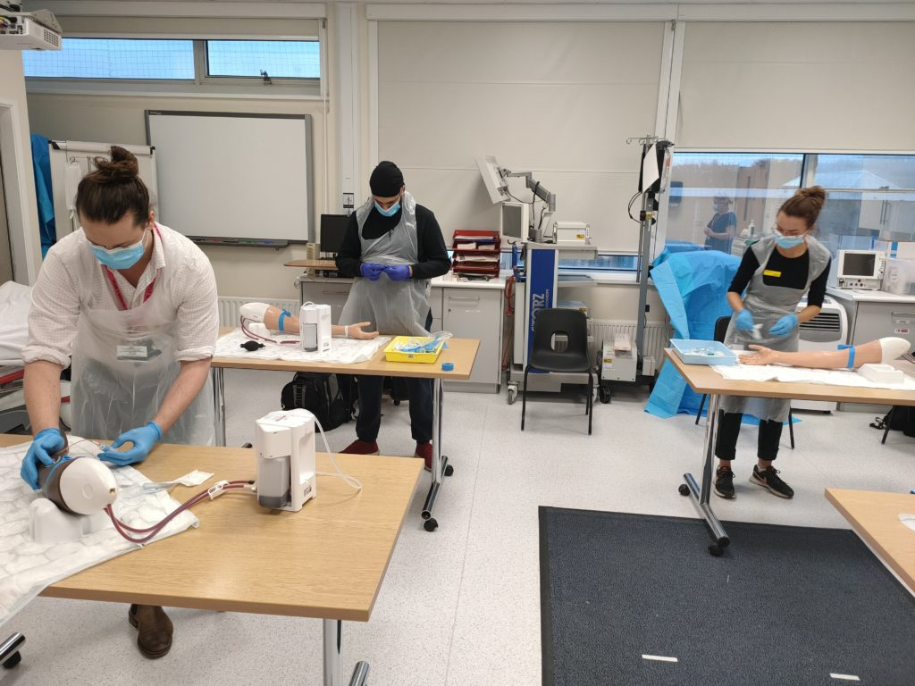
TTF1’s Induction EDGH
Welcome
KCL – Dr John Somarib – KCL Sub Dean
Block Leads: Dr R Nahas, Mr Kam Quraishi
Undergraduate Administrator – Angela Geoghegan
Education Fellows
Specialist Nurse Practitioner, R&D Jo-Anne Taylor
Pastoral Fellow - Paul Gosling
Tour of the hospital / Depart to wards

Slide 3
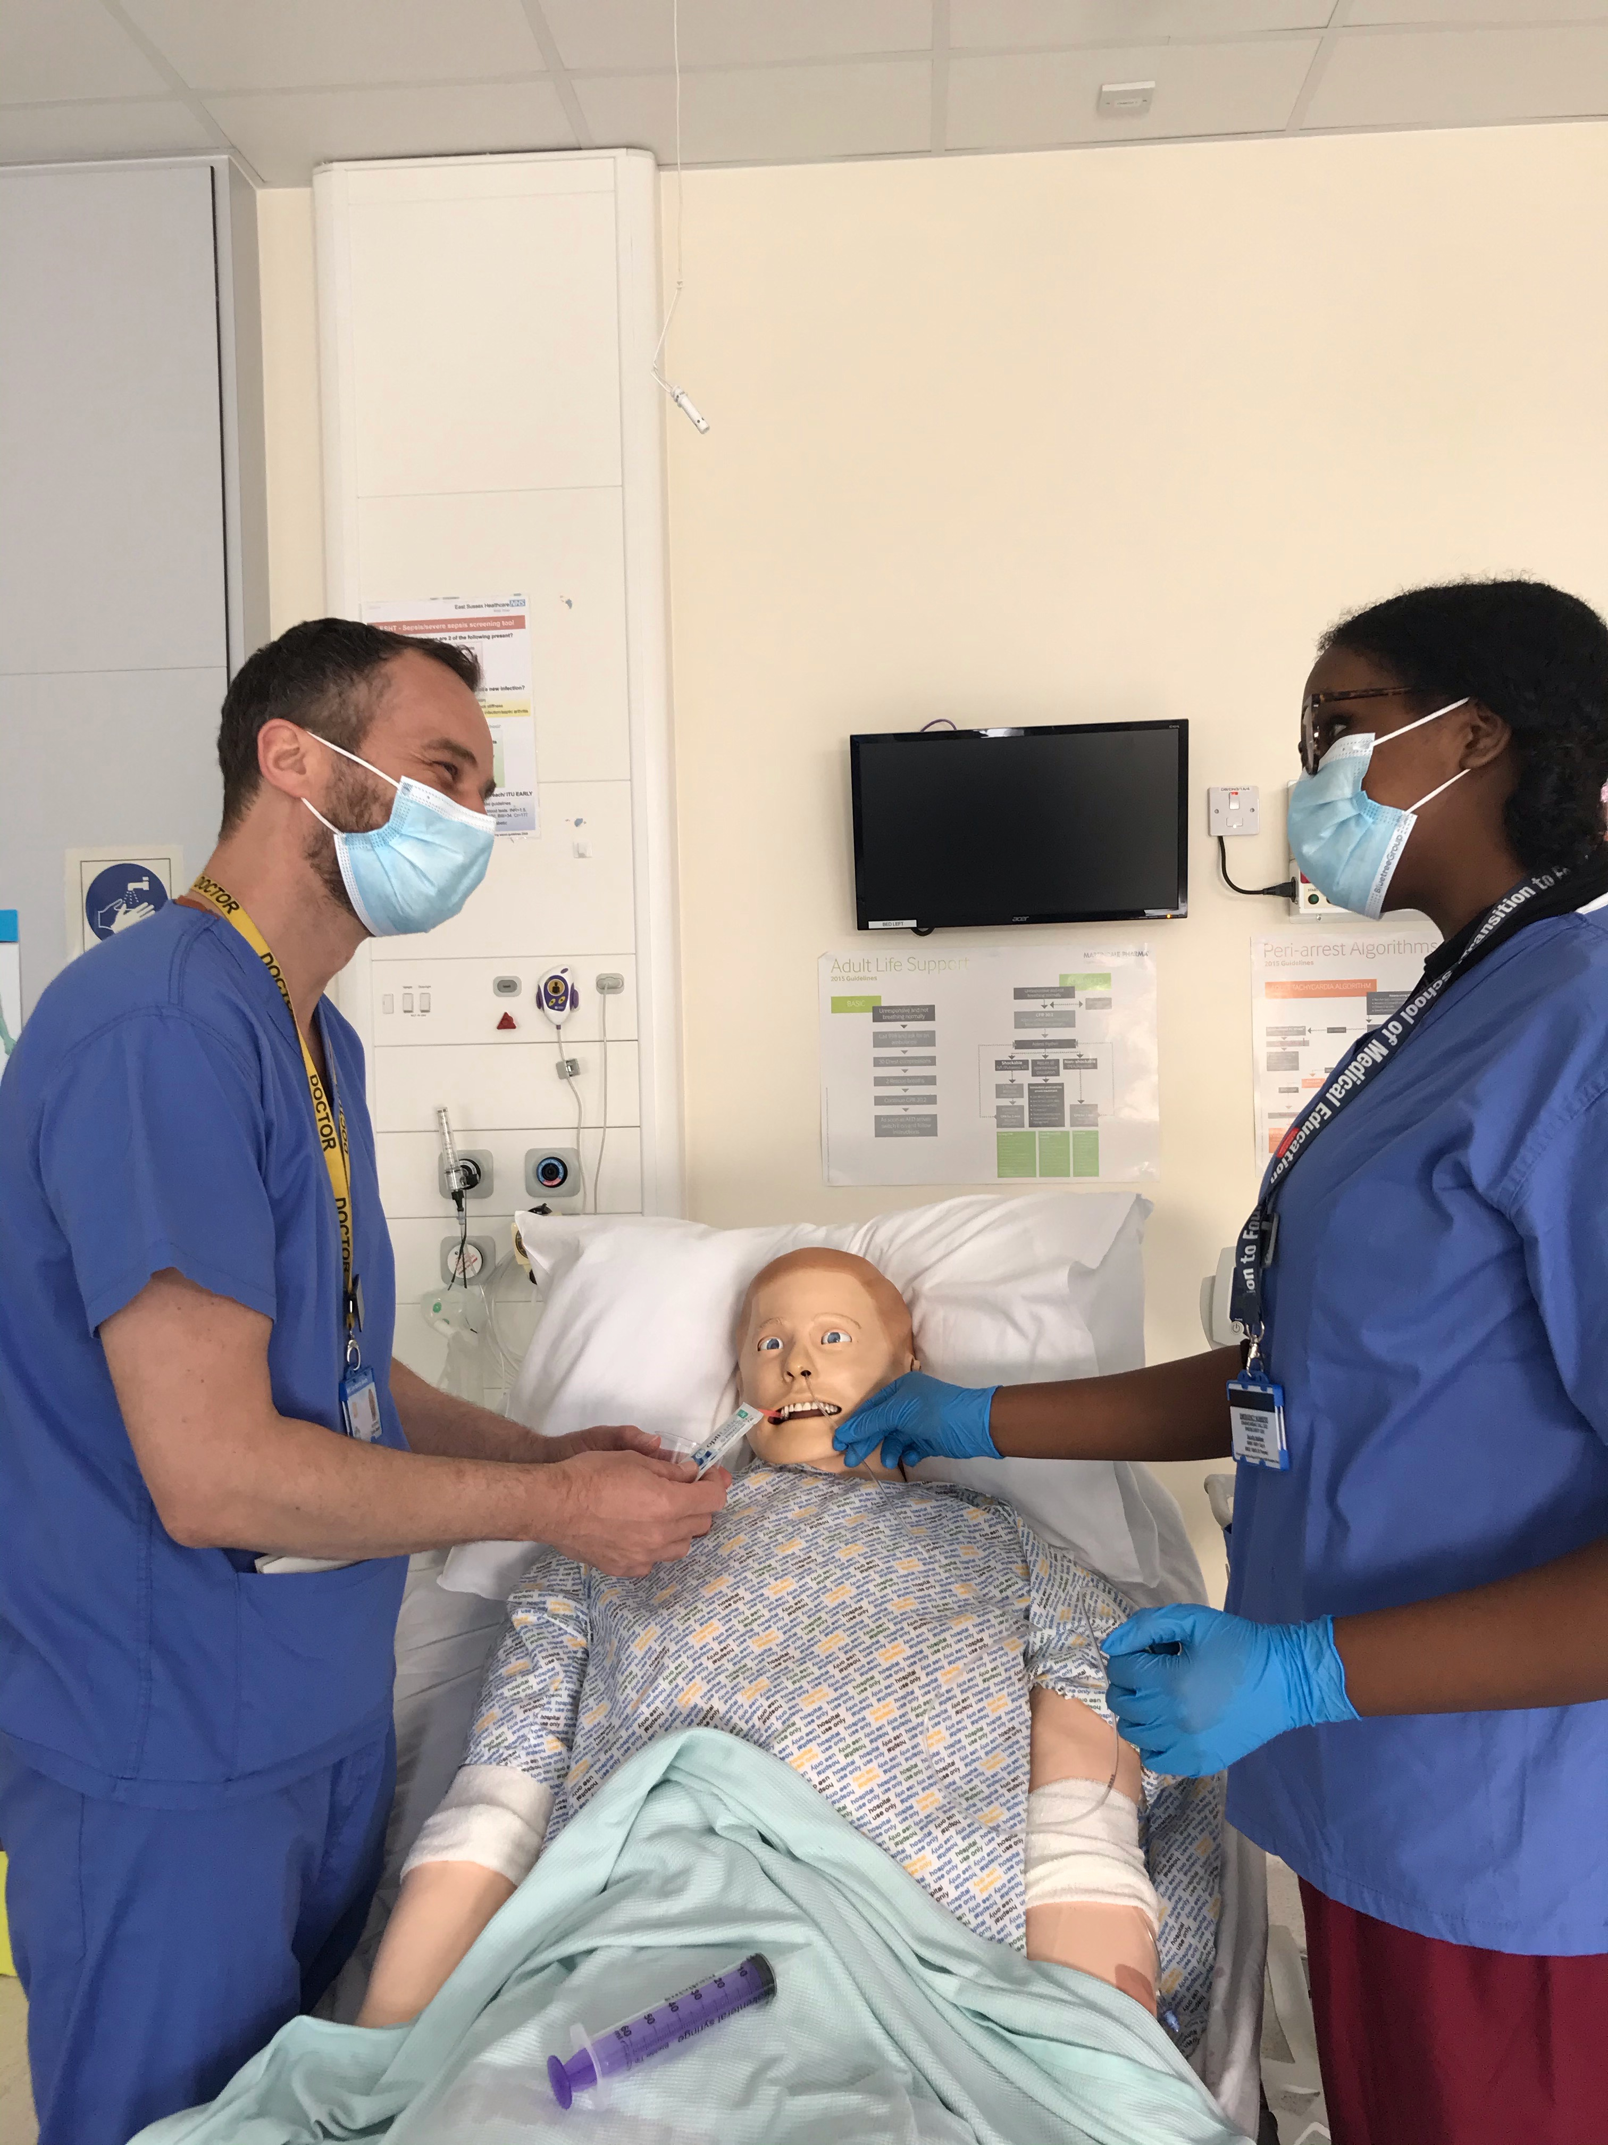
We aim to make your stay enjoyable, educational and productive whilst at East Sussex Healthcare NHS Trust.

Slide 4
Educational and Pastoral Fellows
Name |  | Site
Dr Hani Khaldi | Acute Medicine/SDEC | EDGH
Dr Kashmira Jeeva | Frailty | EDGH
Dr Ami Davies | Rheumatology | EDGH
Paul Gosling paul.gosling@nhs.net | Nurse Fellow | EDGH

Slide 5
Your Allocation Plan 26th January – 13th March 2026
 | BLEEP / ON CALL week | week 1 26/01/2026 | week 2 02/02/2026 | week 3 09/02/2026 | week 4 16/02/2026 | week 5 23/02/2026 | week 6 02/03/2026 | week 7 09/03/2026
Liam Danthanarayana | week 5 | Urology: Miss Sarah Tang, Urology Investigation Suite F : Omar Sajjad |  | ENT : Mr M Al-Hashim FY2: Hannah Breakwell |  | Gastro: Dr D Neal, Michelham Ward FY1: Sydney Huggins
Alan Francis | week5 | ENT : Mr M Al-Hashim FY2: Hannah Breakwell |  | Urology: Miss Sarah Tang, Urology Investigation Suite FY2 : Omar Sajjad |  | ENDO : Dr K Jacob, Berwick Ward FY1: Margo White
Osama Shamou | week 1 | Gastro: Dr D Neal, Michelham Ward FY1: Sydney Huggins |  |  |  | ENT : Mr A Shanker, Friston Ward FY1: Roya Khan
Jamie Krens | week 1 | ENDO : Dr K Jacob, Berwick Ward FY1: Margo White |  |  |  | Urology: Mr S Mackie, Urology Investigation Suite FY2: Teneisha Duguid
Jabiah Yasmin | week 6 | Urology: Miss Sarah Tang, Urology Investigation Suite FY1: Maria de Oliveira Mendes |  | ENT : Mr M Al-Hashim FY1 Roya Khan |  | Stroke: Dr C Biyanwila, Sovereign Ward FY1: : Azita Ahmadi
Aalia Qureshi | week 6 | Urology: Mr S Mackie, Urology Investigation Suite FY2: Louisa Paynter |  |  |  | Stroke: Dr C Biyanwila, Sovereign Ward FY1: : Jonah Padfield
Jai Chapman | week 7 | Urology: Mr S Mackie, Urology Investigation Suite FY2: Teneisha Duguid |  |  |  | Geriatric: Dr A Nahhas, Seaford Ward FY1: Shaima Chbib
Jurgens Oosthizen | week 7 | ENT : Mr M Al-Hashim FY2: Rhiannon Herold |  | Urology: Miss Sarah Tang, Urology Investigation Suite FY1: Maria de Oliveira Mendes |  | Respiratory: Dr A Sharma, Westham Ward FY1 Hira Malik
Jasmine Moore | week2 | Geriatric: Dr A Nahhas, Seaford Ward FY1: Shaima Chbib |  |  |  | Urology: Miss Sarah Tang, Urology Investigation Suite FY1: Maria de Oliveira Mendes
Roqayah Sanoko | week3 | Respiratory: Dr A Sharma, Westham Ward FY1 Hira Malik |  |  |  | Urology: Miss Sarah Tang, Urology Investigation Suite FY2 : Omar Sajjad
Jenitta Mathew | week3 | Stroke: Dr C Biyanwila, Sovereign Ward FY1: : Jonah Padfield |  |  |  | Urology: Mr S Mackie, Urology Investigation Suite FY2: Filio Savvidou

Slide 6
Meeting your learning requirements:
safe and supported working environment for students
consultants, trainees, nursing staff
education fellows
RESUS and SIM team (manequins can be pre-booked for students’ own practice)
peer group study
voicing your educational needs
logbooks
24/7 Library

Slide 7
Learning outcome ; -Kaizen content: The Event targets are;
Personal Development Plan
Supervised Learning Event: Handover Assessment Tool (HAT)
Supervised Learning Event: Discharge Summary Task
Supervised Learning Event: CBD
Reflective Notes – Out of hours working
Clinical Supervisor Mid-Placement Report
End of Placement Reflection
Educational Supervisor End of Module Report
Reflective Notes – Shadowing an F1
Engagement log – x8
Tutorial on time table
Reflective Notes – Shift working, Health and Sleep – by Paul
Reflective Notes – Managing Stress and Self-Care – By Paul
Reflective Notes Common ward referrals/management of the acutely ill patient – Ed Fellows
Reflective Notes Use of the HORUS e-portfolio; - Ed Fellows
On Call – arrange with Steve Rochester ex 07890 050642 or ex 735337 (see your pack)

Slide 8
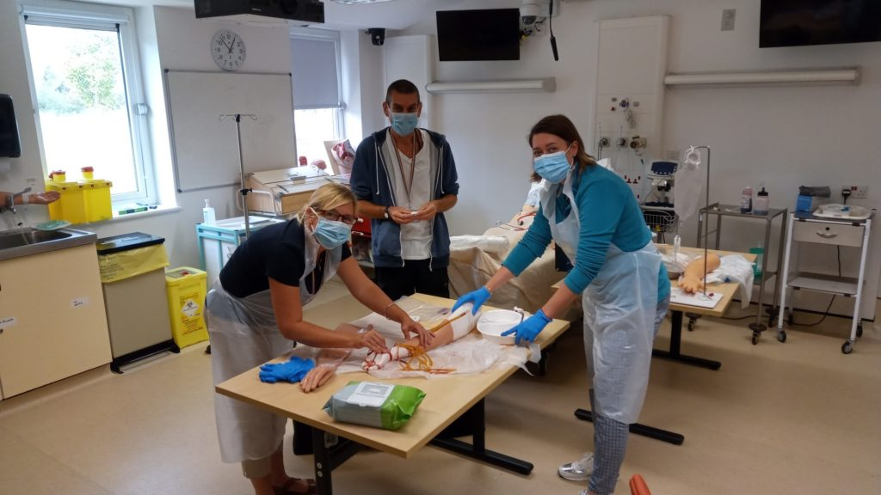
Structured Teaching
Ward rounds and bedside teaching
Grand rounds/ Schwartz rounds
Clinics
Simulation/ skills lab
Resus and acute care teaching
Foundation doctor-led teaching
(Tues)

Slide 9
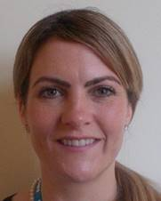



Pastoral Support
Nurse Pastoral Fellows:
Jodi Wilkinson and Paul Gosling
See student handbook for extensive list
of sources of support

Slide 10

ASK and TELL
ASK us questions
TELL us if something concerns you
Make the most of your learning experience

Slide 11
Attendance
Please let the education centre know if you are going to be absent or are off sick
Please let your team know when not attending timetabled teaching
Register with a GP – see your handbook

Slide 12
Library
The library is open Monday to Friday 8.30am to 5.00pm. Outside these hours users can access both libraries using their Trust swipe card for 24 hour access.
If you need to contact library please email them on esh-tr.libraryservices@nhs.net
PCs are accessible in the library 24/7 using your Sussex username and password.

Slide 13

Places to visit in Eastbourne and surrounding areas
Where to go and places to visit please go to www.visiteastbourne.com

Slide 14
Q&A
Questions

