Slide 1

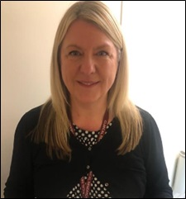
Research & Development
Jo-Anne Taylor, Head of Research
2025-2026
Delivering quality research that will improve the health outcomes for all ESHT patients

Slide 2


Research is the process of discovery, innovation and development
Clinical Research:
Is the key to finding new solutions in healthcare
Enables the delivery of best possible care from the start of our lives
Without research the NHS has no new treatments or drugs and cannot offer tomorrow’s patients anything better than we have today
Research has enabled:
DNA to be sequenced
Organs to be transplanted
Imaging of our whole body
Improvements in cancer screening and cancer treatments
Innovative cardiac treatments
Research is everyone’s business and responsibility

Slide 3
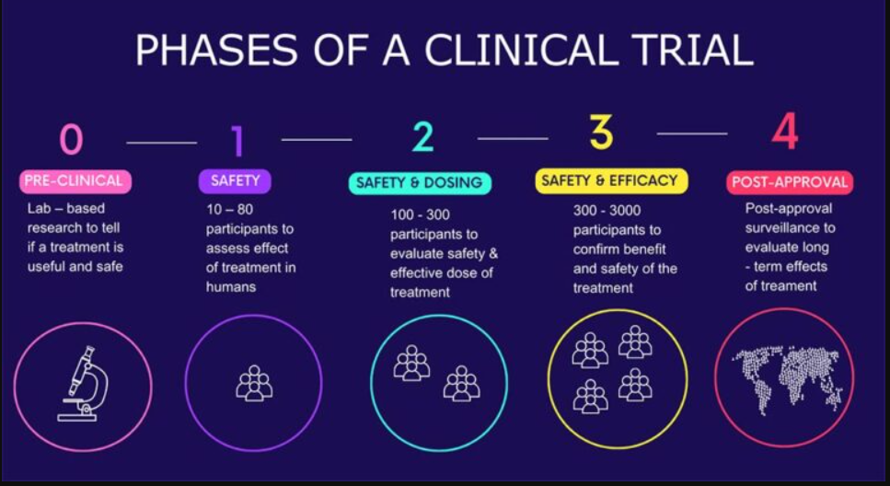

Slide 4
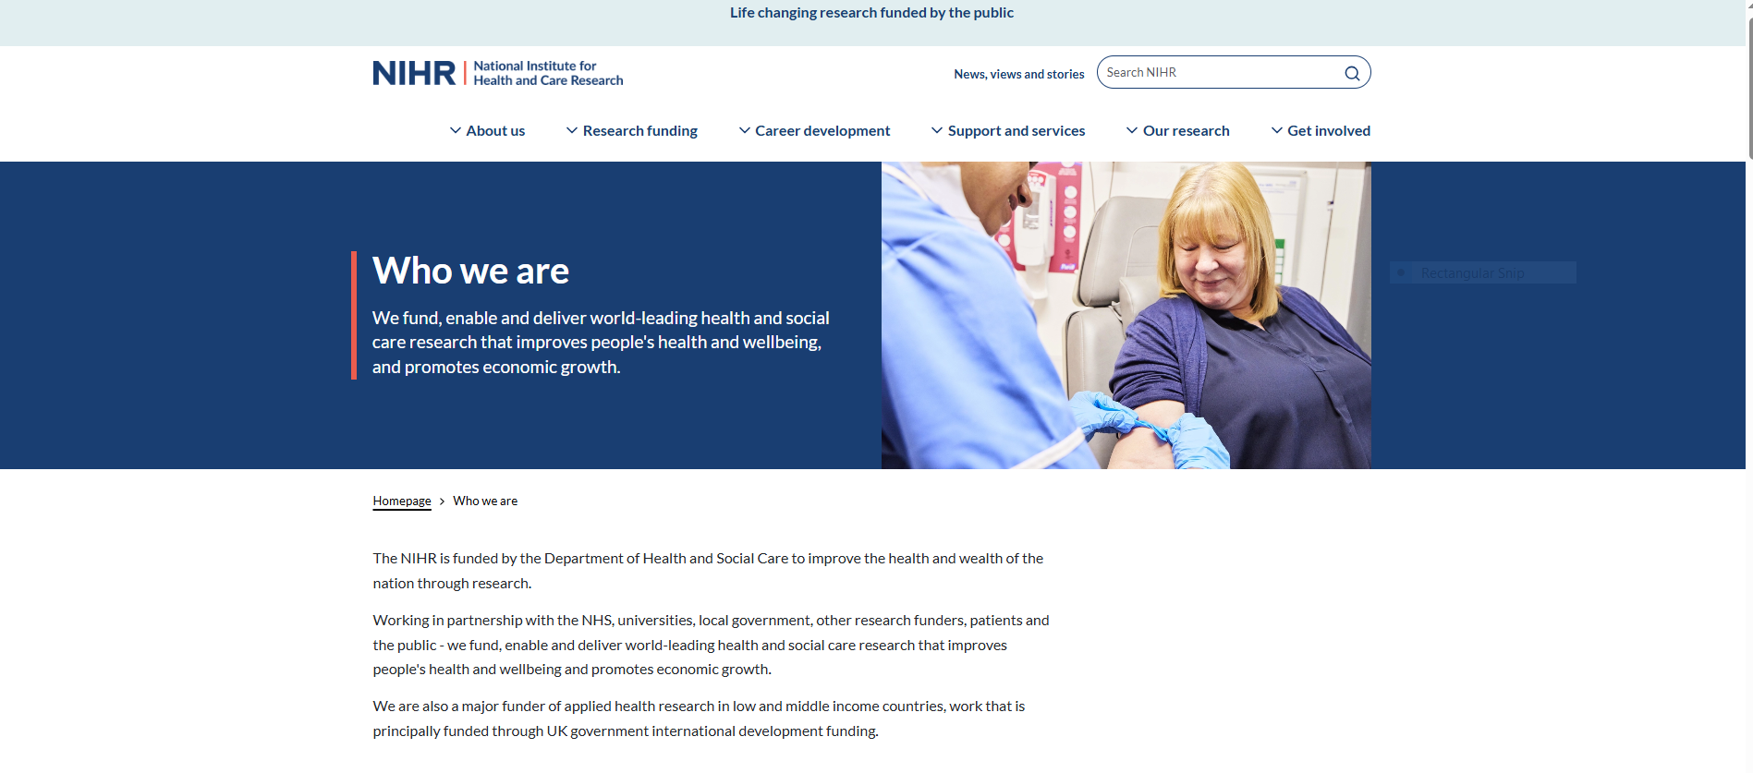

Slide 5
ESHT Performance April 2025-date
Pledge 2025-26: RECRUIT 850 Patients
Recruitment to date: 4033
Trials Open since April 2025: 59

Slide 6
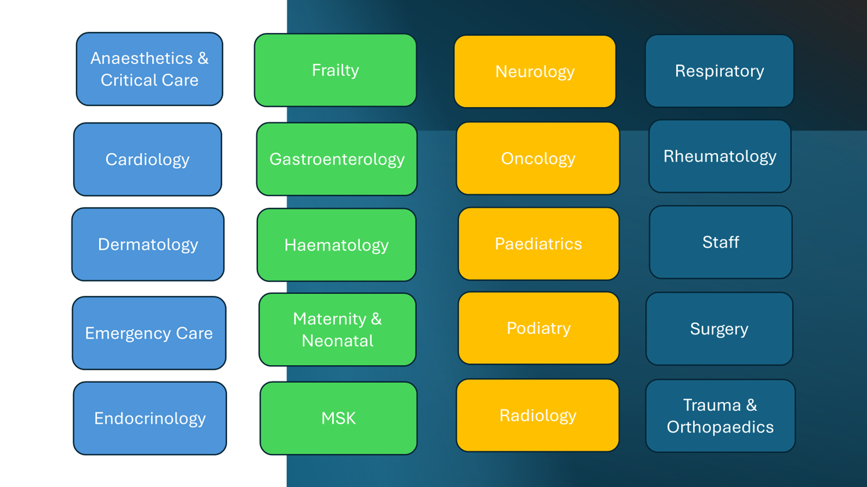

Slide 7
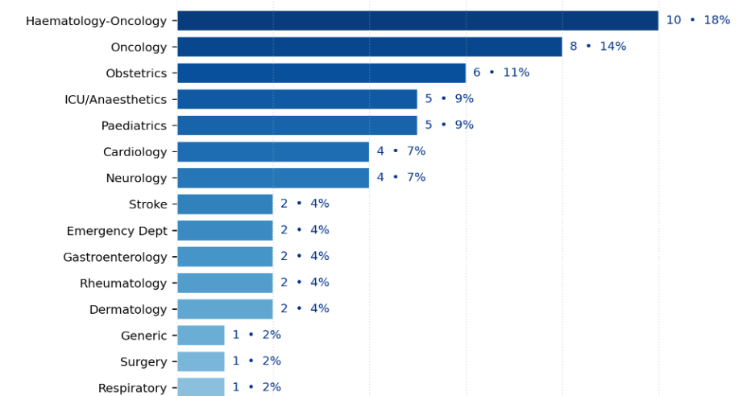

Slide 8

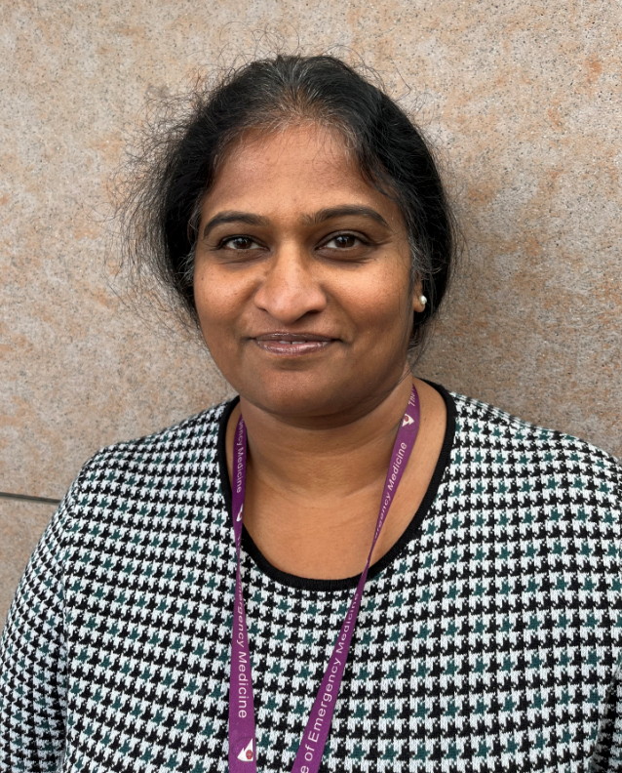


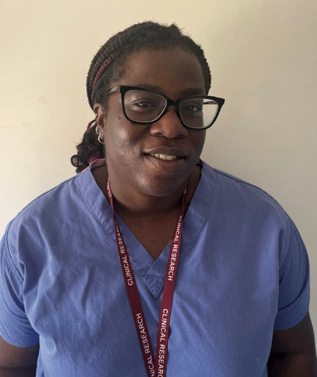
Study Objective
This study aims to compare two treatment methods that are currently standard care for treating wrist fractures.
Per patient £120.00
cost saving
Principal Investigator
Dr Kavitha Anoop, ED Consultant
Hope Ede
Clinical Research Practitioner

Slide 9


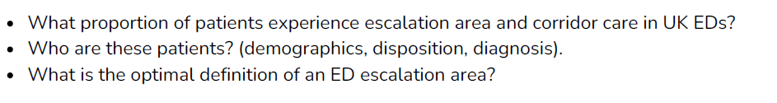

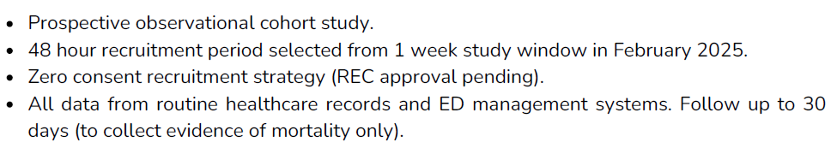
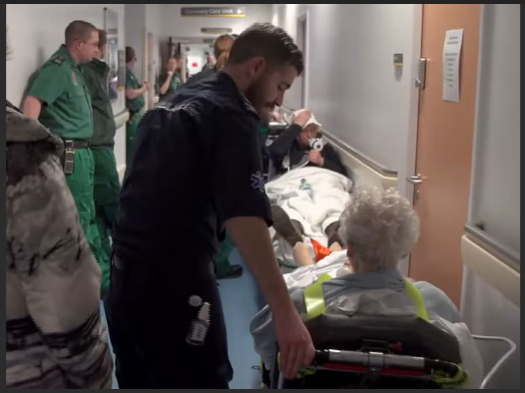


Slide 10


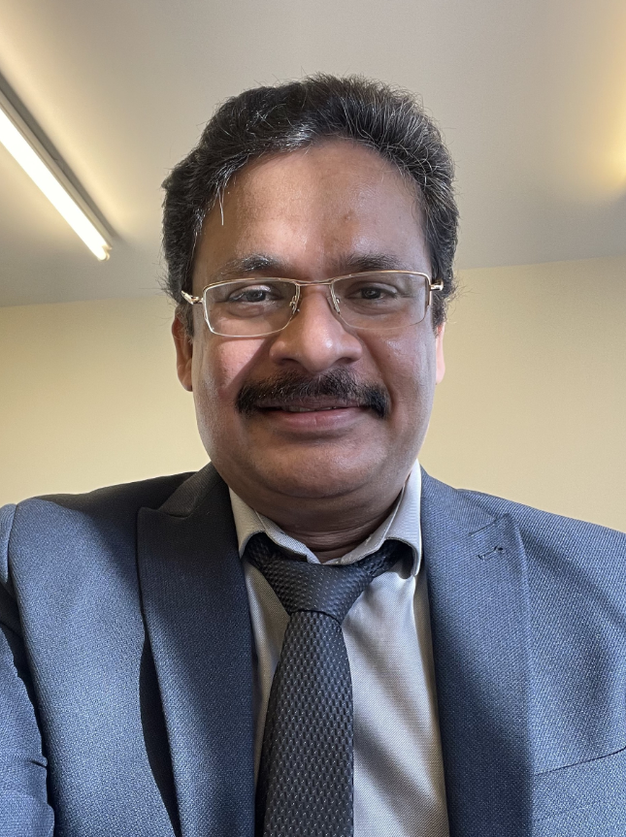
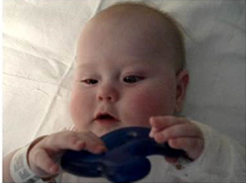
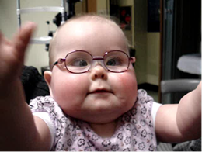
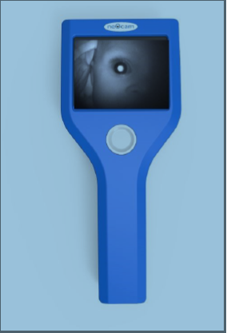
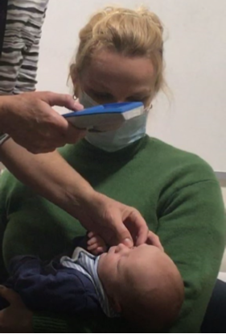
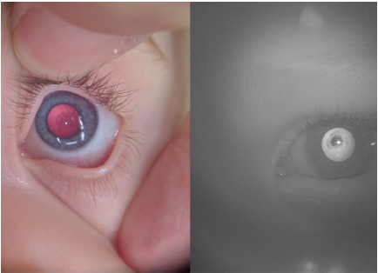
A cataract is an opacity within the lens of the eye
PI: Dr Mani Kandasamy
Consultant Paediatrician
Severe bilateral cataracts detected by the Neocam meant swift surgical intervention helped to save her eyesight.
417 babies recruited

Slide 11



Slide 12
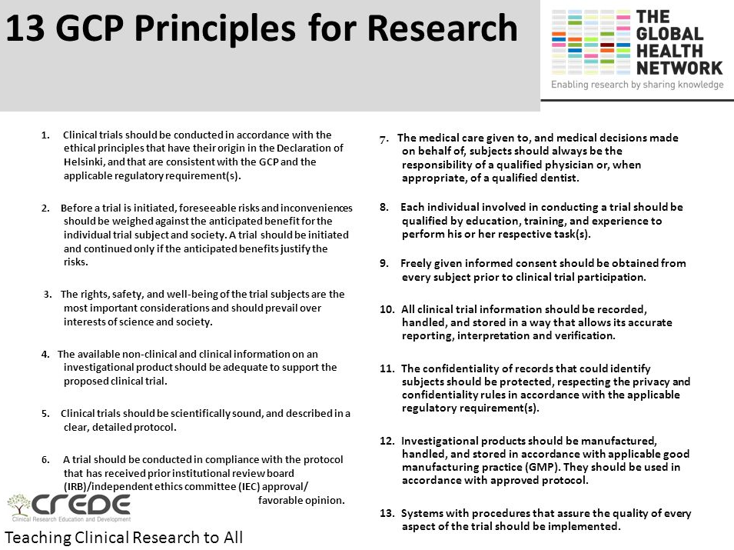

Slide 13
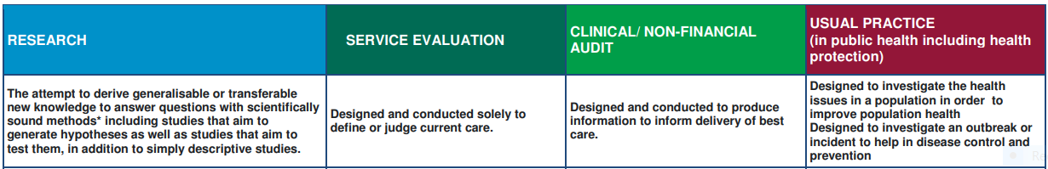
Is My Project Research?
ESHT Home Grown Research – Is my project research?
Research projects attempt to derive generalisable or transferable new knowledge to answer questions with scientifically sound methods.
This includes studies that aim to generate hypotheses as well as those that aim to test them, in addition to simply descriptive studies.
Please note that our Research Governance will only review and assess those projects classified as Research by the HRA decision tool.

Slide 14
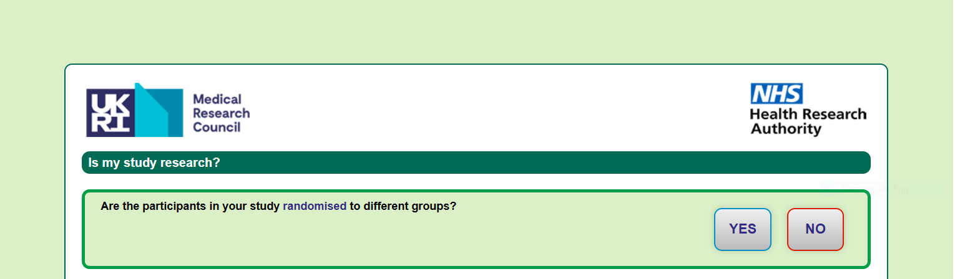
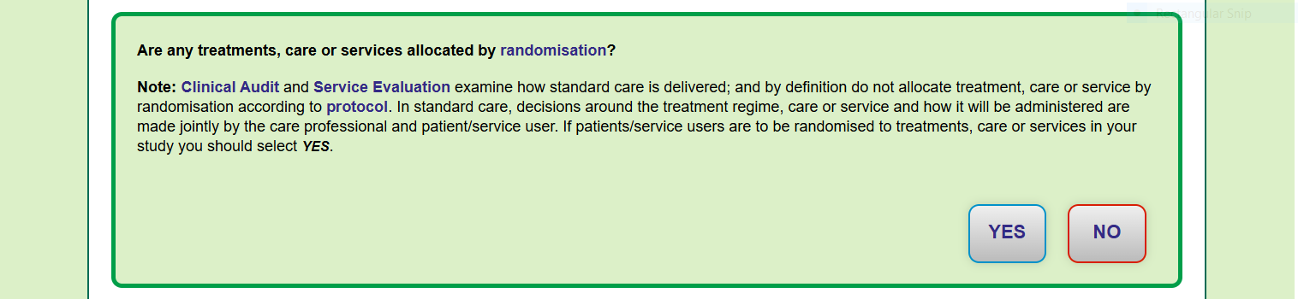
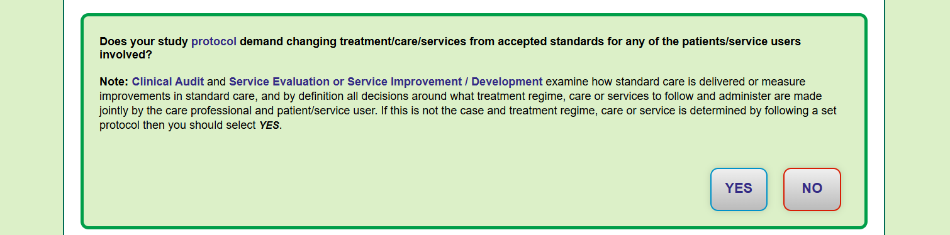

Slide 15
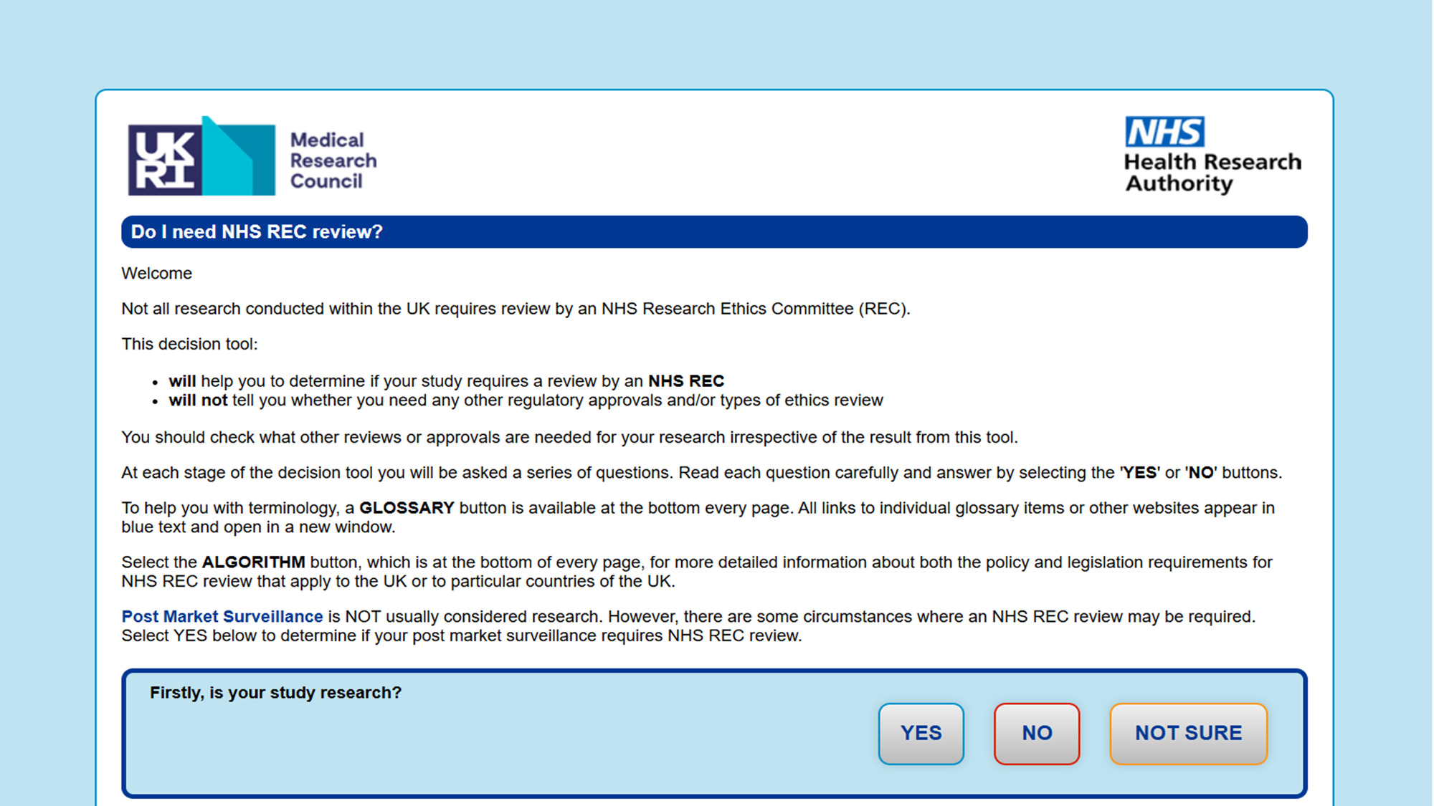

Slide 16
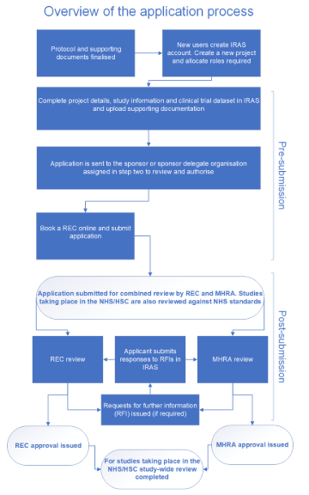

Step by step guide to using IRAS for combined review - Health Research Authority

Slide 17


Slide 18
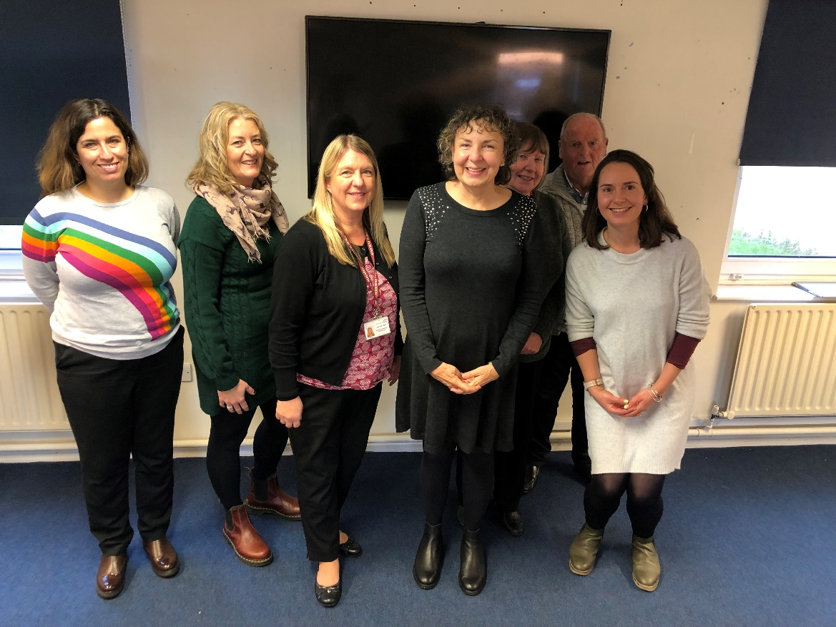

Clinical Research Champions at ESHT
Research Champions are patients, carers, and members of the public, who are passionate about developing better health care and treatments.
NIHR initiative - Supported by the NIHR Kent, Surrey and Sussex region
They help spread the word about research. They also support colleagues to understand a patient’s experience of research
Comment on ESHT clinician research proposals and contribute to design of study and participant documents
Help people find out about research studies, including those available at Be Part of Research and Join Dementia Research
Raise awareness of health and care research and encourage people to take part
Quarterly meetings
Both hospital sites
Penny Boxall Research Champion Lead ESHT
esh-tr.researchanddevelopment@nhs.net
Next Research Champions Mtg: 20th Jan 2026 10-12.30pm Conquest Hospital

