Slide 1
support | protect | represent
Preparing for F1:
An introduction to your first contract
Tim Combley
BMA

Slide 2
Who are the BMA?
The British Medical Association
Your recognised Trade Union with collective bargaining rights
Set up by doctors for doctors
Negotiate national terms and conditions
Over 194,000 doctors & medical students currently in membership
Influence at local, regional and national level
Expert employment advice & support
Career advice & guidance
Sole purpose is to fight for your rights

Slide 3

support | protect | represent
Your contractThe British Medical Association
Your contract should mirror the national terms & conditions
Different contracts in England to Scotland, NI & Wales
You should receive a copy within 8 weeks of starting work
Please chase if you don’t receive a copy
Check it against the national template on the website

Slide 4
Salary
support | protect | represent
Resident doctors in England:
Basic salary at nodal point linked to grade
Five nodal points
Basic pay for 40 hour week
Notes:
You will be paid a basic salary at a nodal pay point linked to your grade or level of responsibility (rather than time served).​
It was 'frontloaded' at the request of the BMA, which means more basic pay is given at the earlier stage of your training.
Thanks to the contract changes agreed last year, a fifth nodal point has been introduced on 1 October 2020 for trainees at ST6 and above, in order to recognise the significant high service contribution these trainees make. This will be introduced through a staggered approach from this month 2020. The pay scales for grades FY1 to ST5 will remain unchanged.

Slide 5
Salary: basic
support | protect | represent
Stage of training | Annual salary value
FY1 | £38,831
FY2 | £44,439
CT1-2 ST1-2 | £52,656
CT3 ST3-5 | £65,048
ST6-8 | £73,992
Notes:
These are the salary points as of 1 April 2020. Each year salary scales are reviewed by the Doctors and Dentists Review Body, which decides whether to increase the salary points with a cost of living rise.

Slide 6
Stage of training | 2022 | 2025/ 2026
FY1 | £29,384 | £38,831
FY2 | £34,012 | £44,439
CT1-2 ST1-2 | £40,257 | £52,656
CT3 ST3-5 | £51,017 | £65,048
ST6-8 | £58,398 | £73,992

Slide 7
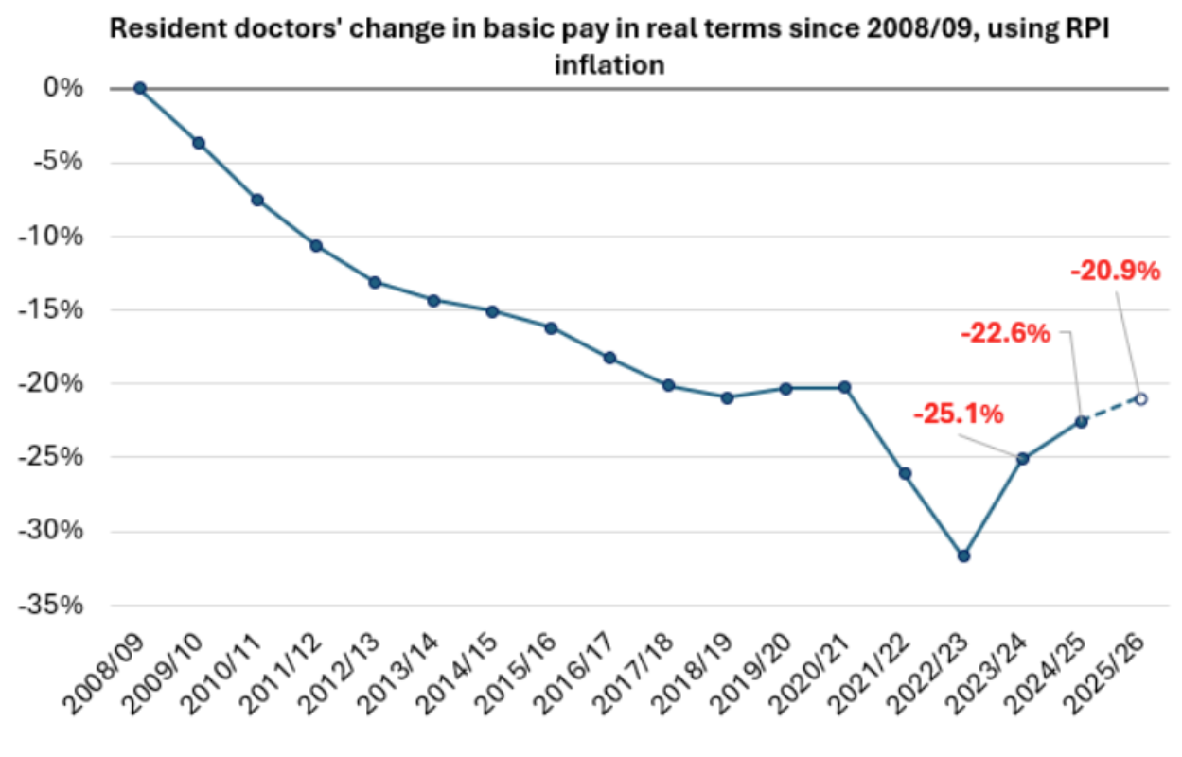

Slide 8
Salary: top-ups
support | protect | represent
Basic salary may be topped up:
up to 8 additional hours @1/40th of basic pay
weekend allowance on-call availability 8%
Anti-social hours 37% 21.00 – 07.00
LTFT £1000
London weighting (if applicable)
Notes:
Most juniors do nearer 48 hours

Slide 9
Salary: weekend allowances
support | protect | represent
Frequency | Allowance
1 weekend in 2 | 15%
<1 weekend in 2 to 1 weekend in 3 | 10%
<1 weekend in 3 to 1 weekend in 4 | 7.5%
<1 weekend in 4 to 1 weekend in 5 | 6%
<1 weekend in 5 to 1 weekend in 6 | 5%
<1 weekend in 6 to 1 weekend in 7 | 4%
<1 weekend in 7 to 1 weekend in 8 | 3%
<1 weekend in 8 | 0%
Notes:
Weekend allowance
If you are rostered to work on a weekend – meaning taking on one or more shifts beginning on a Saturday or a Sunday – at a minimum frequency of 1 in 8 across the length of the rota cycle, you will be paid an allowance.
These will be set as a percentage of your full-time basic salary, in accordance with the rates in this table.

Slide 10
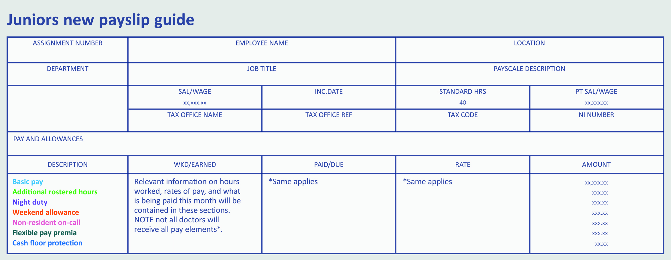
Payslip
Notes:
Your pay slip explained
Basic pay – your relevant nodal pay point for your grade, calculated on an average of 40 hours’ per week
Additional rostered hours – any additional contracted hours over 40 (up to maximum of 48 in total, or 56 for doctors who have opted out of the Working Time Regulations).
Night duty – Any hours receiving an enhanced rate of 37% of your hourly basic pay.
Weekend allowance – An allowance set as a percentage of your basic salary for working 1 in 8 or more frequent weekends.
Non-resident on-call – An allowance of 8% of your basic salary to compensate for your availability while non-resident on-call, regardless of frequency.
Flexible pay premia – Any flexible pay premia that apply, these are currently for emergency medicine, psychiatry, OMFS, academia and GP training, as well as current LTFT trainees and are paid annually.
Cash floor protection – - Not relevant here - Your protected cash floor amount, calculated as your basic salary the day before you transitioned onto the new TCS, plus a banding supplement for the rota you were working the day before transition (based on the banding value for that rota as on 31 October 2015).

Slide 11

support | protect | represent
Pay checker - a tool for resident doctors in England on the 2016 contract
Use Pay checker to make sure you are receiving the pay you are entitled to as a resident doctor in England on the 2016 contract. Check the accuracy of your pay by entering your rota, work schedule and other details. Entering your rota also initiates a safe working check
Regular pay checking
Safe working checks
Downloadable pay reports
Emails to fix your pay
Notes:
Mention contract talk
Our free contract checking service can save you time and money. Before you sign on the dotted line, get each new employment contract checked by our team of experts.
1 in 4 of the contracts we checked in 2020 deviated from the national model, so checking your terms and conditions is vital. We’ll check your contract within 5 working days, comparing it to the BMA’s national model. If there are any discrepancies, you will be assigned a dedicated adviser to help resolve it before it becomes an issue.
As soon as you receive your rota, check that it is compliant with all the rest and hours requirements of the 2016 TCS. Catch any concerns early and raise them to your employer or our employment advisers for support.

Slide 12
Rotas: shift limits
support | protect | represent
Main ones to know:
Max average 48 hours of work per week
Max 1 in 3 weekends, except exceptional circumstances
Max 7 consecutive shifts
Max 4 consecutive long day (12-13 hr) shifts
Min 46 hours rest after any number of nights

Slide 13
Rotas: hours and rest
support | protect | represent
BMA renegotiated better terms in 2018
No more than 48 hours of work per week on average
No more than 72 hours in any 168 hours
5 hour shift =
at least one 30 minute break
9 hour shift =
at least two 30 minute breaks
12 hour shift =
at least three 30 minute breaks (if a night shift)
Notes:
Your contract will include agreed working hours, and allowance for breaks. It is important that these are outlined and adhered to throughout your role.
These agreements will include:
– a maximum average of no more than 48 hours of work per week, and 72 hours within any 168 hour period.
– You should receive at least one 30-minute break for a shift lasting more than 5 hours and
– a second 30-minute break if the shift is more than 9 hours.
These breaks can be taken flexibly during the shift and should be evenly spaced.
Where breaks have been missed on at least 25% of occasions over a 4-week period, a fine may be levied to the trust. If this happens, you should be exception reporting. A work review will also be undertaken to ensure no further breaches occur.​

Slide 14
support | protect | represent
Annual/study and sick leave
– 27 days or, after 5 years, 32 days
– Bank/Public Holidays (8 days)
– life-changing events
– not be fixed to a working pattern
– sick pay
– 15 days study leave
Notes:
Annual/study and sick leave
– annual leave year runs from the start date of the doctor’s appointment
– 27 days or, after 5 years, 32 days
– annual leave must be allowed for life-changing events (wedding day etc.)
– leave should not be fixed to a working pattern for any reason without agreement from the doctor
– sick pay – 1 month full pay, 2 months half pay during first year of service
– 15 days study leave
* Study leave includes: ​
Study – linked to a course or programme​
Research​
Teaching​
Taking exams​
Attending conferences for educational benefit​
Rostered training events​
For F1’s study leave will take the form of regular scheduled teaching/training sessions as agreed locally.​

Slide 15
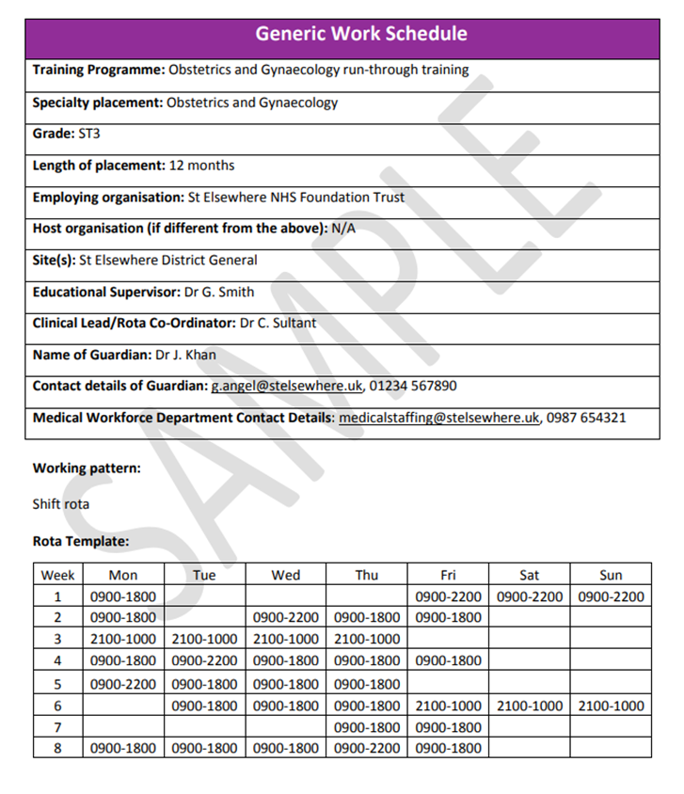
Work schedule
support | protect | represent
Work commitments and training outcomes
Working hours, training opportunities
Rolling rota (remember checker!)
Pay, with breakdown of components (check against payslip)
Key contact details for queries / concerns
(Clinical lead, rota co-ord, medical workforce Dept)
Notes:
Here is an example of a work schedule and what you should expect to find on it.
A work schedule is a document setting out the work commitments and training outcomes in your job.
You will receive a generic work schedule before starting in your post
A personalised version will be agreed in your first meeting with your educational supervisor
It is a single source for all the information you need, including:
- your work commitments and training outcomes
- details of your supervisors, your pay, your working hours and what training you will be doing
- a copy of the rolling rota you will be working to. It will usually apply for the duration of a training placement
the name and contact details of your guardian of safe working
It should also provide details of other useful contacts, such as your clinical lead, rota coordinator and medical workforce department​
Your template rota should be received eight weeks before your post starts, and the duty roster six weeks before.
This means you are able to request leave when you receive a copy of your rota template, so that this can be built into the final roster.

Slide 16
Work schedule
support | protect | represent
Check:
Does rota in schedule match your payslip?
Does rota in schedule match real rota you are working?
Does schedule include your educationally useful activities?
Use work schedule reviews to fix the schedule if necessary
Notes:
If schedule doesn’t match payslip then you may be paid wrong so make sure you double check that the rota reflects what you are working in reality.
If you have concerns about your work schedule, a risk to patient safety or your own safety as a result of working hours breached, a review can be requested by you, your supervisor, manager or the guardian.
Ideally problems will be resolved by making adjustments to the work schedule​
In some cases retrospective pay or compensatory time off in lieu may be awarded
You must meet with your supervisors within 4 weeks of your start date, and can be released from clinical duties for this.

Slide 17
BMA support – Rota checking
support | protect | represent
When you receive your personalised rota (6 weeks before you start a new rotation) run it past our online rota checker.
It’s simple to use and effective in spotting non-compliant rotas. Always check that your rota matches your work schedule.
Use our rota checking app:
https://rotachecker.bma.org.uk
Notes:
SAM
It’s best to catch rota concerns early so you can negotiate required changes with your employer.
Compliance with contractual rules is only one part of a well-designed rota. We've developed comprehensive guidance on the principals of good rota design to improve your wellbeing and safety in the workplace.
Our rota checker tool takes only a few minutes to check whether your rota complies with the England JD 2016 contract. You'll receive your results immediately and, if required, you can be referred to a dedicated employment adviser to help you with the next steps.

Slide 18
support | protect | represent
Exception reporting
Working over your scheduled hours
Missing training opportunities
Missing breaks
Not receiving Self development time
= Exception report it!
Where a work schedule does not reflect the reality of what you are doing, in terms of service or training. ​
Electronic exception report submitted to educational supervisor
Submit your exception report as soon as possible after the exception takes place, within a maximum of 14 days (or 7 days when making a claim for pay)
Notes:
Exception reporting
- Doctors will raise exception reports where their work schedule does not reflect the reality of what they are doing, in terms of service or training. ​Ideally, keep a diary of your hours/working and a copy of your work schedule, note the time, date & reason for report in a diary entry so you can keep track.
- If exception report not addressed or not resolved call FPC on 0300 123 1233 and open a case with BMA
Copy to guardian of safe working hours (if hours breach) or the Director of Medical Education (if a training breach). The doctor should send the exception report as soon as possible after the exception takes place, within a maximum of 14 days (or 7 days when making a claim for pay). Ideally the problem is resolved quickly within the trust probably with an adjustment to the work schedule but exception reporting also allows for the payment of unplanned hours worked
What to do when I have immediate safety concerns?
discuss with clinician responsible
confirm the breach electronically
clinician must take immediate action
notify clinical supervisor and guardian within 24 hours
clinical supervisor to take further action if needed
The purpose is to ensure a work schedule remains fit for purpose, where informal discussions may have failed to resolve concerns. ​
Exception reports give employers real time information to identify patterns and pick up any issues quickly. ​
These should be addressed ASAP by the educational/clinical supervisor and may lead to work schedule review ​

Slide 19

Time Out Of Training (TOOT)
For those in Foundation Year 1 and 2, if you take more than 20 days out of training (when you would normally be at work), this may lead to a review of overall performance and achievement of curricular outcomes, but does not mean an automatic extension to training. Provided that outcomes are being met, there would be no justification to extend training as a result of taking industrial action.
More info: https://www.bma.org.uk/pay-and-contracts/leave/time-out-of-training-toot/time-out-of-training-toot

Slide 20
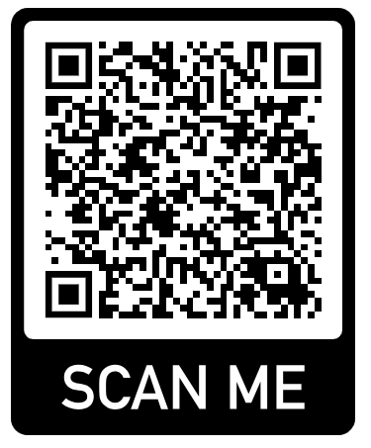
Please provide your details so I can send you the Resident Doctor Handbook

Slide 21
Membership benefits for members Tools to help you prepare for your F1 post

Slide 22

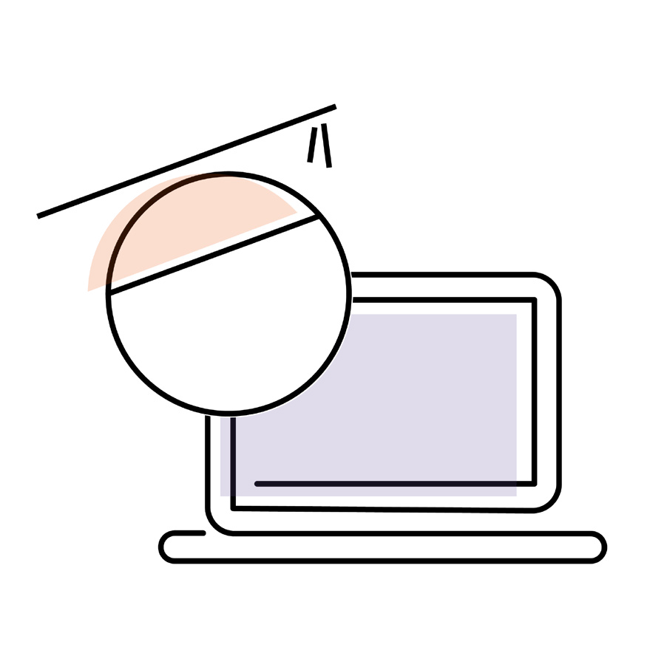
BMJ learning – clinical modules
Access to hundreds of accredited, peer reviewed e-learning modules based on the latest evidence and guidelines.
Hospital presentations: joint swelling
Cervical cancer and the human papillomavirus vaccination
The health benefits of physical activity: Cancer
Free module: Lumps, bumps, and sarcomas: a guide
Giant cell arteritis
Arterial blood gases: a guide to interpretation
Motivational interviewing in brief consultations
Starting patients on anticoagulants in secondary care: how to do it
Assessing pain and using the analgesic ladder
Upper gastrointestinal bleeding: acute assessment and treatment of non-variceal bleeds
Notes:
Talk around top ten downloads……………….live data from the guys at BMJ. Top ten downloads by students. I have so many foundation doctors tell me how fantastic BMJ learning is and how they discovered it as a student.

Slide 23
BMJ learning – non-clinical
- Medical CVs and applications
- Career planning
Hit the wards running with -
Workload and time management
Effective handovers
Building professional relationships
Giving & receiving useful feedback
Interview skills for speciality posts
Presenting skills
Negotiating skills
Preparing for your FY1 role
Notes:
Non-clinical skills, look at the offering, its vast for your professional development

Slide 24

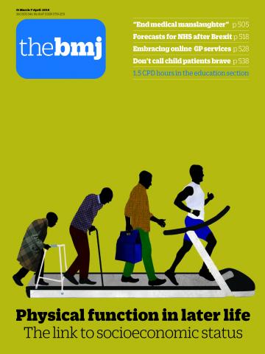
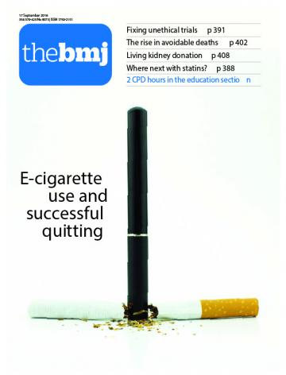
support | protect | represent
The British Medical Journal
FREE upgrade to the full BMJ today for all members and
new joiners.
Print version or app available.
Want to upgrade - email me (John):
Jhayward@bma.org.uk

Slide 25
support | protect | represent
BMA Library
Your one-stop shop for studying.
Access everything online:
Thousands of textbooks and journals
Medical databases
Experts to help with research
bma.org.uk/library

Slide 26
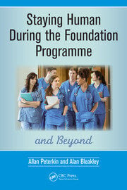
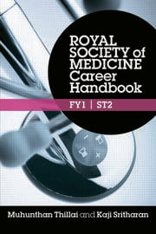


BMA Library
Reading list
All available through the BMA Library for free!
bma.org.uk/library
Combined value: £85
Notes:
BMA Library is home to thousands of online textbooks and journals that you can access whenever you need to.
You can also use the medical databases; Embase and Medline
Our team of experts are there to help with your research
And ClinicalKey Student is our newest addition

Slide 27
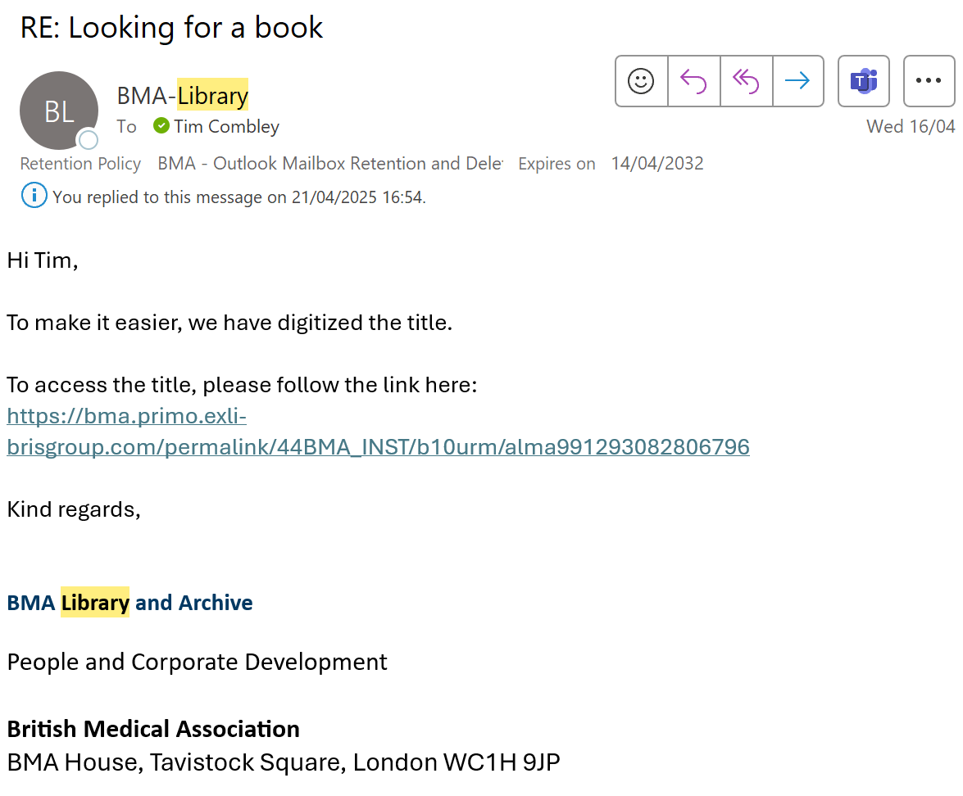
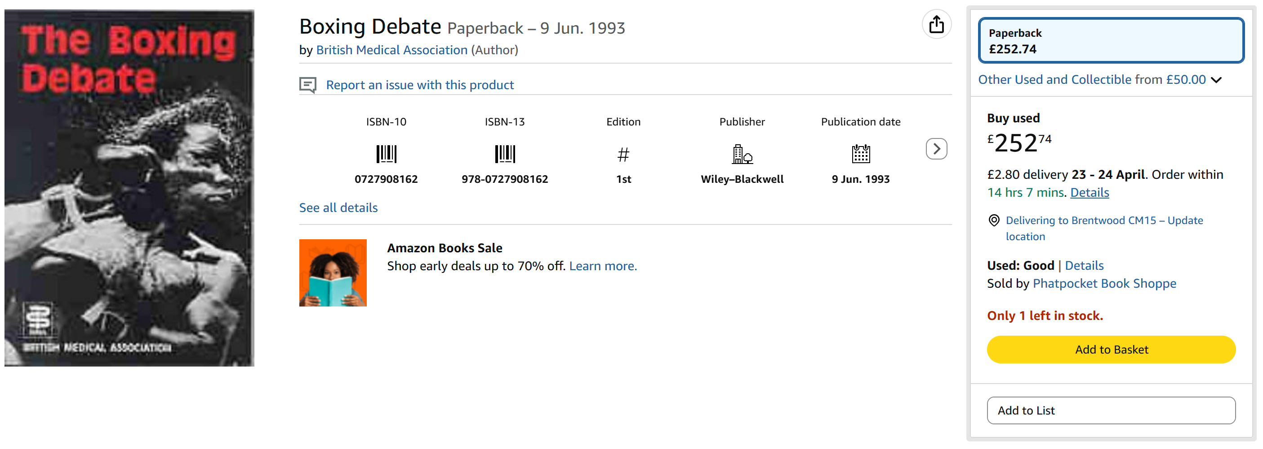
support | protect | represent
BMA Library

Slide 28

Your wellbeing
support | protect | represent
Our confidential counselling and peer support services are open 24/7 and free of charge to all doctors and medical students.
There is always someone you can talk to.
0330 123 1245
bma.org.uk/yourwellbeing
Notes:
These are exceptional times for the health service, and as new doctors you may find yourselves experiencing additional pressures, stress or anxiety as you enter the workforce.
If at any time you need support, or you would like to speak to someone in confidence, please know that we are here for you. Our BMA wellbeing support services are open 24/7 to all doctors and medical students.​ You will have the choice of speaking to a counsellor, or another doctor who you can contact for peer support. ​Visit bma.org.uk or call 0330 123 1245
​The services are confidential and free of charge.

Slide 29
support | protect | represent
Your Starting Work Checklist:
Join the BMA!
Contact the BMA with any questions about your contract / work schedule
Make sure you’re working the correct hours with the BMA’s Rota Checking Tool
Familiarise yourself with the Exception Reporting platform at your place of work
Use the BMA Pay Checker
Update us of your change of address/email/workplace
Contact our advice team through the website if you have any questions

Slide 30
Please provide your details so I can send you the Resident Doctor Handbook

Slide 31
support | protect | represent
Join Today
£10 Amazon Voucher
for new joiners
tcombley@bma.org.uk

Slide 32
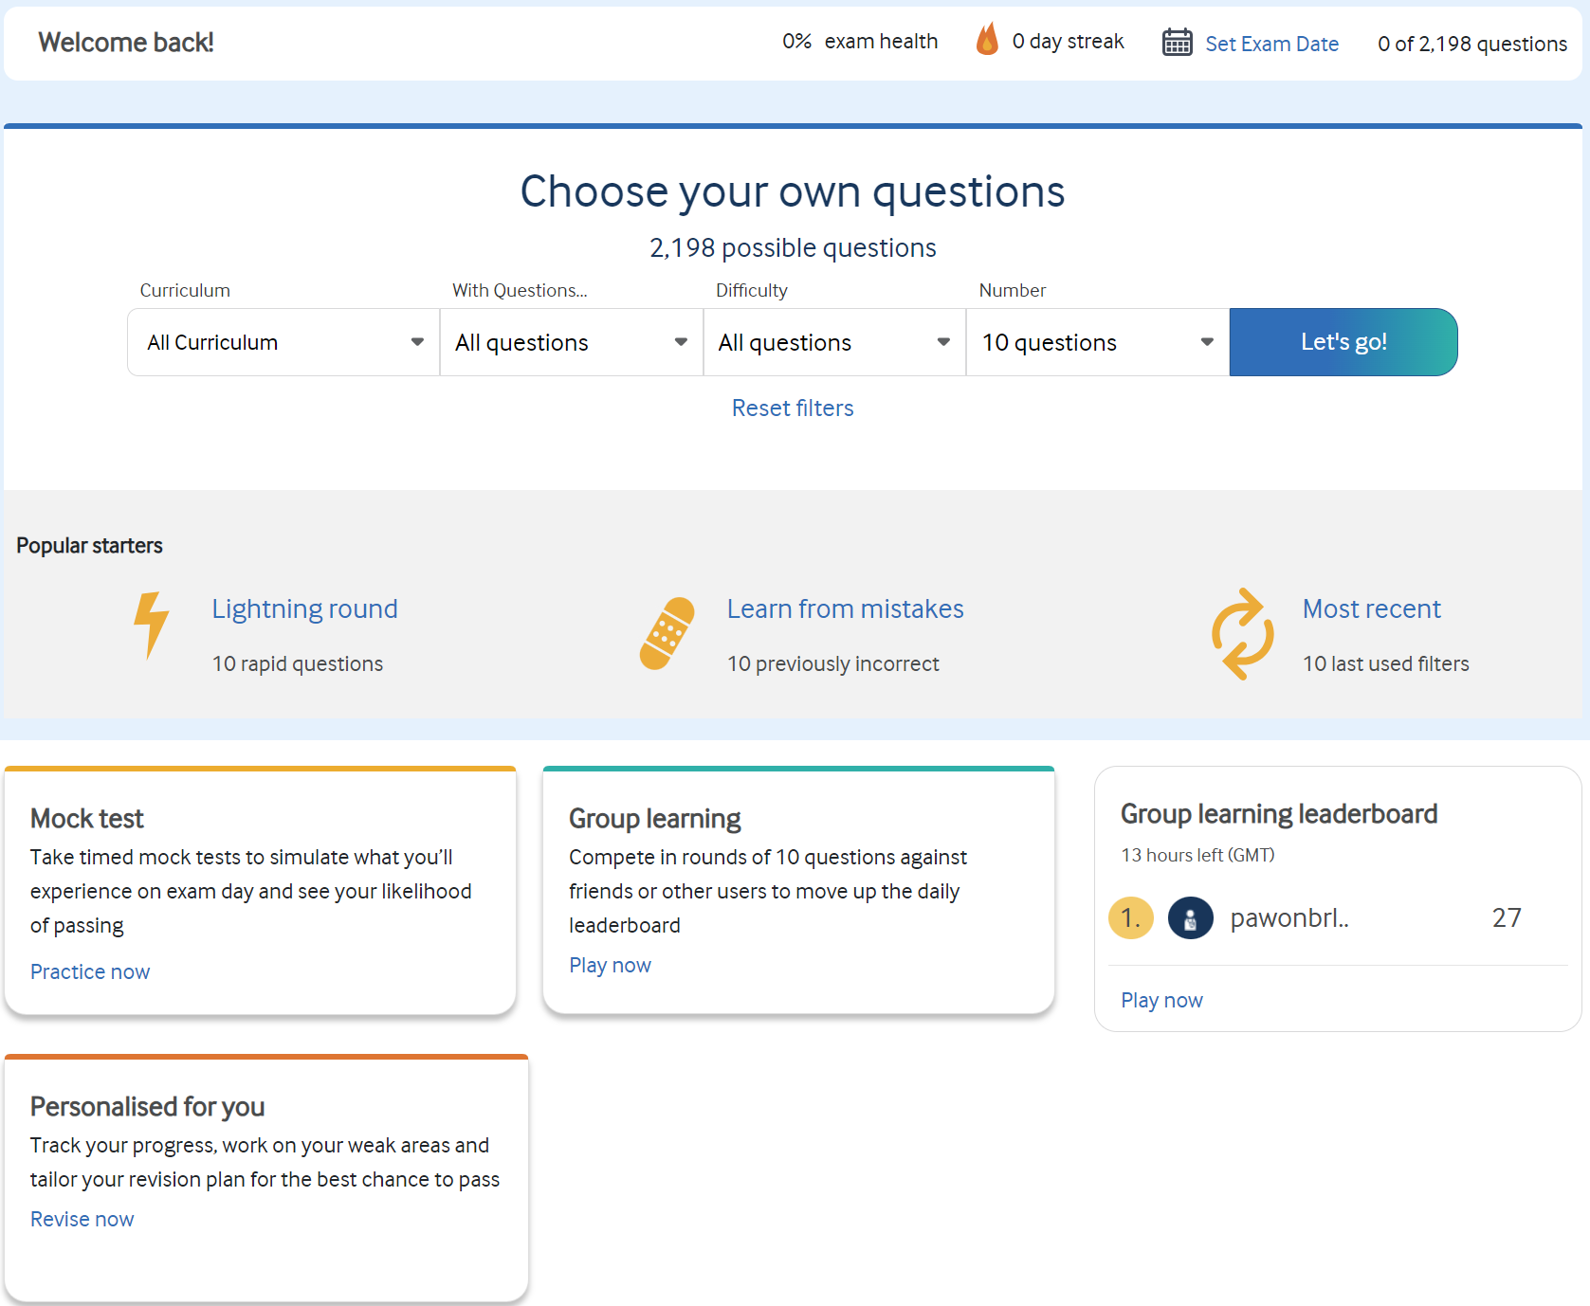
Notes:
Curriculum- The MLA focusses on what you are most likely to see in your foundation years so there is an imbalance towards those areas of medicine. There’ll be more about patients presenting with broken arms and tummy aches than complex brain surgery. You can choose what areas you want to focus on with the curriculum dropdown box.
With questions doesn’t matter the first time you use it however on subsequent time you can use that to filter out questions you have seen before and got correct. So if you want to only see questions you haven’t done you can select that filter and if you only want to see questions you have got incorrect you can filter to that too.
Difficulty- Easy, medium, hard.
Number of questions.
Popular starters, pre-set filters.
Mock test- best way to see what the assessment is going to be like. This will be in exam format, timed and in exam conditions.
Group learning is a way to compete against your classmates or other random, anonymous users to climb that leaderboard. Just to reiterate the MLA itself is either pass or fail, it is not ranked, however if you want to get competitive in your revision, this is a fun way to do that.

Slide 33
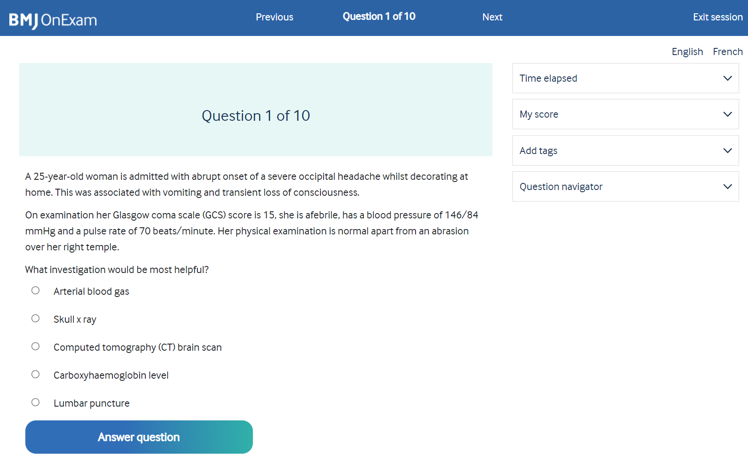
Notes:
Really simple and easy to use.
A question with 5 possible answers, reflecting the 5 options you will have in the real thing. Now as you will see there’s quite a lot of information there to think about.
Age, gender, symptoms along with GCS score and blood pressure. If you recall this is an assessment of your application of knowledge to a real world example as opposed to your ability to repeat information.
Before I go on, if anyone wants to write what they think the answer is in the chat then go ahead.

Slide 34
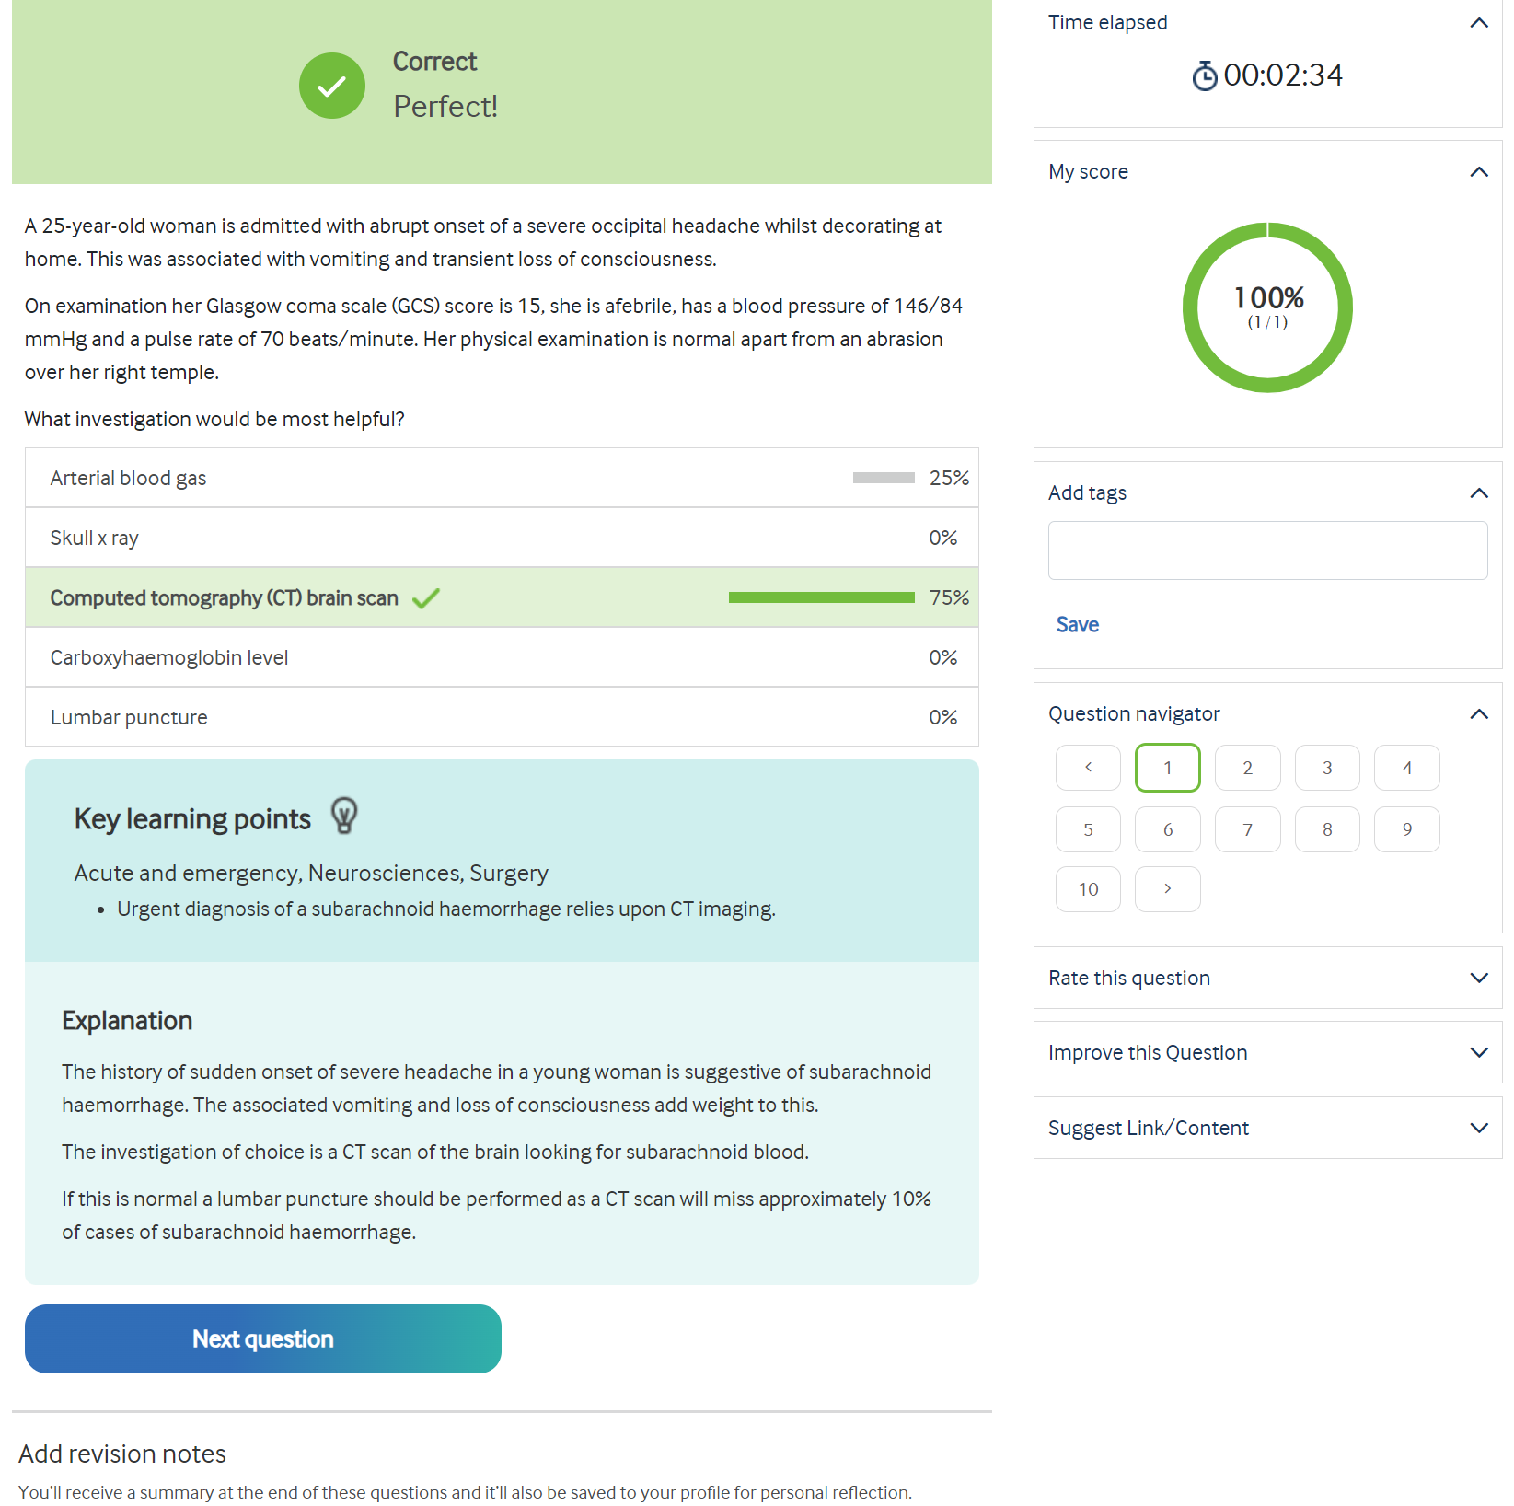
Notes:
Luckily I managed to get this one correct. I’m not a medic
Go through learning points and explanation- Lumbar Puncture
REVISION NOTES
DROPDOWN BOXES

Slide 35
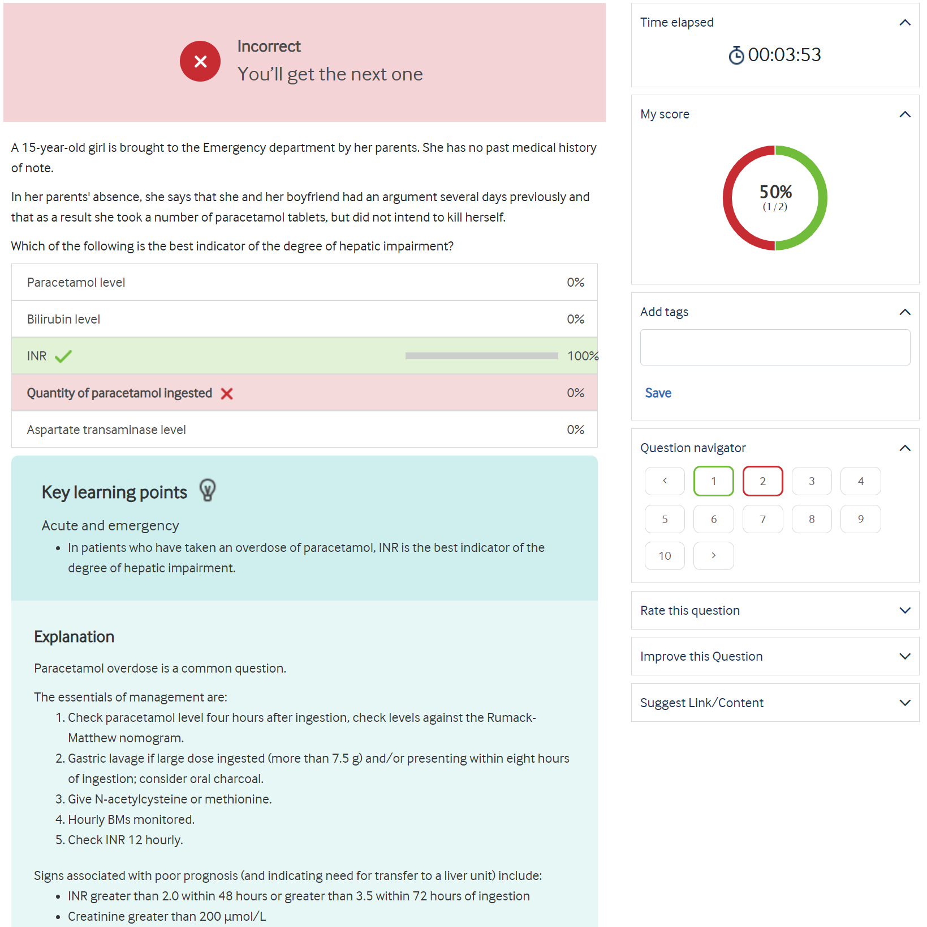
Notes:
Just to show you what it looks like if you get a question wrong. My score has gone down

Slide 36
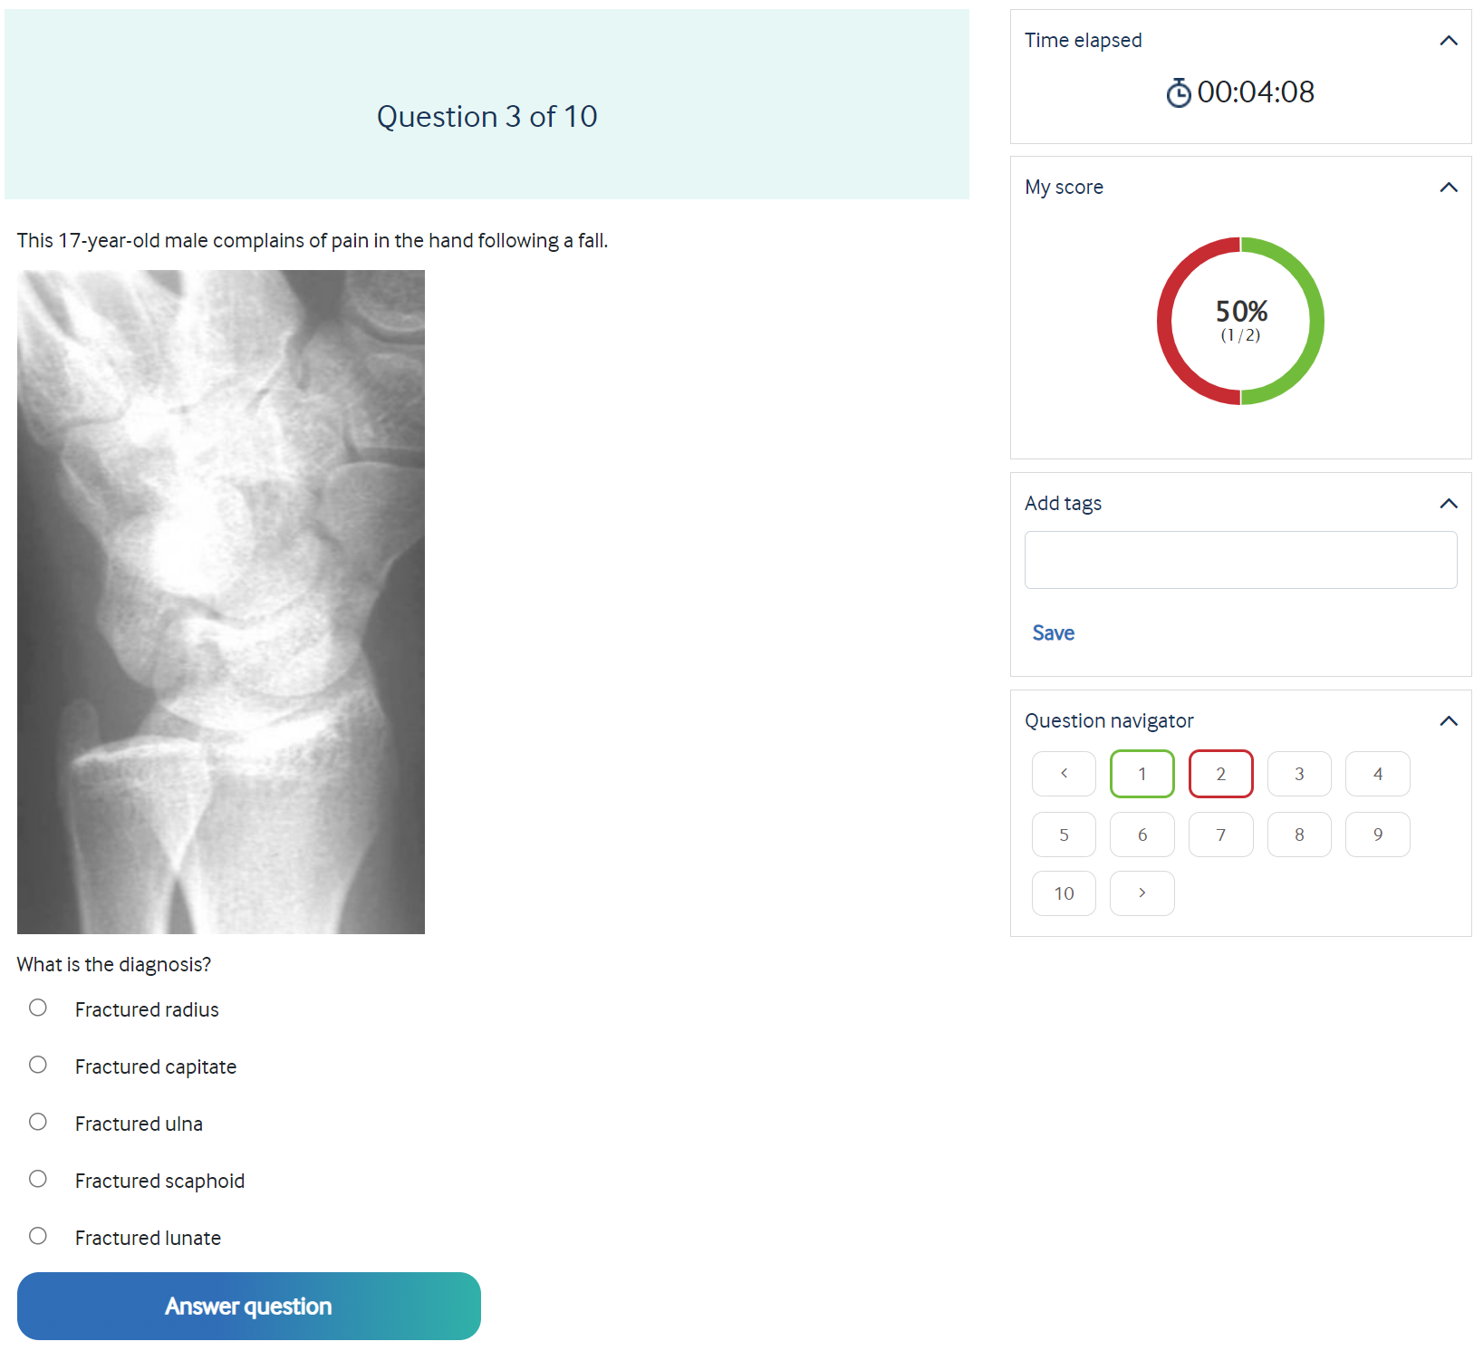
Notes:
This shows that it isn’t all written. You might have to assess x-rays and scans plus complex data.

Slide 37
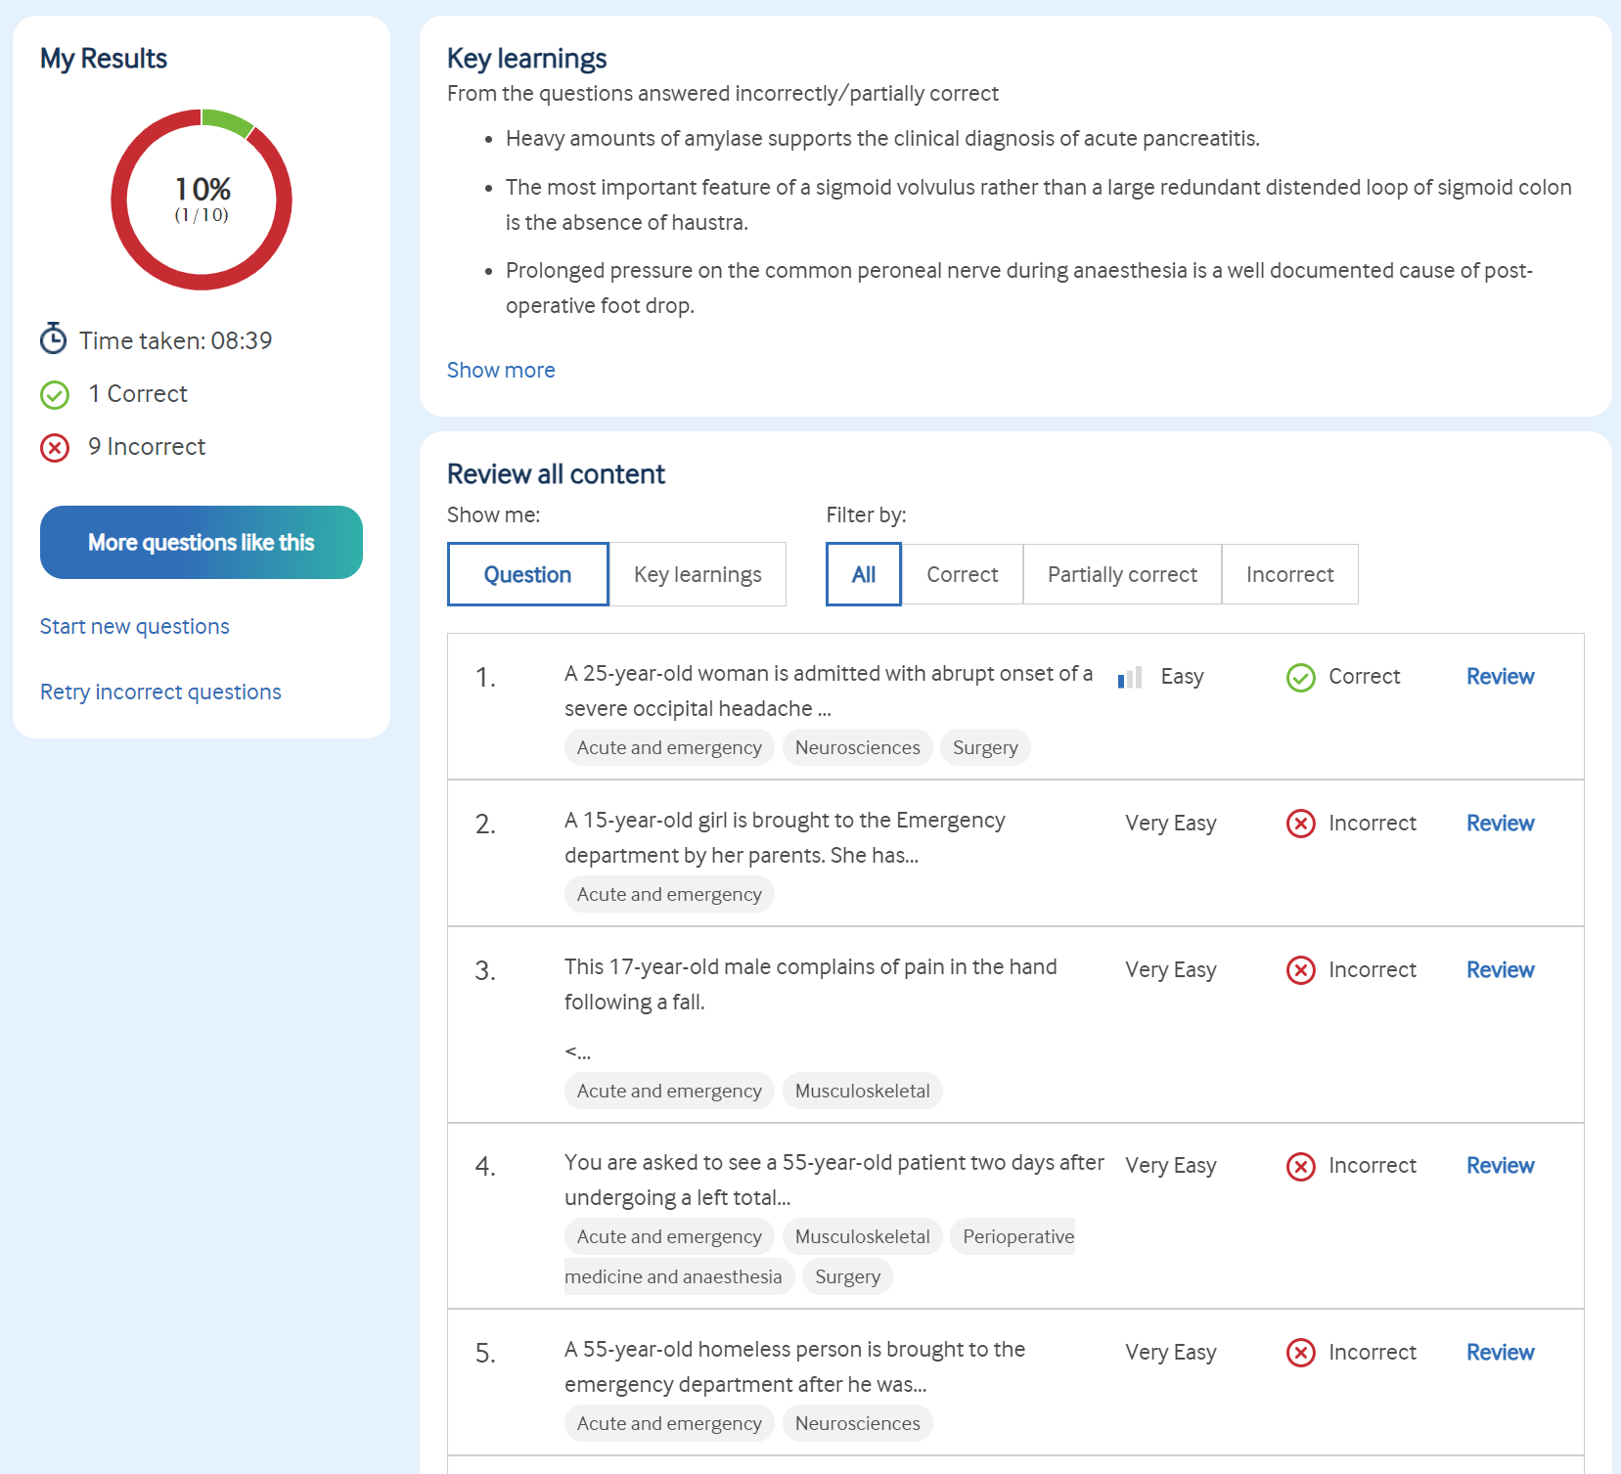
Notes:
Then at the end it provides a summary. As you can see I didn’t do very well, I’m sure you’ll all do better but if you remember you can filter questions to ones you have got wrong so if I want to revisit them in the future I can.
I can also go back and review the notes and explanations to all the questions.
So that’s BMJ OnExam in a nutshell. It’s a great tool that’s going to be essential for your practice and revision. To remind you, it’s FREE with your BMA Membership and available offline through the app.

