Slide 1

Acute Care Block Induction
Dr. Charlotte Rooks (A&E Educational Fellow)
Dr. Mohammed Quraishi, Consultant Urologist (Acute Care Block Lead; KCL)

Slide 2
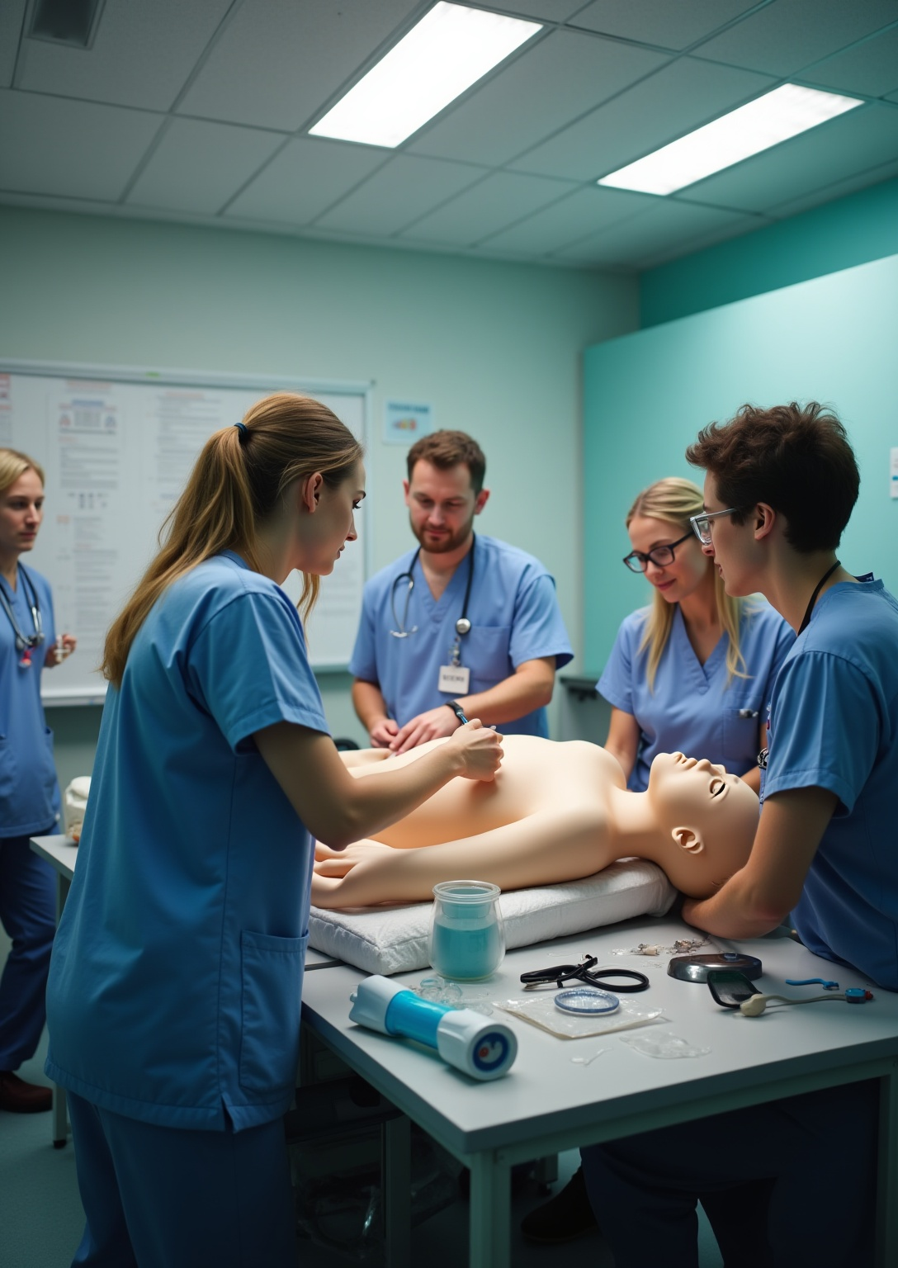
Block Overview
•Interactive Lessons on acute medical & surgical emergencies
•Simulation (SIM) session
• Mock OSCEs
•Case-Base Discussions (CBDs)
•Regular bedside teaching
•Weekly catch-up meetings

Slide 3

Attendance Policy
Ensure you attend all mandatory and monitored lessons and sessions!

Slide 4
Teaching Timetable
Prescribing
Mock OSCEs
CBDs -
Sepsis and Syncope
Resus Training
SIMS (All day)
Acute abdomen

Slide 5
Teaching Timetable
Basic Suturing Skills
Upper GI bleed
Surgical emergencies -
Joint examination session
ENT emergencies -

Slide 6
Points of contact
For educational support and clinical supervision during the block, contact :
-Dr. Charlotte Rooks (A&E Educational Fellow)
-Dr. Mohammed Quraishi, Consultant Urologist (Acute Care Block Lead; KCL)

Slide 7
“Your F1 Rehearsal Starts Here”
📅 Every ward round, every bedside teaching, every SIM is a safe rehearsal for next year.
👏 Engage fully, and you’ll walk into F1 ready, resilient, and confident.
🌟 Make this block your turning point.

Slide 8

Thank you!
Do you have any questions?

