Slide 1


Becoming a resident doctor:
Intro to your first contract
John Hayward
British Medical Association
Any questions – please contact me: JHAYWARD@BMA.ORG.UK

Slide 2


Complete a form today (date the form 1st June) and receive
3 MONTHS FREE MEMBERSHIP
+ paper Dr BMJ – Not available online
Any questions – please contact me: JHAYWARD@BMA.ORG.UK
Notes:
Join/ re-join the BMA today using this link and get a £10 amazon voucher: https://join.bma.org.uk/intro?campaigncode=4050
Once joined, drop me an email JHayward@bma.org.uk with your BMA ID number and I’ll arrange your voucher to be sent by email.
If you’re unsure whether you’re in membership, email me with your full name and DOB.

Slide 3

Who are the BMA?
Trade union only for doctors and medical students
Probably the strongest trade union in the UK right now
Represent you locally and nationally
Individual support
Professional development and learning tools
Here throughout your career
Everything non-clinical, pay, contracts etc
*Not the same as indemnity, although we recommend you have that too*
Joining the BMA allows you to become part of a community of over 194,000 members doctors and medical students
Notes:
The BMA is the doctors’ trade union and professional association. We are the voice of the medical profession, representing all doctors and medical students locally and nationally on the issues that affect you.
The more members we have, the stronger we are as a TU. YOU are the BMA, without members we would not exist.
We are here if you experience any difficulties at work, need career support or want to build on your professional development.
We are not an indemnity insurer and we don’t deal with patient complaints, so we recommend you seek this cover.
We’re going to give you some tips on pay and contracts for new starters in all grades, and tell you about what the BMA does for you individually, at your new Trust and nationally

Slide 4
What are the main issues that Resident Dr’s ask the BMA about?
The British Medical Association
Your contract (terms & conditions of service)
Your pay (payslips & deductions)
The hours that you work (rotas)
Annual leave issues

Slide 5
support | protect | represent
Your contractThe British Medical Association
Your contract should mirror the national terms & conditions
Different contracts in England (2016) to Scotland, NI & Wales (2002)
You should receive a copy within 8 weeks of starting work
25% of contracts checked in 2025 were incorrect
Please chase if you don’t receive a copy
Check your contract with BMA online templates
Top Tip: Check if you are being paid for full shadowing period or
if some days are voluntary & not paid

Slide 6
support | protect | represent
Working time directivehe British Medical Association
You may be asked to sign out of working time directive (formerly EWTD)
You don’t have to!
Signing out may increase your working hours from max of 48 to 56 hours per week on average
You should always have a choice & not be pressurised/bullied into signing out
Not signing out will not affect any Dr’s pay
Please check what you are signing, if you sign out and change you mind, employer may hold you to a three month period before opting back in

Slide 7
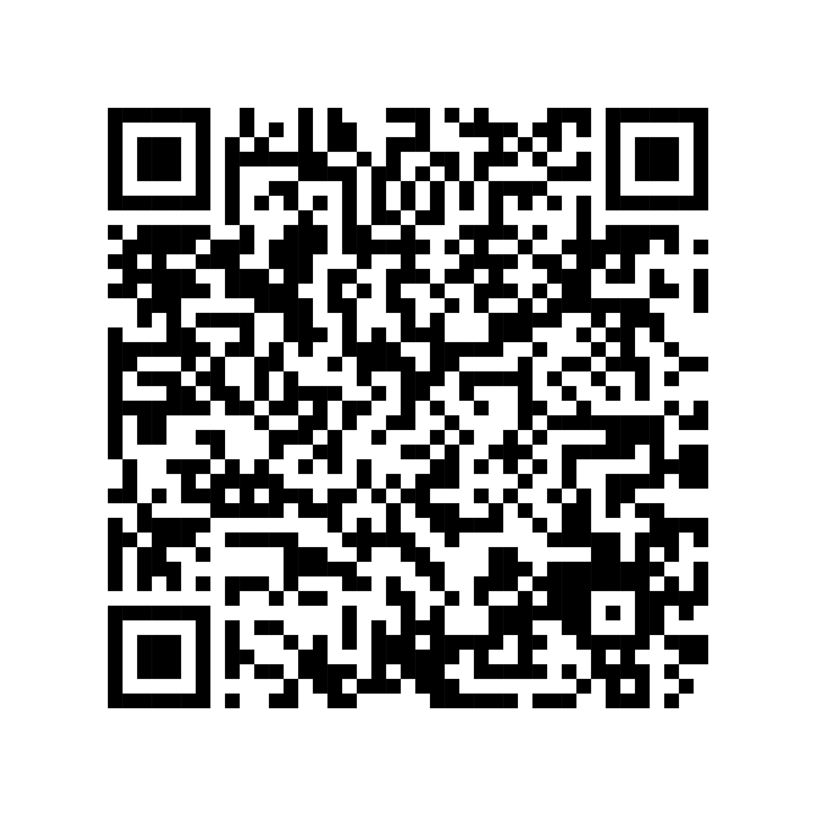

support | protect | represent
BMA support – Check your contract
How to get your first contract checked
In 2025, 1 in 4 of the contracts checked did not comply with the national model. Terms & conditions are sometimes added or omitted.
Visit our website and use our contract checking tool to make sure your contract is correct:
https://www.bma.org.uk/pay-and-contracts/contracts/your-contract-of-employment/your-contract-of-employment#heading_c231e02504ee4e1bb91e9d049d39d30c
Notes:
Our free contract checking template can save you time and money. Before you sign on the dotted line, get each new employment contract checked by our team of experts.
1 in 4 of the contracts we checked in 2020 deviated from the national model, so checking your terms and conditions is vital. We’ll check your contract within 5 working days, comparing it to the BMA’s national model. If there are any discrepancies, you will be assigned a dedicated adviser to help resolve it before it becomes an issue.
As soon as you receive your rota, check that it is compliant with all the rest and hours requirements of the 2016 TCS. Catch any concerns early and raise them to your employer or our employment advisers for support.

Slide 8
support | protect | represent
DDRB – Doctors & Dentists review body
The British Medical Association
The DDRB is the independent body that advises the UK government on the pay of doctors and dentists in the National Health Service (NHS).
Many organisations provide evidence to help determine the DDRB recommendation (including BMA)
The Government(s) then decide to accept to reject recommendations.

Slide 9

Salary
support | protect | represent
Resident doctors in England:
Basic salary at nodal point linked to grade
Basic salary - £38,831
Five nodal points
Basic pay for 40 hour week + top ups
Notes:
You will be paid a basic salary at a nodal pay point linked to your grade or level of responsibility (rather than time served).​
It was 'frontloaded' at the request of the BMA, which means more basic pay is given at the earlier stage of your training.
Thanks to the contract changes agreed last year, a fifth nodal point has been introduced on 1 October 2020 for trainees at ST6 and above, in order to recognise the significant high service contribution these trainees make. This will be introduced through a staggered approach from this month 2020. The pay scales for grades FY1 to ST5 will remain unchanged.

Slide 10
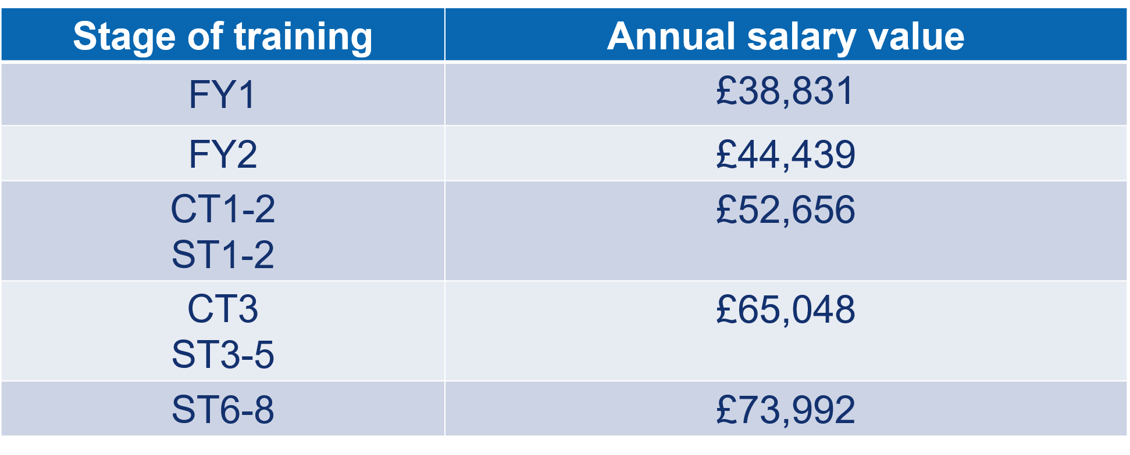
Salary: basic (England)
support | protect | represent
Notes:
These are the salary points as of 1 April 2020. Each year salary scales are reviewed by the Doctors and Dentists Review Body, which decides whether to increase the salary points with a cost of living rise.

Slide 11
Salary: top-ups
support | protect | represent
Basic salary may be topped up:
up to 8 additional hours @1/40th of basic pay (£18.66 p/h)
weekend allowance on-call availability 8%
Anti-social hours 37% 21.00 – 07.00 (£25.57 p/h)
LTFT £1000
London weighting (£2126 per year if central, decreases further out)
Notes:
Most juniors do nearer 48 hours

Slide 12
Salary: weekend allowances
support | protect | represent
Frequency | Allowance
1 weekend in 2 | 15%
<1 weekend in 2 to 1 weekend in 3 | 10%
<1 weekend in 3 to 1 weekend in 4 | 7.5%
<1 weekend in 4 to 1 weekend in 5 | 6%
<1 weekend in 5 to 1 weekend in 6 | 5%
<1 weekend in 6 to 1 weekend in 7 | 4%
<1 weekend in 7 to 1 weekend in 8 | 3%
<1 weekend in 8 | 0%
Notes:
Weekend allowance
If you are rostered to work on a weekend – meaning taking on one or more shifts beginning on a Saturday or a Sunday – at a minimum frequency of 1 in 8 across the length of the rota cycle, you will be paid an allowance.
These will be set as a percentage of your full-time basic salary, in accordance with the rates in this table.

Slide 13
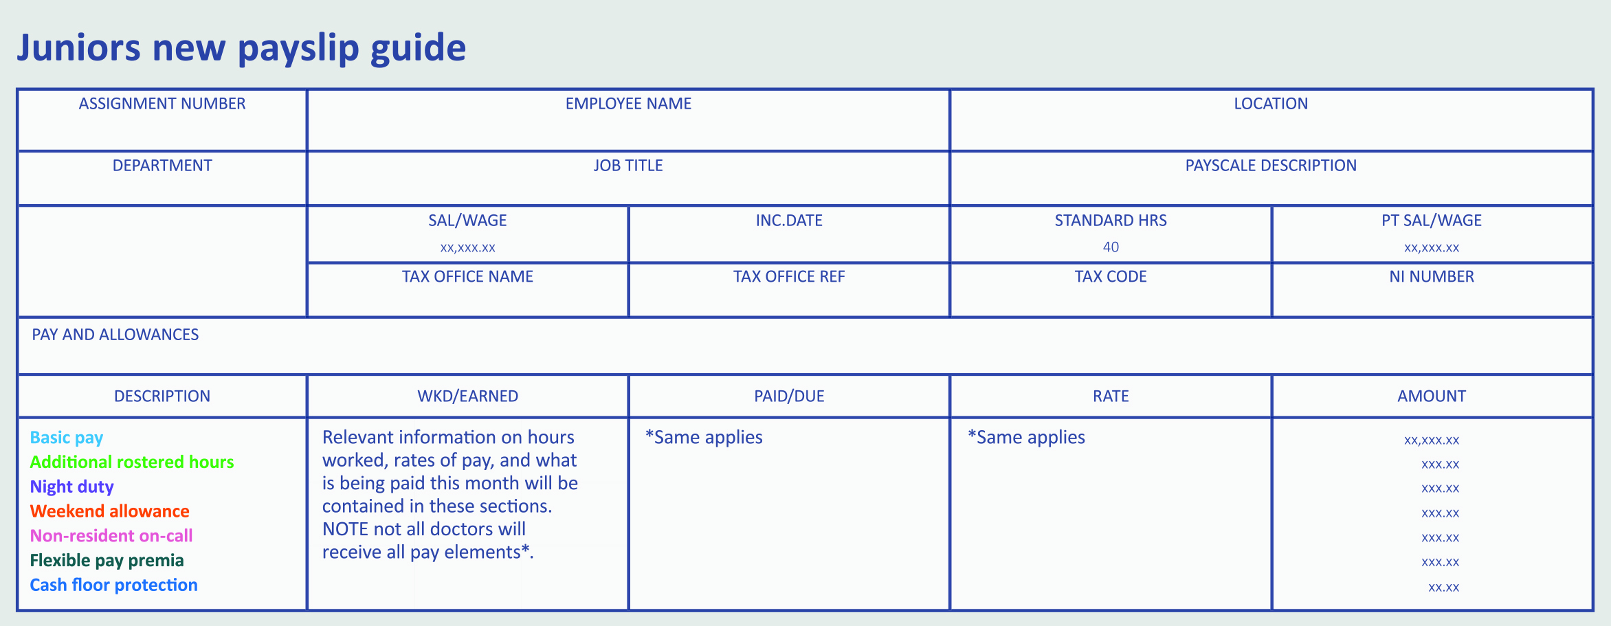
The importance of your payslip
Notes:
Your pay slip explained
Basic pay – your relevant nodal pay point for your grade, calculated on an average of 40 hours’ per week
Additional rostered hours – any additional contracted hours over 40 (up to maximum of 48 in total, or 56 for doctors who have opted out of the Working Time Regulations).
Night duty – Any hours receiving an enhanced rate of 37% of your hourly basic pay.
Weekend allowance – An allowance set as a percentage of your basic salary for working 1 in 8 or more frequent weekends.
Non-resident on-call – An allowance of 8% of your basic salary to compensate for your availability while non-resident on-call, regardless of frequency.
Flexible pay premia – Any flexible pay premia that apply, these are currently for emergency medicine, psychiatry, OMFS, academia and GP training, as well as current LTFT trainees and are paid annually.
Cash floor protection – - Not relevant here - Your protected cash floor amount, calculated as your basic salary the day before you transitioned onto the new TCS, plus a banding supplement for the rota you were working the day before transition (based on the banding value for that rota as on 31 October 2015).

Slide 14

Pay checker
Many resident doctors face pay errors that cost thousands of pounds.
Are you getting paid correctly?
Your payslip will be sent electronically to you each month but how do you know if your being paid correctly?
Each year we deal with many under and overpayment queries from Juniors.
Pay checker enables you to check your pay to see if you’re receiving what you’re entitled too. All you need is your rota, work schedule and a few additional details to check your pay today.
Download today

Slide 15
Rotas: shift limits
support | protect | represent
Main ones to know:
Max average 48 hours of work per week
Max 1 in 3 weekends, except exceptional circumstances
Max 7 consecutive shifts
Max 4 consecutive long day (12-13 hr) shifts
Min 46 hours rest after any number of nights

Slide 16
Rotas: hours and rest
support | protect | represent
BMA renegotiated better terms in 2018
No more than 48 hours of work per week on average
No more than 72 hours in any 168 hours
Protected teaching is not a rest break
5 hour shift =
at least one 30 minute break
9 hour shift =
at least two 30 minute breaks
12 hour shift =
at least three 30 minute breaks
(if a night shift)
Notes:
Your contract will include agreed working hours, and allowance for breaks. It is important that these are outlined and adhered to throughout your role.
These agreements will include:
– a maximum average of no more than 48 hours of work per week, and 72 hours within any 168 hour period.
– You should receive at least one 30-minute break for a shift lasting more than 5 hours and
– a second 30-minute break if the shift is more than 9 hours.
These breaks can be taken flexibly during the shift and should be evenly spaced.
Where breaks have been missed on at least 25% of occasions over a 4-week period, a fine may be levied to the trust. If this happens, you should be exception reporting. A work review will also be undertaken to ensure no further breaches occur.​

Slide 17
support | protect | represent
Annual/study and sick leave
– 27 days or, after 5 years, 32 days
– Bank/Public Holidays (8 days)
– life-changing events
– not be fixed to a working pattern
– sick pay
– 15 days study leave
– Zero days are not holiday
Notes:
Annual/study and sick leave
– annual leave year runs from the start date of the doctor’s appointment
– 27 days or, after 5 years, 32 days
– annual leave must be allowed for life-changing events (wedding day etc.)
– leave should not be fixed to a working pattern for any reason without agreement from the doctor
– sick pay – 1 month full pay, 2 months half pay during first year of service
– 15 days study leave
* Study leave includes: ​
Study – linked to a course or programme​
Research​
Teaching​
Taking exams​
Attending conferences for educational benefit​
Rostered training events​
For F1’s study leave will take the form of regular scheduled teaching/training sessions as agreed locally.​

Slide 18
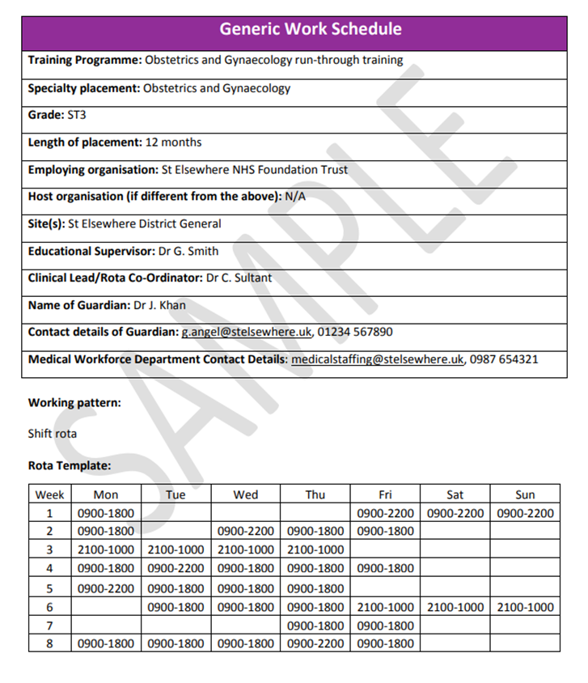
Work schedule
support | protect | represent
Work commitments and training outcomes
Working hours, training opportunities
Rolling rota (remember checker!)
Pay, with breakdown of components (check against payslip)
Key contact details for queries / concerns
(Clinical lead, rota co-ord, medical workforce Dept)
Notes:
Here is an example of a work schedule and what you should expect to find on it.
A work schedule is a document setting out the work commitments and training outcomes in your job.
You will receive a generic work schedule before starting in your post
A personalised version will be agreed in your first meeting with your educational supervisor
It is a single source for all the information you need, including:
- your work commitments and training outcomes
- details of your supervisors, your pay, your working hours and what training you will be doing
- a copy of the rolling rota you will be working to. It will usually apply for the duration of a training placement
the name and contact details of your guardian of safe working
It should also provide details of other useful contacts, such as your clinical lead, rota coordinator and medical workforce department​
Your template rota should be received eight weeks before your post starts, and the duty roster six weeks before.
This means you are able to request leave when you receive a copy of your rota template, so that this can be built into the final roster.

Slide 19
Work schedule
support | protect | represent
Check:
Does rota in schedule match your payslip?
Does rota in schedule match real rota you are working?
Does schedule include your educationally useful activities?
Use work schedule reviews to fix the schedule if necessary
Notes:
If schedule doesn’t match payslip then you may be paid wrong so make sure you double check that the rota reflects what you are working in reality.
If you have concerns about your work schedule, a risk to patient safety or your own safety as a result of working hours breached, a review can be requested by you, your supervisor, manager or the guardian.
Ideally problems will be resolved by making adjustments to the work schedule​
In some cases retrospective pay or compensatory time off in lieu may be awarded
You must meet with your supervisors within 4 weeks of your start date, and can be released from clinical duties for this.

Slide 20
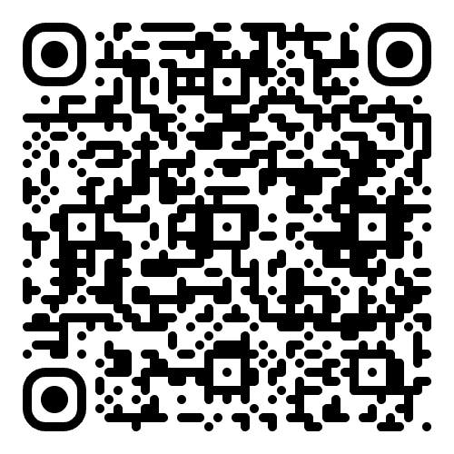
BMA support – Rota checking app
support | protect | represent
When you receive your personalised rota (6 weeks before you start a new rotation) run it past our rota checker app.
It’s simple to use and effective in spotting non-compliant rotas. Always check that your rota matches your work schedule.
Use our rota checking app:
https://rotachecker.bma.org.uk
Notes:
It’s best to catch rota concerns early so you can negotiate required changes with your employer.
Compliance with contractual rules is only one part of a well-designed rota. We've developed comprehensive guidance on the principals of good rota design to improve your wellbeing and safety in the workplace.
Our rota checker tool takes only a few minutes to check whether your rota complies with the England JD 2016 contract. You'll receive your results immediately and, if required, you can be referred to a dedicated employment adviser to help you with the next steps.

Slide 21
support | protect | represent
Exception reporting
Working over your scheduled hours
Missing training opportunities
Missing breaks
Not receiving Self development time
= Exception report it!
Where a work schedule does not reflect the reality of what you are doing, in terms of service or training. ​
New streamlined process: Removing clinical and educational supervisors from the sign-off process for additional hours worked
Educational exception reports → Directors of Medical Education (DMEs)
All other reports → HR / Medical Workforce HR
Guardians of Safe Working keep overall oversight.
Doctor choice preserved:
Doctors may choose TOIL or pay for extra hours worked (except where safety breaches mandate TOIL).
Submit your exception report as soon as possible after the exception takes place.
Notes:
Exception reporting
- Doctors will raise exception reports where their work schedule does not reflect the reality of what they are doing, in terms of service or training. ​Ideally, keep a diary of your hours/working and a copy of your work schedule, note the time, date & reason for report in a diary entry so you can keep track.
- If exception report not addressed or not resolved call FPC on 0300 123 1233 and open a case with BMA
Copy to guardian of safe working hours (if hours breach) or the Director of Medical Education (if a training breach). The doctor should send the exception report as soon as possible after the exception takes place, within a maximum of 14 days (or 7 days when making a claim for pay). Ideally the problem is resolved quickly within the trust probably with an adjustment to the work schedule but exception reporting also allows for the payment of unplanned hours worked
What to do when I have immediate safety concerns?
discuss with clinician responsible
confirm the breach electronically
clinician must take immediate action
notify clinical supervisor and guardian within 24 hours
clinical supervisor to take further action if needed
The purpose is to ensure a work schedule remains fit for purpose, where informal discussions may have failed to resolve concerns. ​
Exception reports give employers real time information to identify patterns and pick up any issues quickly. ​
These should be addressed ASAP by the educational/clinical supervisor and may lead to work schedule review ​

Slide 22
Exception Reporting Changes – February 2026
Dr’s clinical judgement around working additional hours will not be challenged
Employer accountability increased:
  Fines for blocking access to reporting systems
  Penalties for inappropriate data‑sharing.
Contract updates:
  2016 TCS will be amended to embed all reforms.
Trust requirements:
  Update systems and processes, train HR/DMEs, ensure accessibility, and create a more supportive culture for reporting.
Notes:
JP
<Launch poll for Q1>
Employment Law in the UK gives all employees some basic rights
Your employment contracts and Trust policies detail your rights in your particular employment, which may be more than basic rights – e.g. statutory v NHS maternity pay; statutory annual leave v NHS annual leave
The BMA can help you with how to deal with some of the challenges you might face at work, and knowing what your rights are in difficult situations
If you’re not sure who can help get in touch – we can always point you to the right place if we can’t help you directly.
ANSWERS:
No – although they may do this. Your employer should tell you first, and agree with you how it can be repaid – always contact BMA for advice as often calculations can be incorrect.
No – contract will end at end date unless renewed before – if you don’t hear and think they wish to keep you on call Medical HR before the contract ends. Contracts can be ended with notice at any time – but usually this requires a process and reason – get in touch with the BMA if this happens to you
No – they should discuss concerns with you and support you to make any improvements – if they dismiss or threaten this contact the BMA straightaway
Contact the BMA for help and advice straightaway– you should be told about the problem / allegation and be able to have a rep with you
Consultants / SAS doctors – log extra time worked and request job plan review; JD 2016 contract – exception report – pay / TOIL; LEDs – depends on contract – always keep a record of extra work done. Contact the BMA for advice if you find this happening
YES – employers should have process to follow to raise these concerns – get BMA advice first
Contact BMA for advice – we can point you to the right way to raise concerns – either through Trust policies, Guardians of safe working, your supervisers and HEE or Freedom to speak up Guardians – don’t suffer in silence
<Then pause for any questions about pay and contracts section>

Slide 23
The BMA has increased your pay….
F1 Basic Pay has gone from £29,384 to £38,831 since the BMA began fighting for resident doctor pay increases in 2022. The BMA and its members have made this happen.
A 32% Increase in F1 Pay!
and a £32k increase in basic pay across the first 3 years of your career (F1, F2 and ST1/CT1)
With only a 3.5% proposed increase by the government for 26/27 April award, something we are fighting!
Grade | 2022-23 Basic Pay Scale | Uplift on 2022-23 pay Scale % £ |  | 2025-26 Basic Pay Scale
Fy1 | £29,384 | 32.15% | £9447 | £38,831
Fy2 | £34,012 | 30.65% | £10,427 | £44,439
ST1/2 CT1/2 | £40,257 | 30.80% | £12,399 | £52,656
ST3/4 CT3-5 | £51,017 | 27.50% | £14,031 | £65,048
ST6-8 | £58,398 | 26.70% | £15,594 | £73,992
26/27 (proposed)
+2.5%
+2.5%
+2.5%
+2.5%
+2.5%

Slide 24
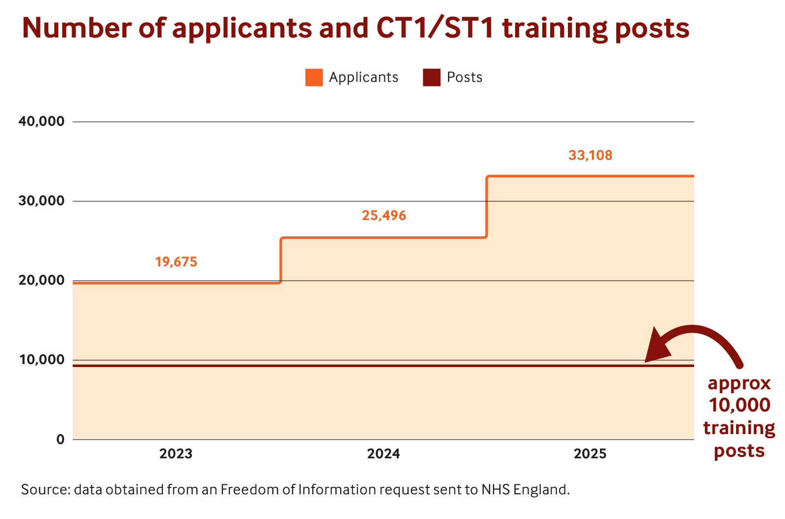
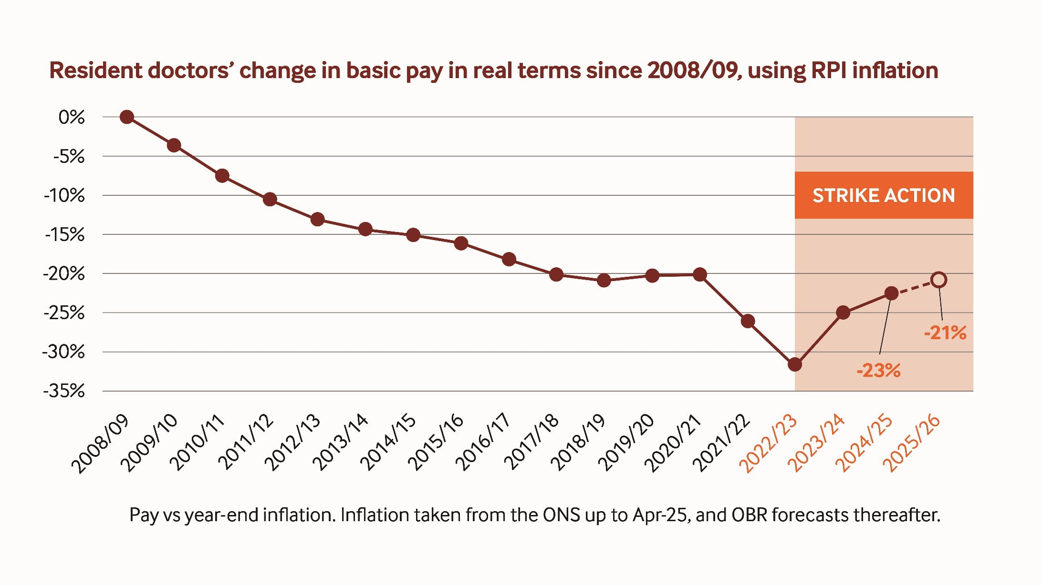
The fight goes on and we need you…
UK Graduate Prioritisation 2026
UK medical graduates are to be given priority access to specialty training jobs in the NHS, as part of emergency legislation unveiled early this year by the Government.
Something the BMA has been advocating for and has brought to the attention of the government. This win wouldn’t have happened had it not been from BMA pressure.
The legislation will seek to ensure that UK medical graduates be prioritised for access to core and higher training places from 2026.
Your pay is still down 21%, and now, doctors are facing job insecurity.
In 2025, there were more than 30,000 doctors applying in round one of specialty training recruitment competing for one of around 10,000 places.
Notes:
NOT ENOUGH JOBS. NOT ENOUGH PAY.
Pay:
We are asking for FY1 pay to be restored from £18.62/hour to £22.67/hour.
Specialty training places:
A third of all resident doctors and 52% of FY2s we surveyed said they had no job from August.
This year, there were more than 30,000 doctors applying in round one of specialty training recruitment competing for one of around 10,000 places.
However, the Government has only committed to create an additional 1,000 training places over the next three years.
The specialty training crisis is unacceptable.
Enough is enough.

Slide 25
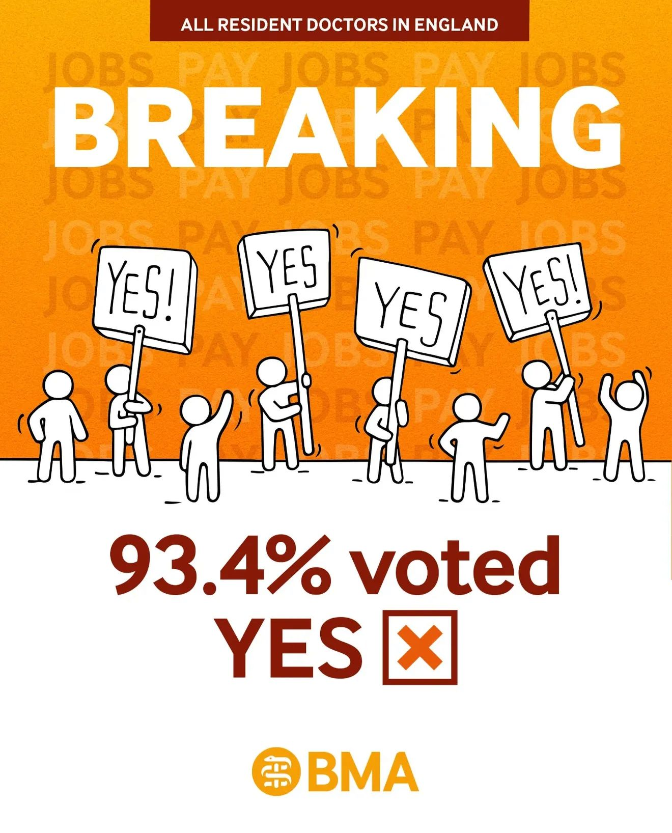
Strike Mandate 2026
Six-month strike mandate for every resident doctor, across every grade until August 2026.
Talks with the Government have failed and new strike dates were held in April. Look out for future dates.
Here are our priorities:
Oppose the Government’s proposed real terms pay cut for this year, and making progress towards restoring the pay and value of being a resident doctor
Increasing the number of specialty training places at all levels, to address the jobs crisis
Demanding the Government creates a more stable jobs market using long-term contracts for all locally employed doctors, to provide stability, particularly whilst the bottleneck is addressed.
This impacts you, your pay and your career so join today as this is your fight too!
Notes:
52.54% Turnout
Very strong YES vote
Fresh 6 month mandate for every resident doctor
When we meet with govt we continue to have important leverage to keep pushing to fix jobs crisis and restoring pay.
In recent talks the govt have finally shown a willingness to discuss pay

Slide 26
Membership benefits for members
Tools to help you prepare for your F1 post

Slide 27
BMJ Learning
Accelerate your learning with CPD-accredited online modules based on the latest clinical evidence, as well as non-clinical topics to help progress your career. There are hundreds to choose from.
Popular topics for incoming FY1s
Clinical
ECG skills: diagnostic testing
Hyponatraemia: basic principles, types and causes
Understanding the normal ECG trace
Basic anatomy and physiology of the heart
Arterial blood gases – a guide to interpretation
Non-clinical
Preparing for your first FY1 post
Dealing with pressure in your foundation years
Career planning
Workload and time management
How to achieve a healthy work-life balance

Slide 28

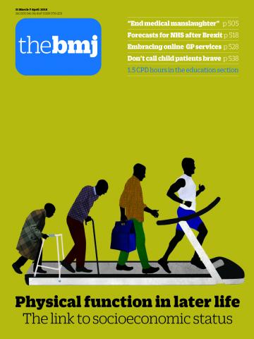

The British Medical Journal
FREE upgrade to a print subscription of The BMJ today.
Also available online or by app. Delivered fortnightly.
Contact us – bma.org.uk/contactus

Slide 29

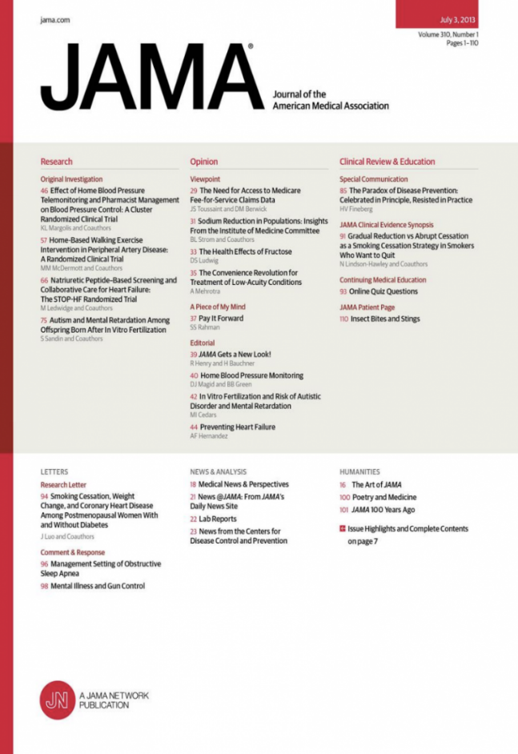
BMA library and archive
Access thousands of e-journals and e-books e.g.
The Lancet, Nature, and JAMA.
ClinicalKey
A point of care tool with the most up to date information that helps you make informed decisions on the go.
Features:
Clinical overviews and procedure videos
Drug monographs and clinical calculators
Patient education to print or email

Slide 30

Your wellbeing
Our confidential counselling and peer support services are open 24/7 and free of charge to all doctors and medical students.
There is always someone you can talk to.
0330 123 1245
bma.org.uk/yourwellbeing
Notes:
These are exceptional times for the health service, and as new doctors you may find yourselves experiencing additional pressures, stress or anxiety as you enter the workforce.
If at any time you need support, or you would like to speak to someone in confidence, please know that we are here for you. Our BMA wellbeing support services are open 24/7 to all doctors and medical students.​ You will have the choice of speaking to a counsellor, or another doctor who you can contact for peer support. ​Visit bma.org.uk or call 0330 123 1245
​The services are confidential and free of charge.

Slide 31
Your Starting Work Checklist:
Join the BMA today
Contact the BMA with any questions about your contract / work schedule
Make sure you’re working the correct hours with the BMA’s Rota Checking Tool
Familiarise yourself with the Exception Reporting platform at your place of work
Use the BMA Pay checker to check your first or subsequent payslips
Update us of your change of address/email/workplace
Contact our advice team if you have any questions – support@bma.org.uk

Slide 32
Complete a form today (date the form 1st June) and receive
3 MONTHS FREE MEMBERSHIP
+ paper Dr BMJ – Not available online
Any questions – please contact me: JHAYWARD@BMA.ORG.UK
Notes:
Join/ re-join the BMA today using this link and get a £10 amazon voucher: https://join.bma.org.uk/intro?campaigncode=4050
Once joined, drop me an email JHayward@bma.org.uk with your BMA ID number and I’ll arrange your voucher to be sent by email.
If you’re unsure whether you’re in membership, email me with your full name and DOB.

